Slide 1
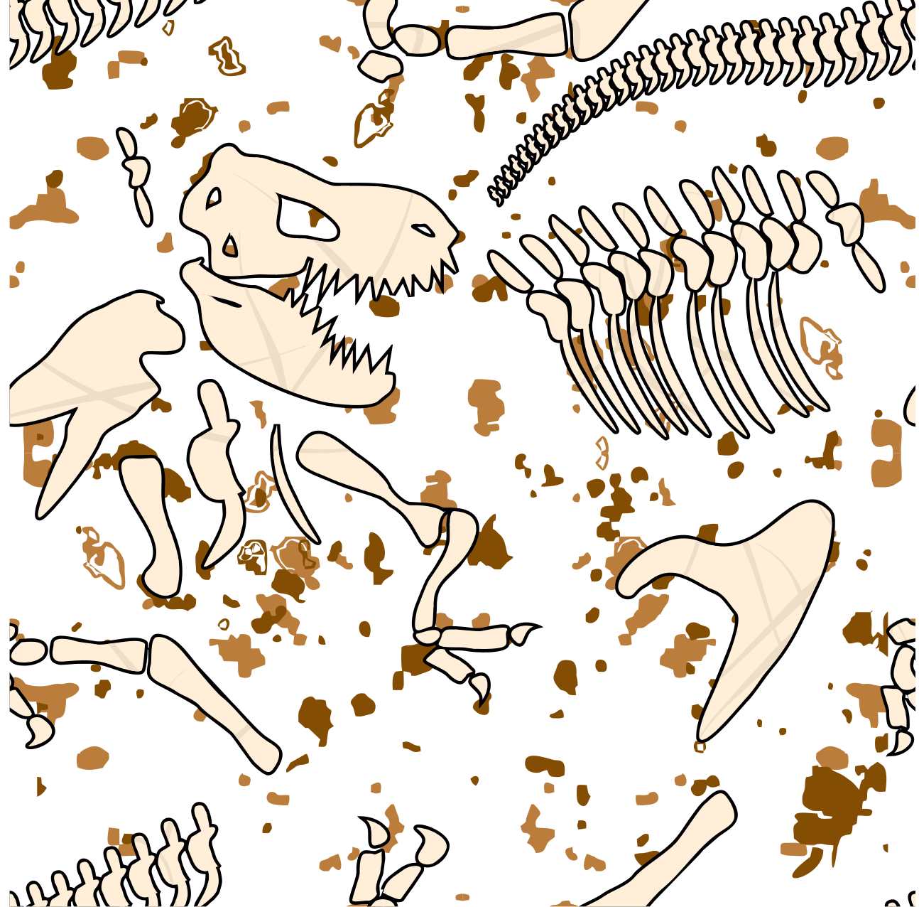
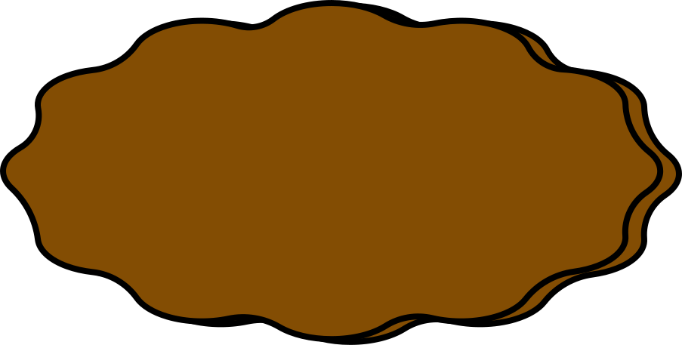
Can Ya Dig It?
An adventure in measurement

Slide 2



Can Ya Dig IT? - A Stuffed Animal Quest
https://www.canva.com/design/DAGDYfrKsVk/kxu4MBJvvmb_kDVBeVQdsg/edit?utm_content=DAGDYfrKsVk&utm_campaign=designshare&utm_medium=link2&utm_source=sharebutton

Slide 3

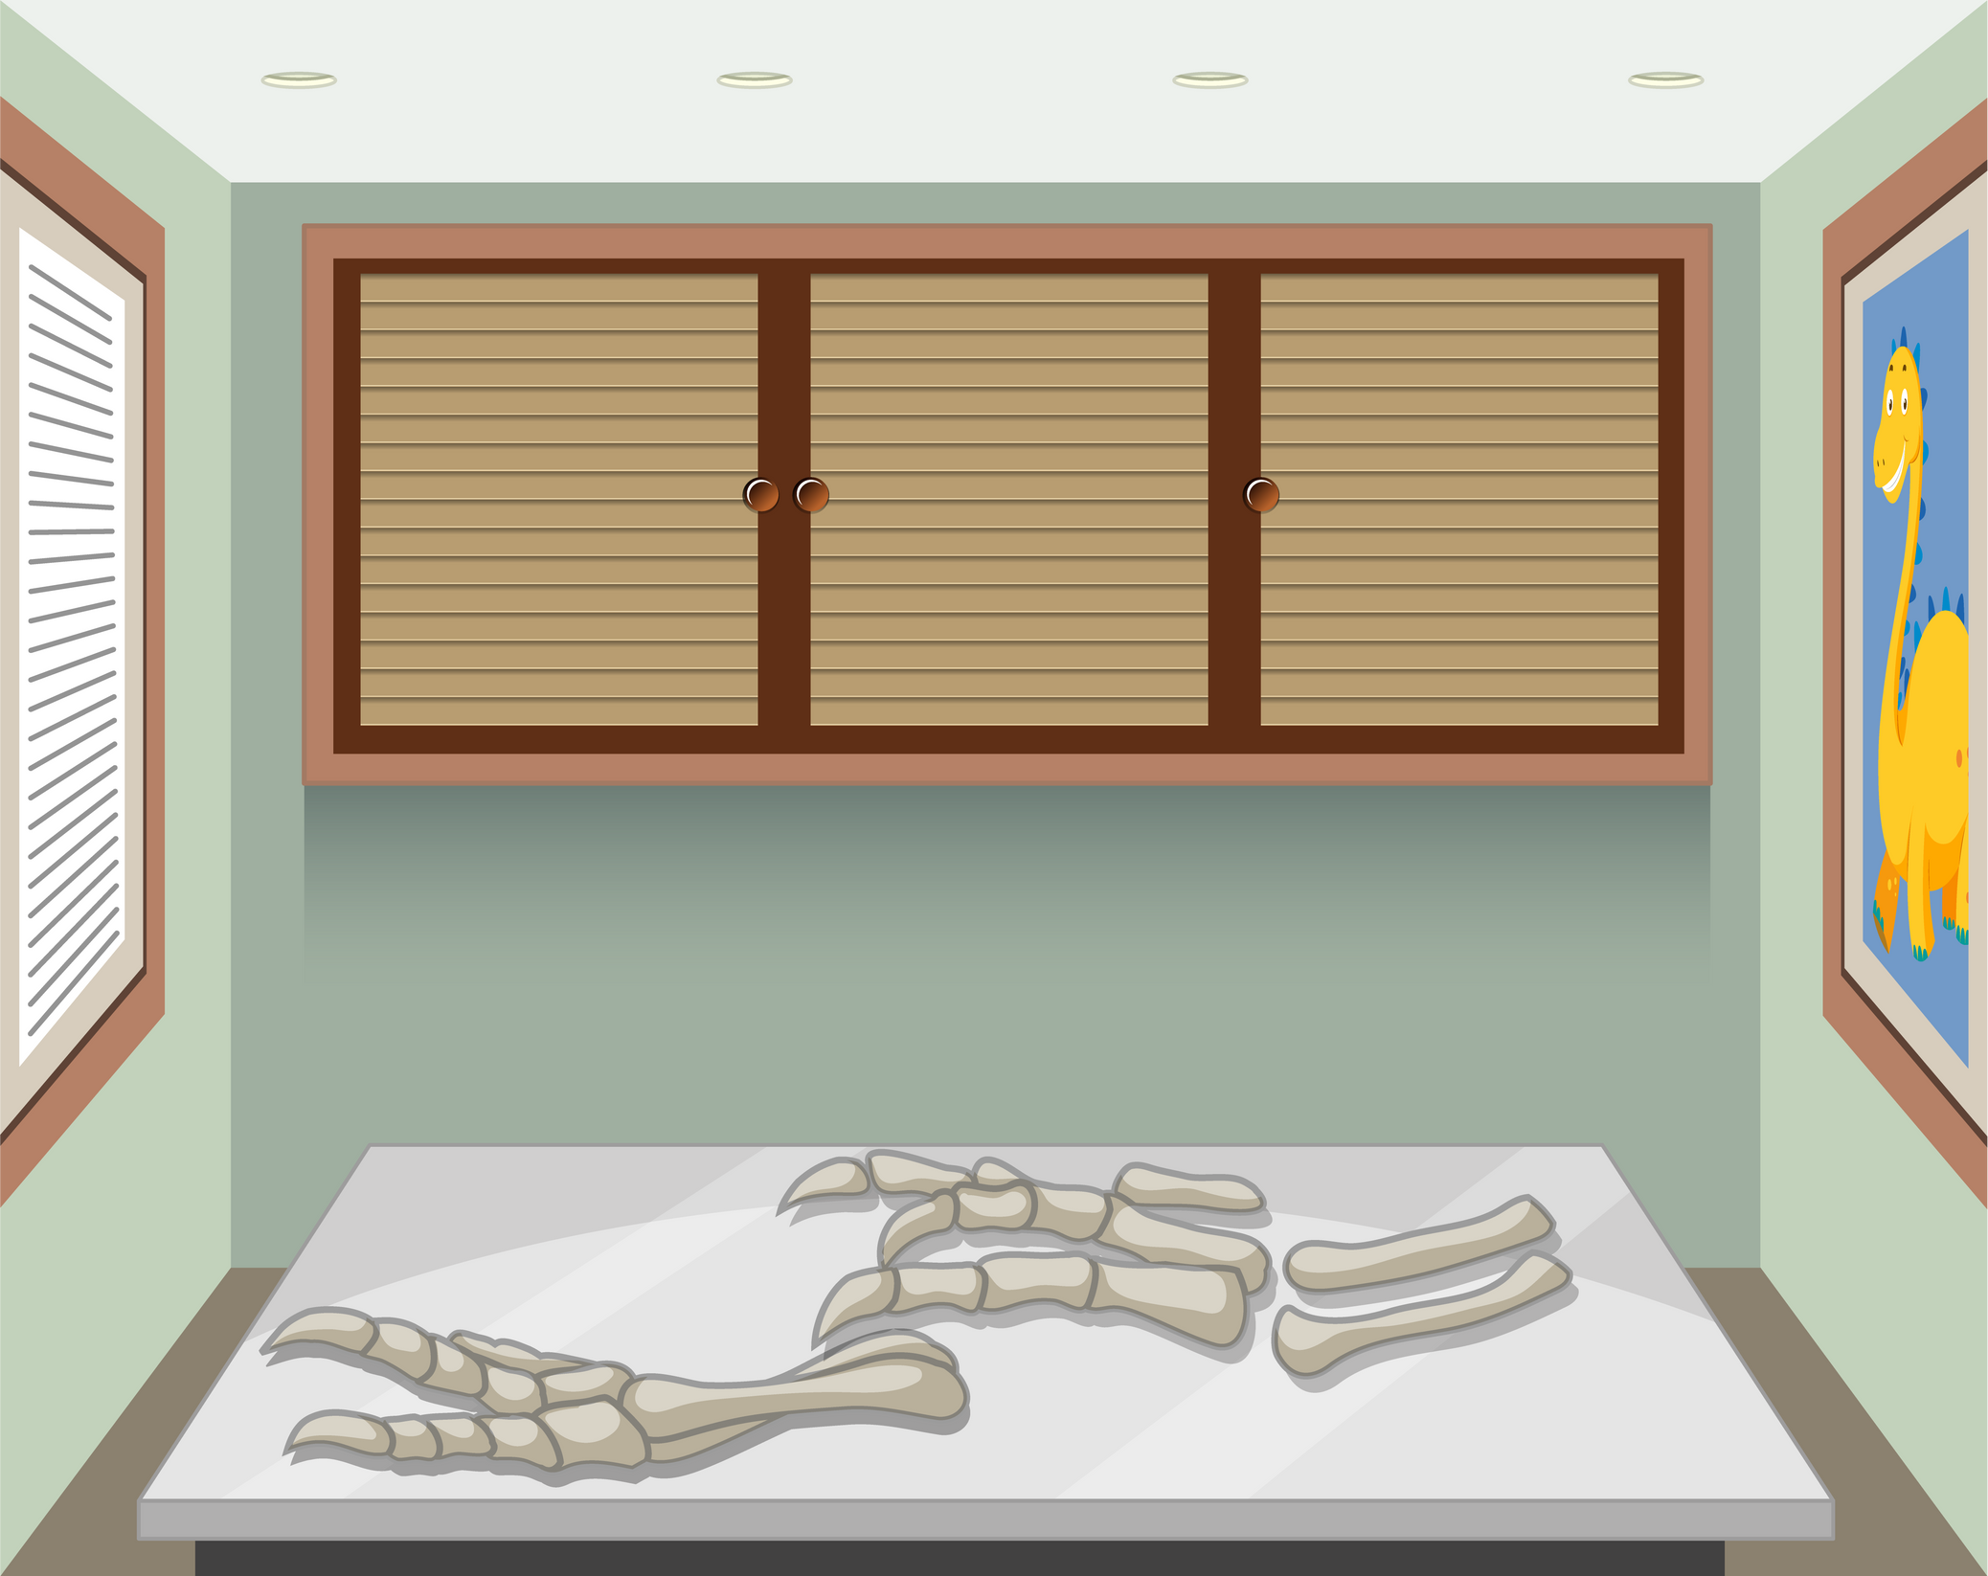

Today We get to be Paleontologists
and find our own fossils!
Just like at Hands On! Discovery Center.

Slide 4
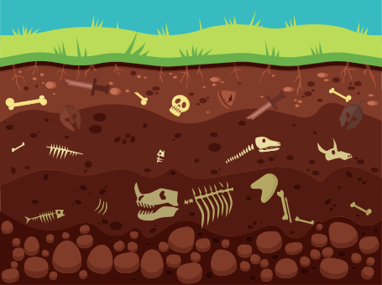

Objective:
Essential Questions
Why is it important that we organize our measurement data from smallest to largest on our line plot?
How could using different units of measurement impact our interpretation of data on the line plot?
How might scientists use line plots and measurements to study and compare fossil specimens in the real-world?
How can we apply our understanding of fractions to solve problems related to the data presented on the line plot?
By the end of this activity, you will be able to measure fossils to the nearest quarter inch, create a line plot to display the measurements and use subtraction and a number line to find the difference between the largest and smallest fossils.

Slide 5
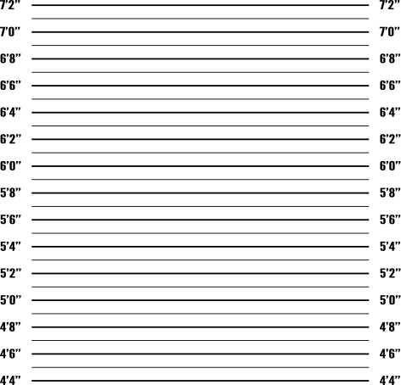
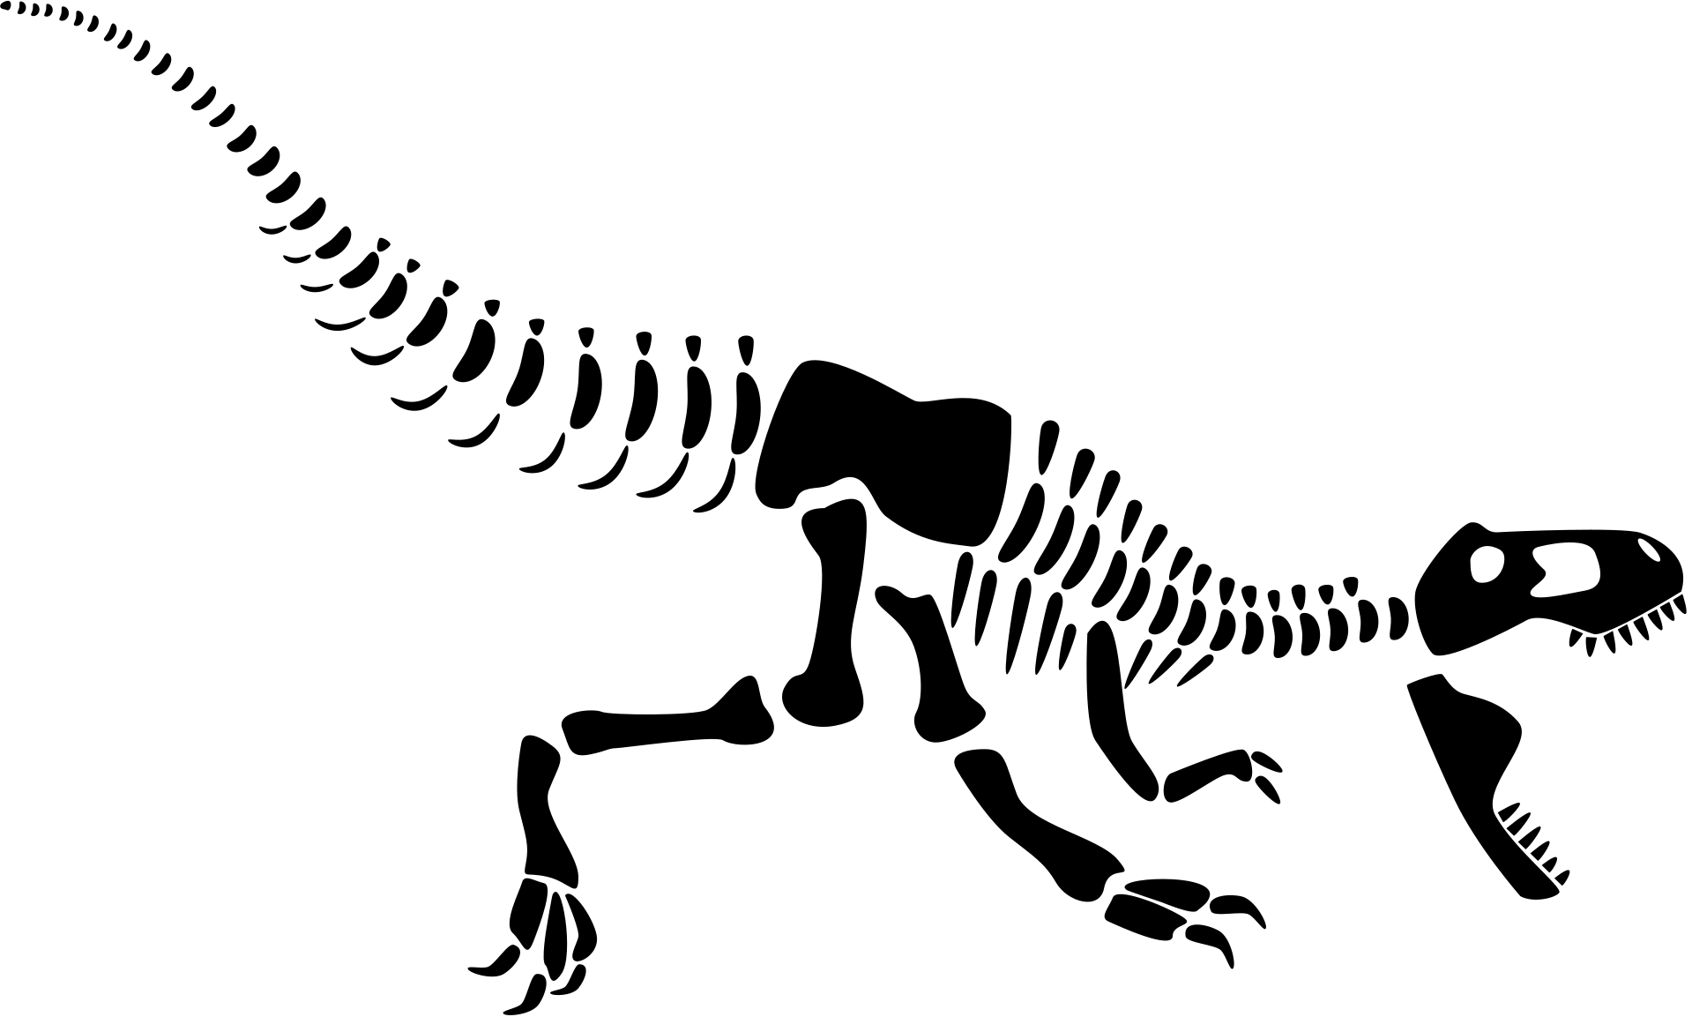
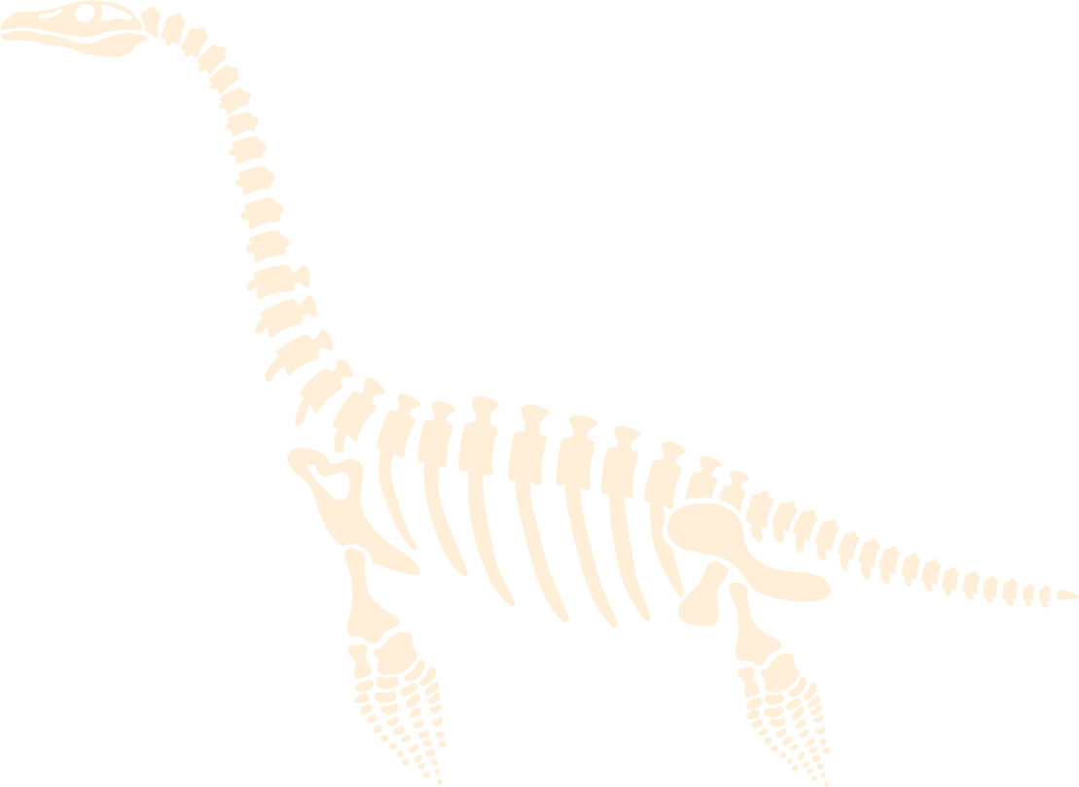
Has there ever been a time when
you needed to measure something?
Can anyone share a story with us?

Slide 6
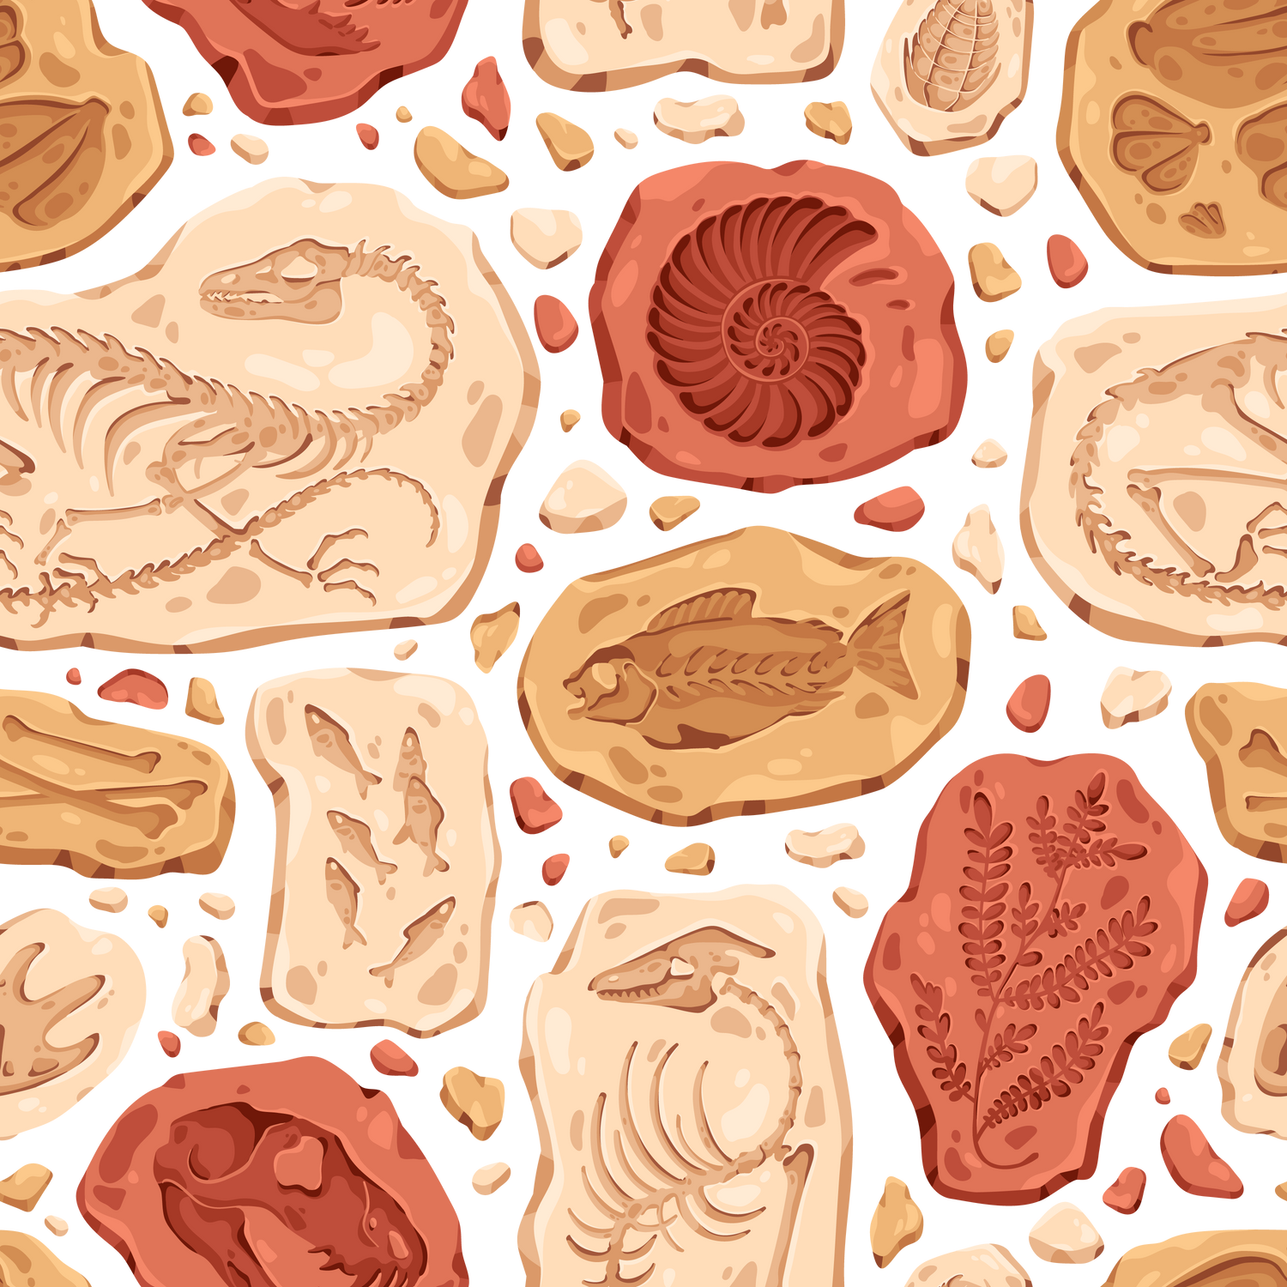
Vocabulary
Term | Definition | Example
Fossil | A trace or remnant of an organism from a past geologic age | Shells, footprints, bones, and imprints
Measurement | The process of determining or quantifying the size, length, or amount of something using standard units of measurement. | Inches, centimeters, millimeters, tbsps, meters, etc.
Quarter Inch | A unit of measurement equal to one-fourth of an inch. Often represented as 1/4" or 0.25 inches. | Four quarter inches equal 1 inch, just like four quarters equal 1 dollar

Slide 7
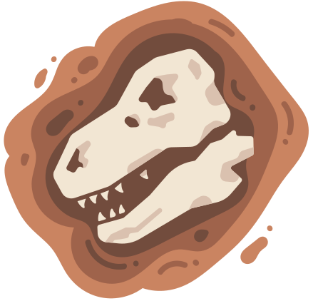
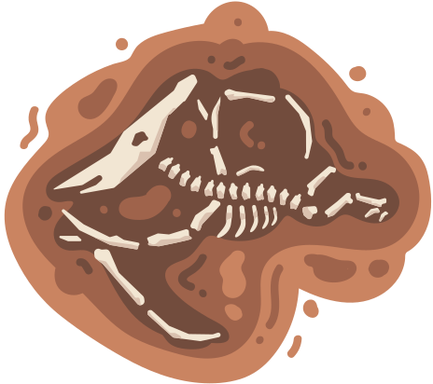







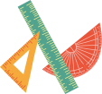








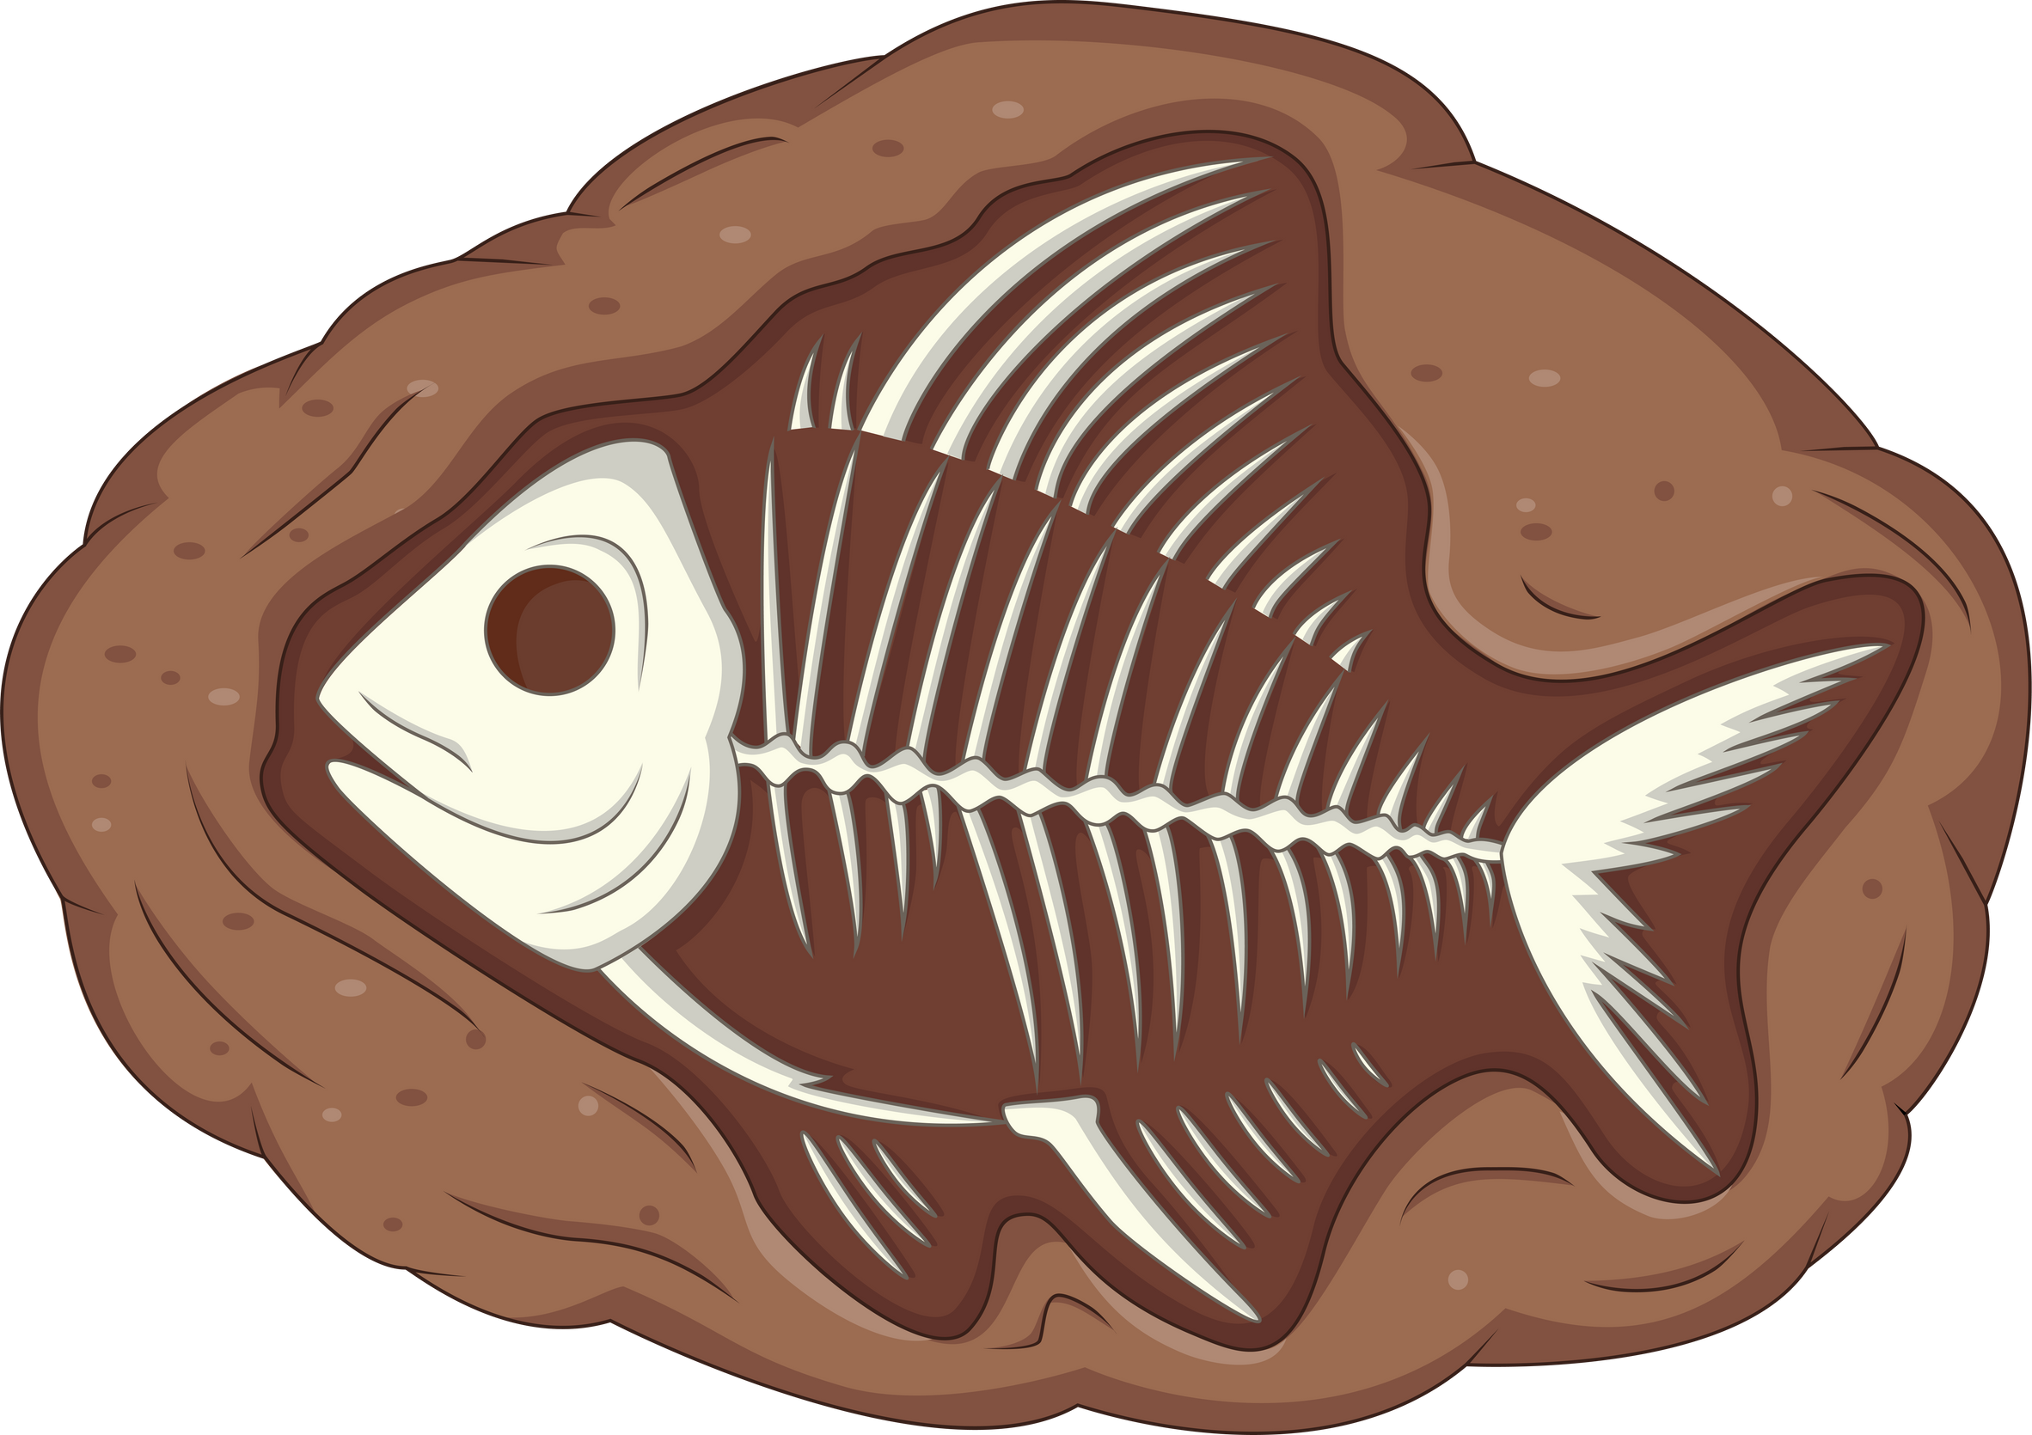
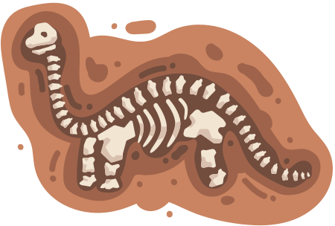
WhY Measurements
Are Important
Distance to a Quest
Height of a
Pokemon
How many stickers can
fit on our cups?
Construction of
Buildings & Structures
Cooking & Food
Production
Navigation

Slide 8

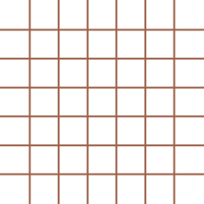


Line Plot
A line plot is like a picture of numbers on a line. Each number represents something we measured or counted, and we put an x or a dot on the line to show where that number is. It helps us see how many times each number appears and how they're spread out.
1/4 2/4 3/4 1 1/4 2/4 3/4 2 1/4

Slide 9
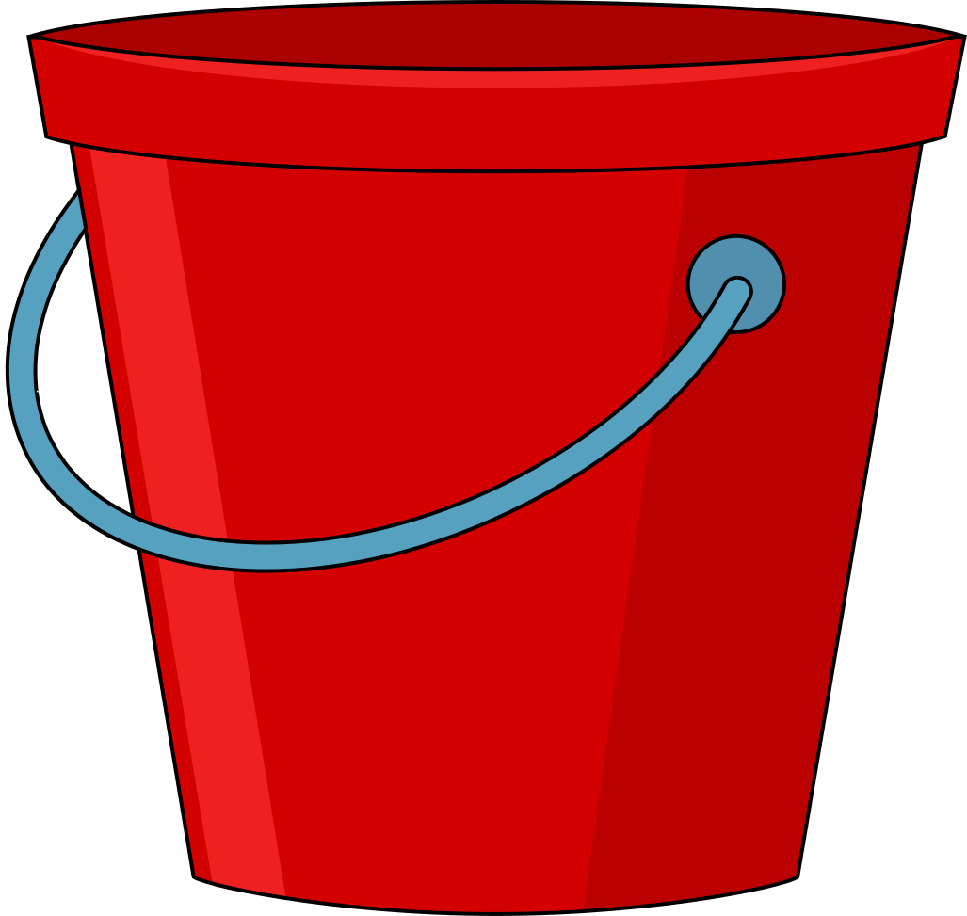

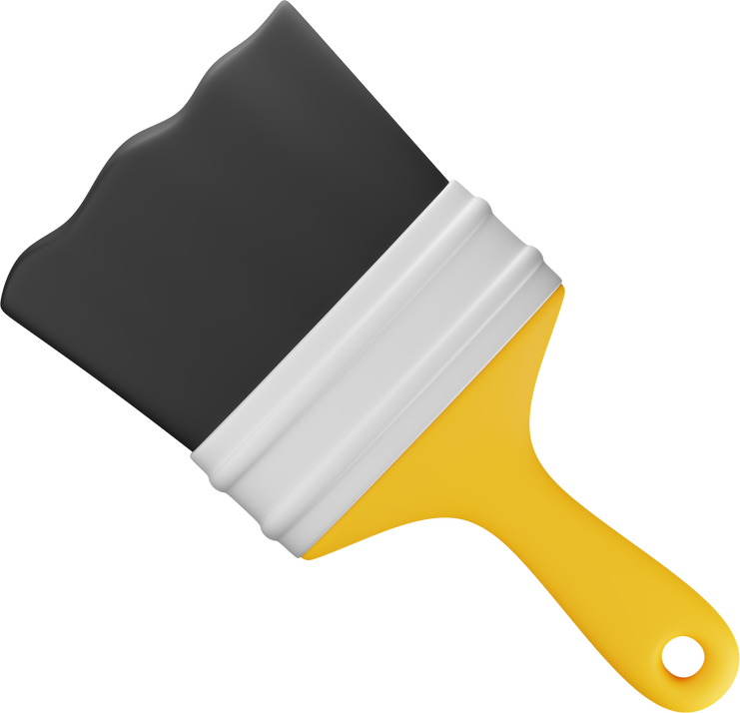
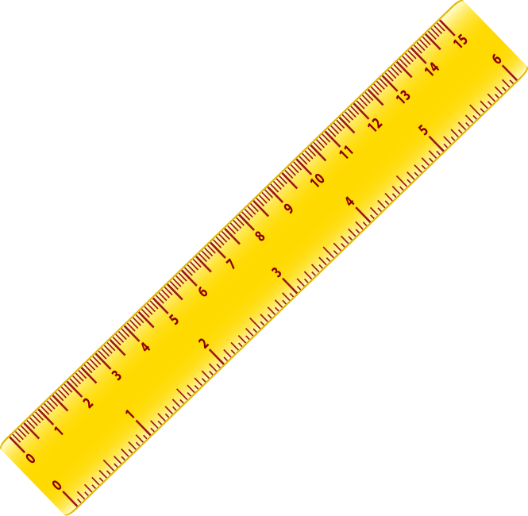
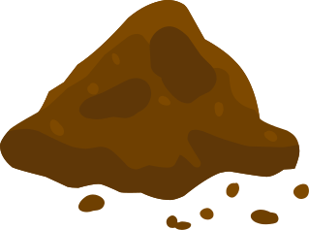
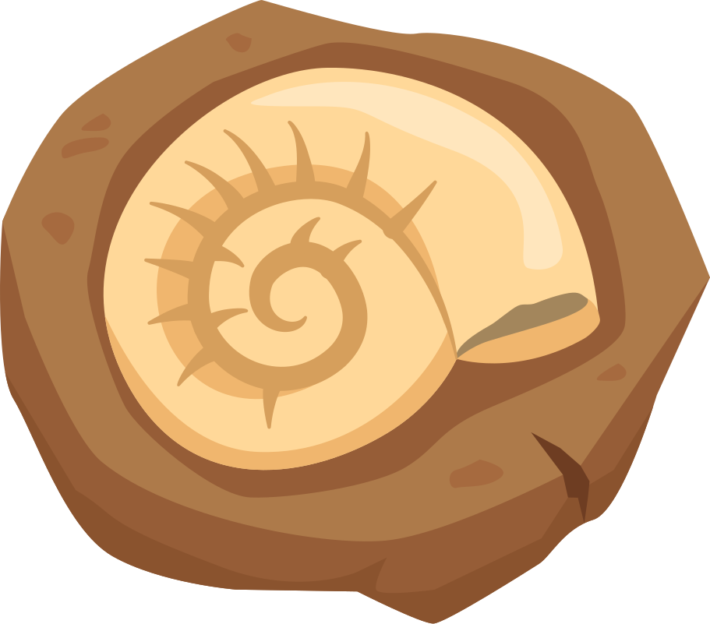
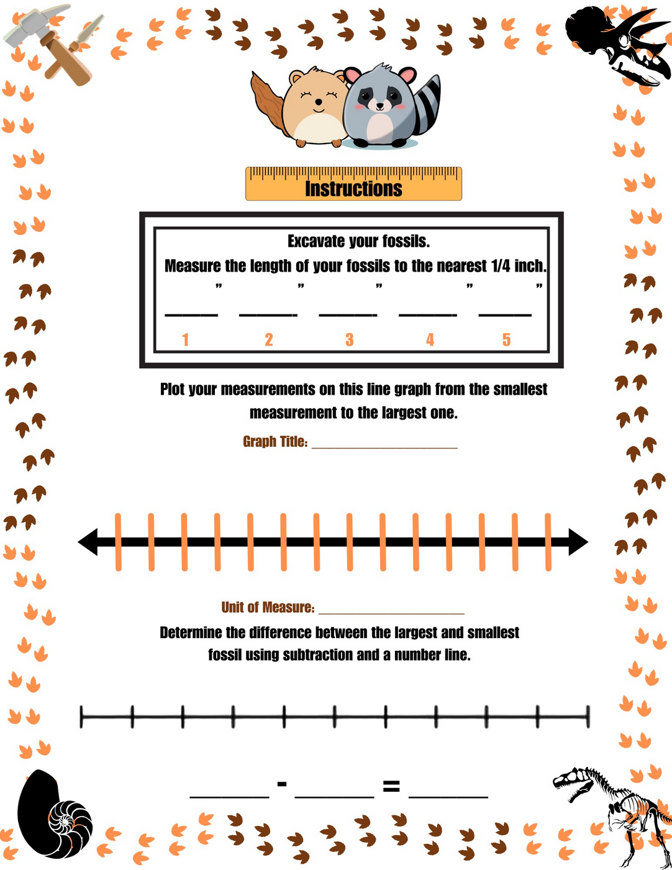
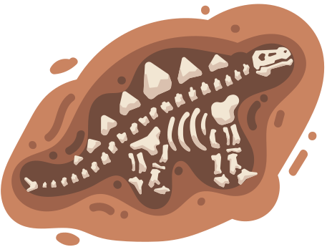

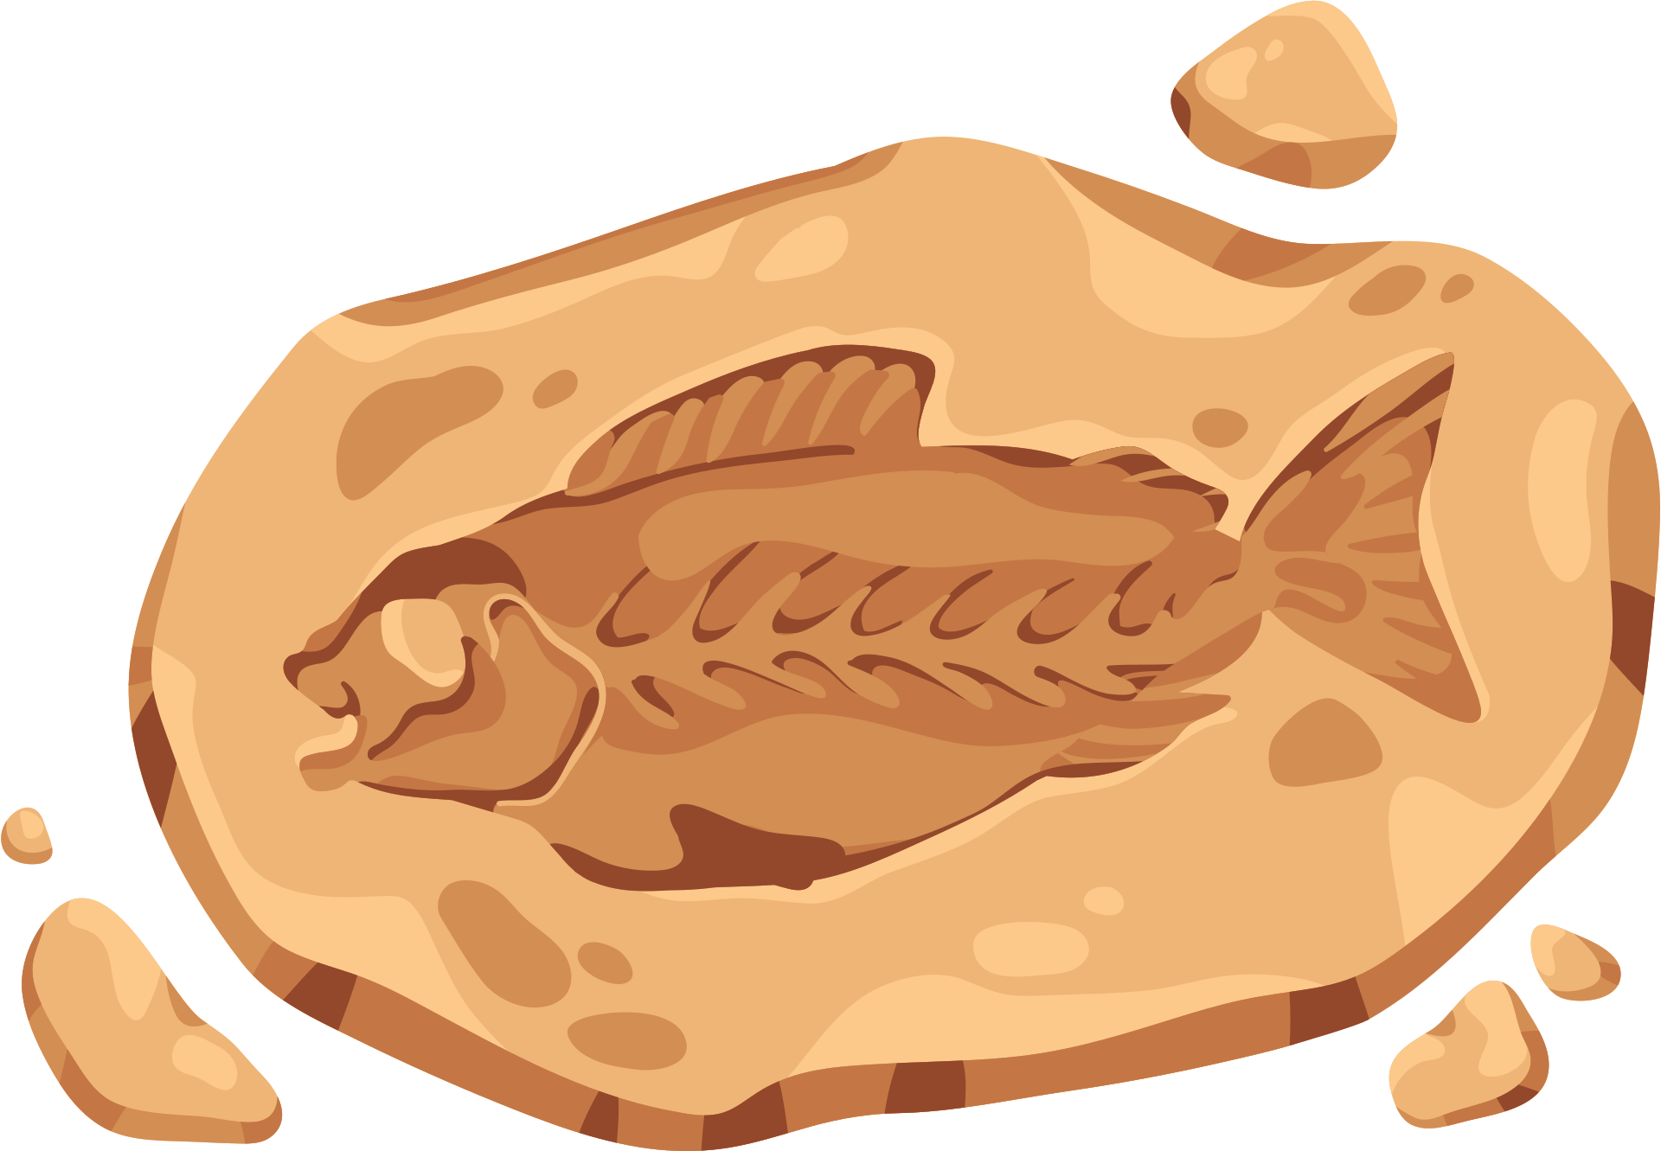
Materials
  Buckets
  Dirt/sand
  Fossils
  Excavation tools
  Rulers
  Lab sheets
  Pencil & erasers

Slide 10
Instructions
  Get materials for each group.
  Use the excavation tools to excavate your fossil (one fossil per group member).
  Measure your fossil and write the measurement on your lab sheet (to the nearest quarter inch).
  Write the measurements of your groupmates' fossils on your lab sheet.
  Plot your measurements on the line graph from the smallest to the largest measurement. (make sure to title your graph and label the axis with the unit of measurement.)
  Present your graph to your groupmates. Explain how and why you labeled your graph and distributed your data the way you did.
  Determine the difference between the largest and smallest fossils using subtraction and a number line. Record the results on your lab sheet.

Slide 12

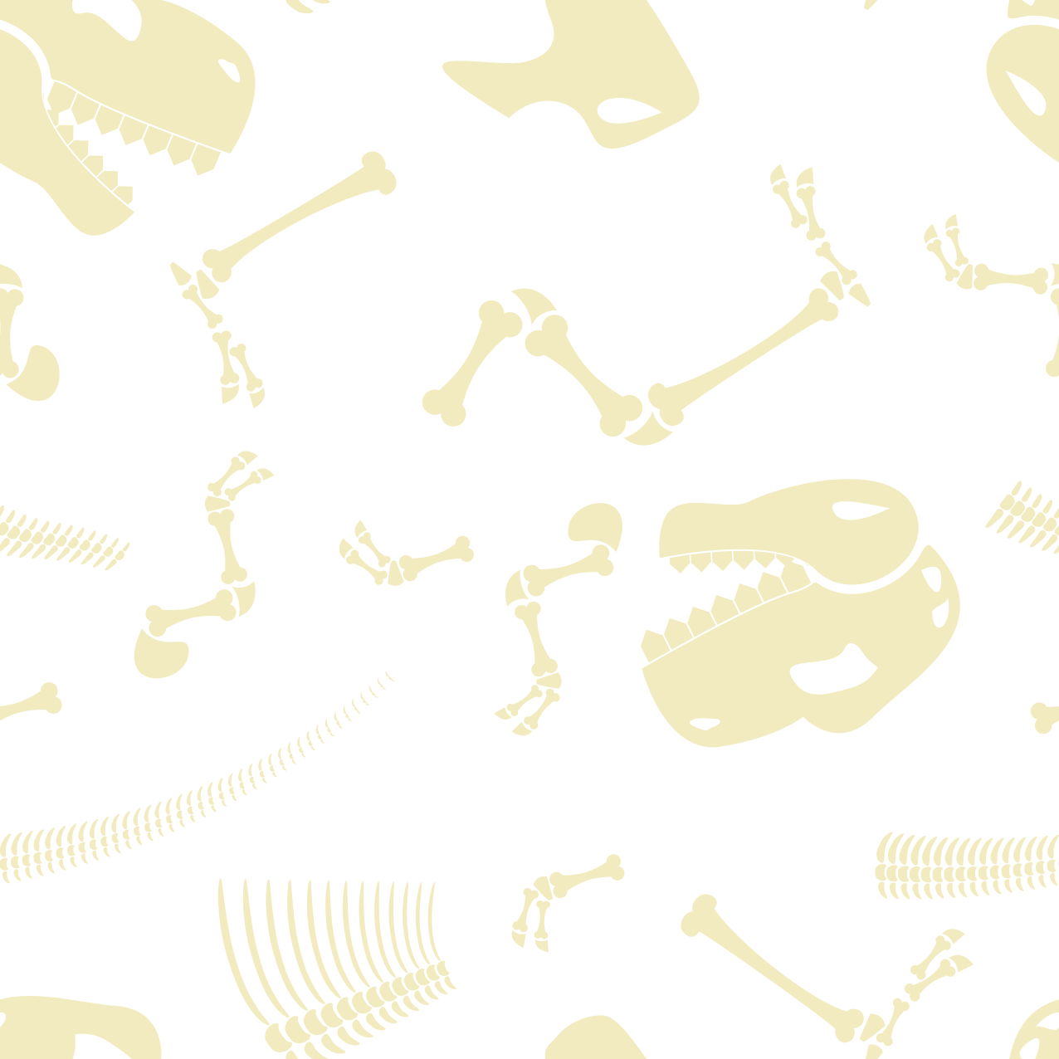

Essential Questions
Why is it important that we organize our measurement data from smallest to largest on our line plot?
How could using different units of measurement impact our interpretation of data on the line plot?
How might scientists use line plots and measurements to study and compare fossil specimens in the real-world?
How can we apply our understanding of fractions to solve problems related to the data presented on the line plot?

Slide 13
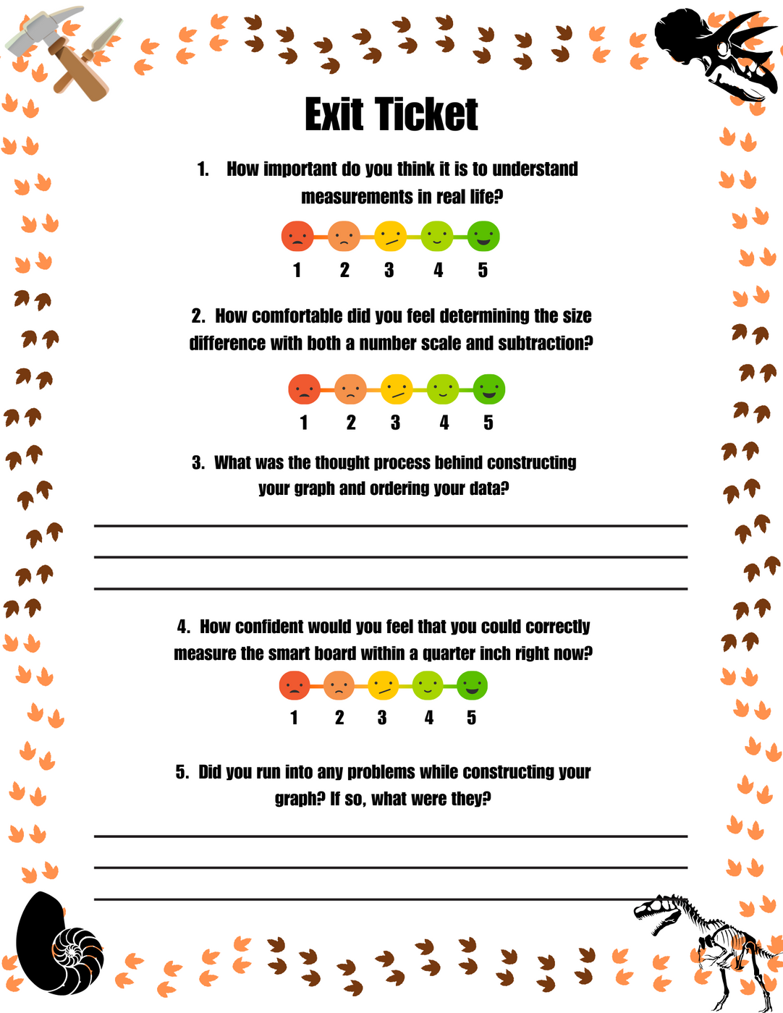


Exit Ticket

