Slide 1
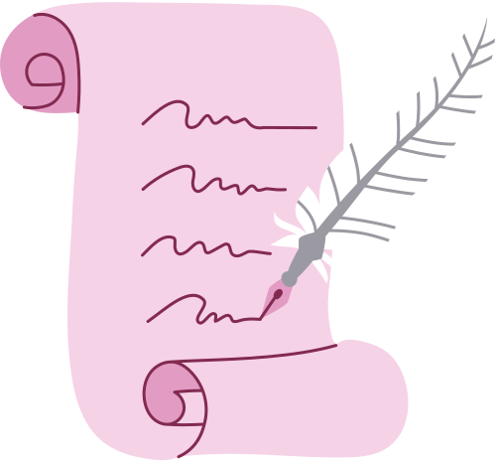
Case Study
Presentation
Kristen Townsend

Slide 2

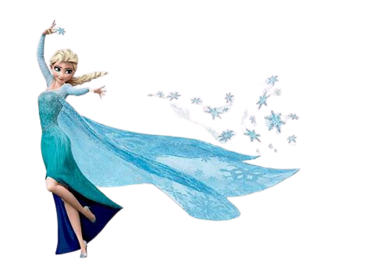
Anna Heeler
Anna is a six-year-old first grader at South Side Elementary and is one of the sweetest children you will ever meet. Our sessions working together were the highlight of my week. She loves Bluey, dogs, Pokemon, and Frozen.

Slide 3
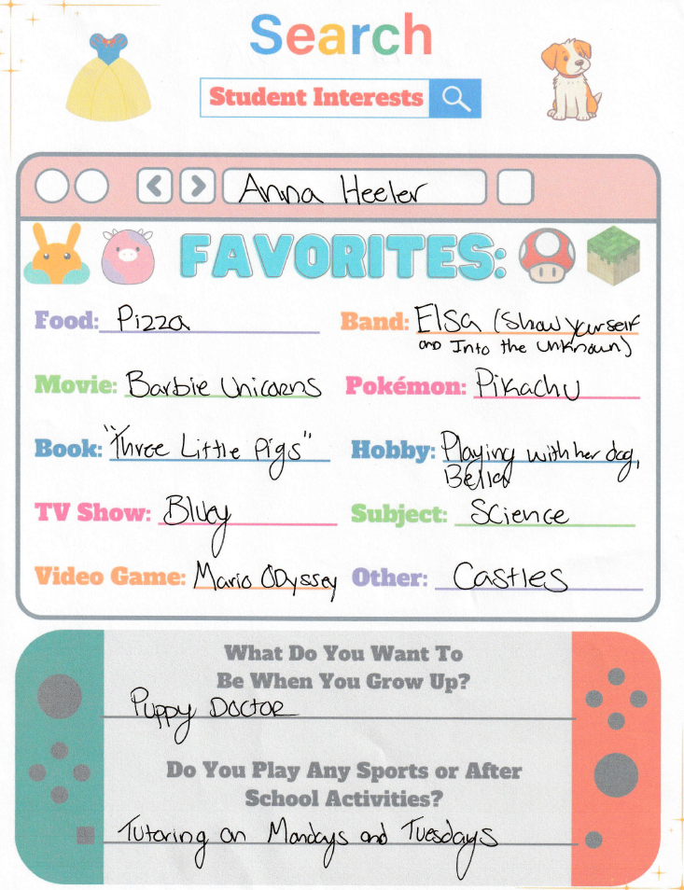
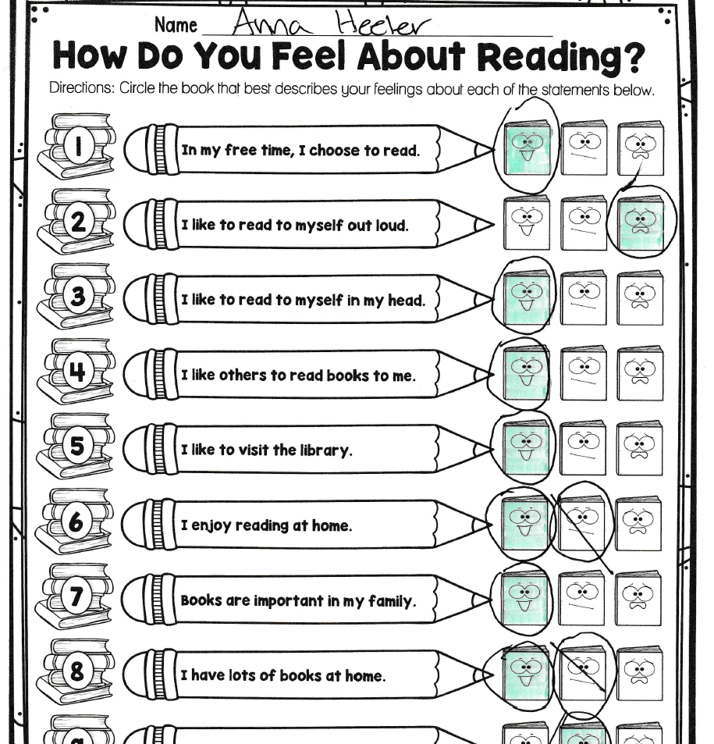
Inventories

Slide 4
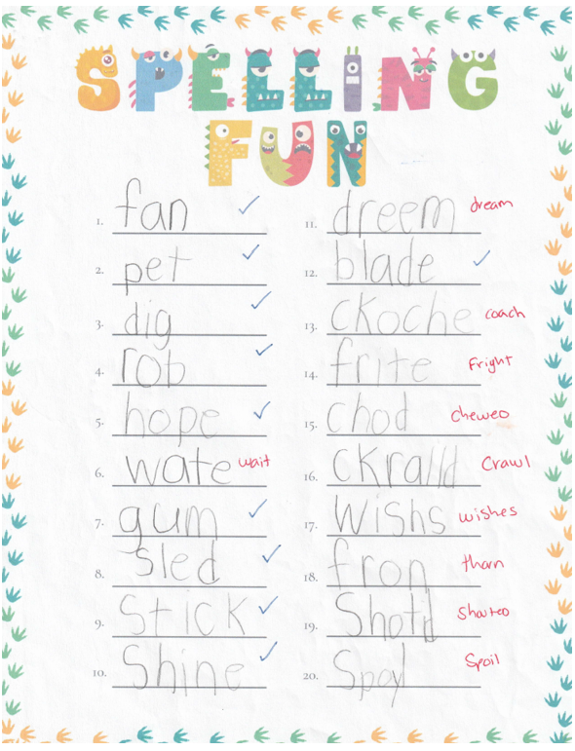
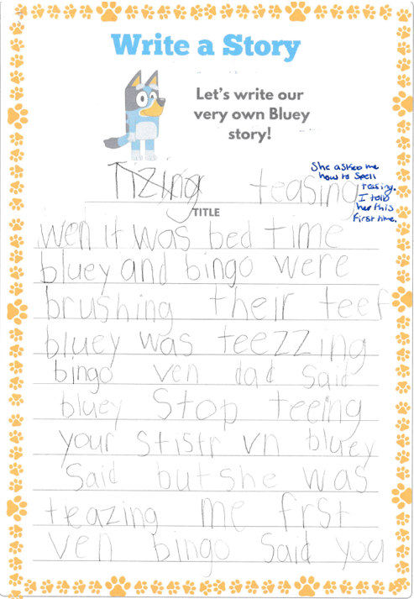
A
S
S
E
S
S
M
E
N
T
S

Slide 5
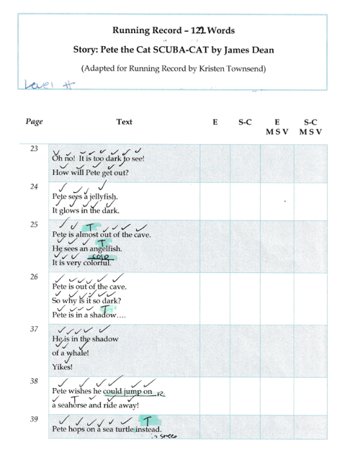

Assessments Continued
92.6%

Slide 6
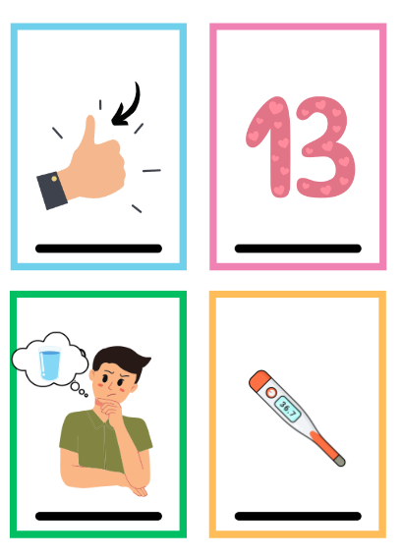
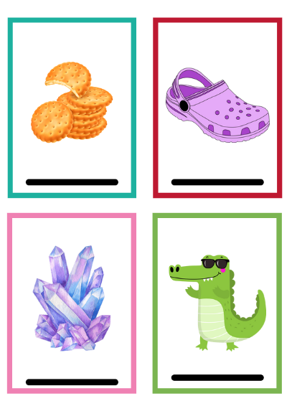
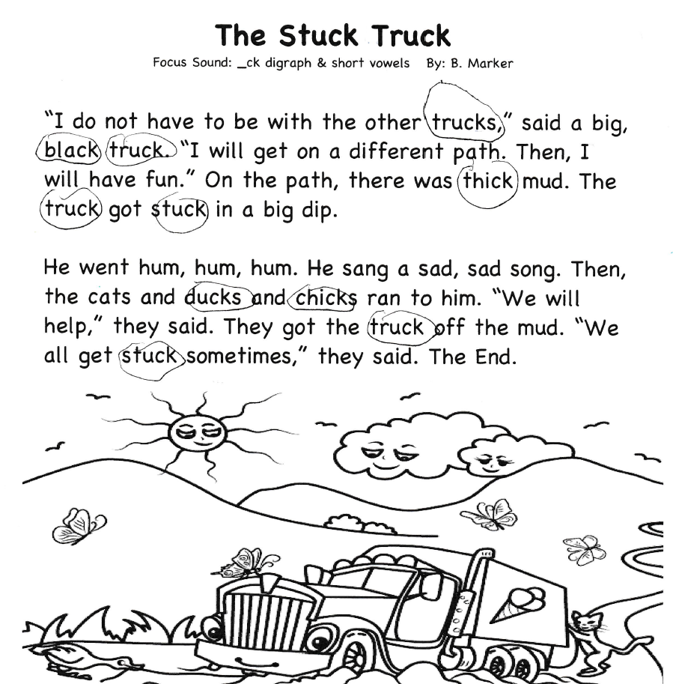

Interventions

Slide 7
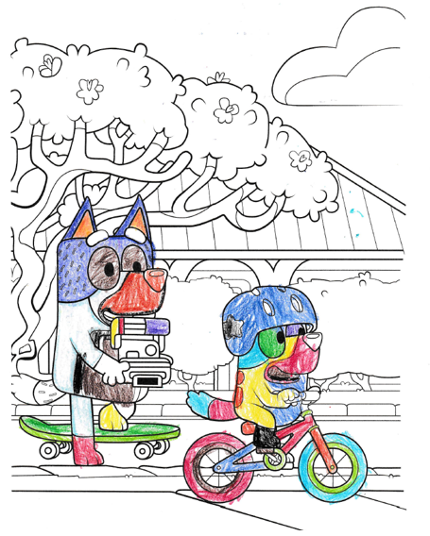
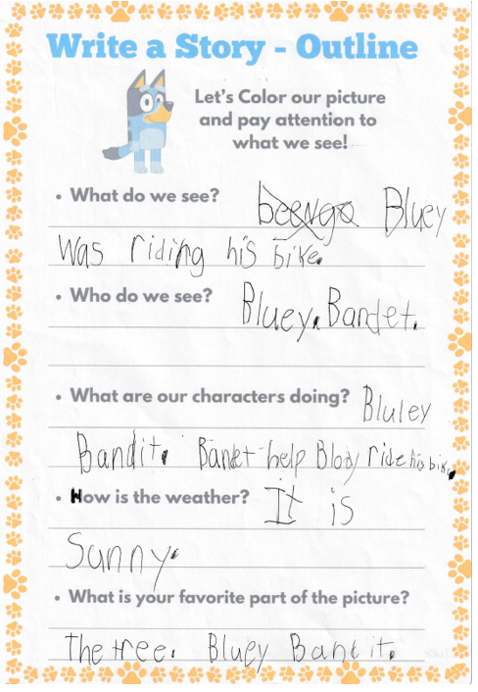
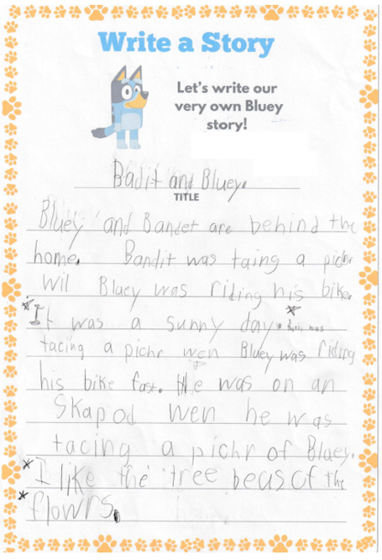
Interventions

Slide 8

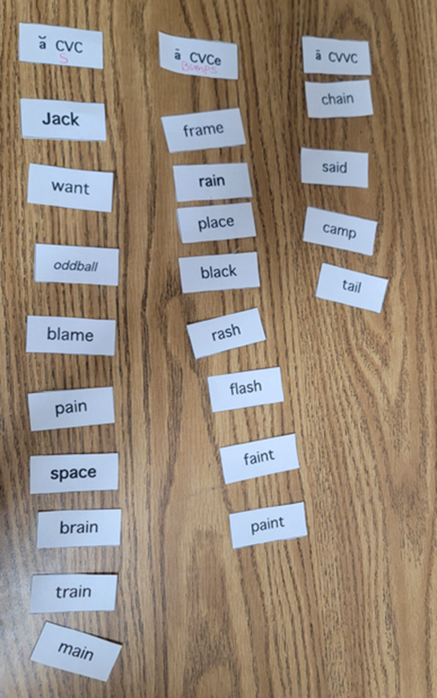
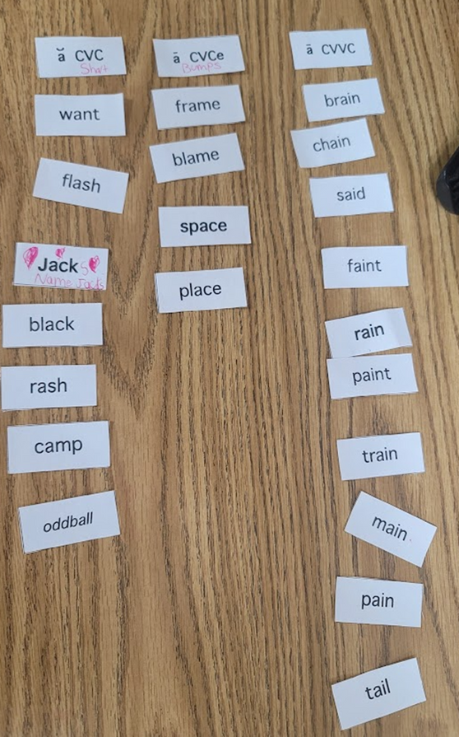
Post Assessment

Slide 9

Reflection
Anna is a bright and dedicated student who loves to learn. She lacks confidence when asked to read and often seeks reassurance from adults working with her. Once she is encouraged and praised for her efforts, she sheds this fear and you can discern a drastic difference in her reading abilities. During our sessions, she struggled with the ck & th digraphs and the cl blend. Throughout our sessions, she showed much improvement and moved past these to the ai word sorts, which she excelled at after practice. She moved from the Middle Letter-Name Alphabetic Stage to the Middle Within Word Pattern Stage. She has made tremendous progress and I could not be more proud of her. I am grateful for the opportunity to work with Anna and I feel like she taught me as much, if not more than I taught her.

