Slide 1
CINDERELLA WHO?

Slide 2

VIDEO

Slide 3

Objective:
Today, we are going to compare and contrast two different versions of Cinderella stories, to learn how they are the same, and how they are different. We are going to use a Venn diagram to do this.
By the end of our lesson:
  I can make a Venn Diagram to show what is the same and what is different in two Cinderella stories.

Slide 4
VOCABULARY
Compare: To find out how two or more things are the same.
Example: When we compare, we look for things that are alike.
Contrast: To find out how two or more things are different.
Example: When we contrast, we look for things that are not the same.
Perspective: The way someone sees or understands something.
Example: Your perspective is how you see the world and think about things.
Culture: The way a group of people lives, including their language, food, traditions, and beliefs.
Example: Culture is what makes people from different places special, like their
holidays, food, and clothes.

Slide 5


CULTURE
What is it?
Turn and talk to a partner

Slide 6
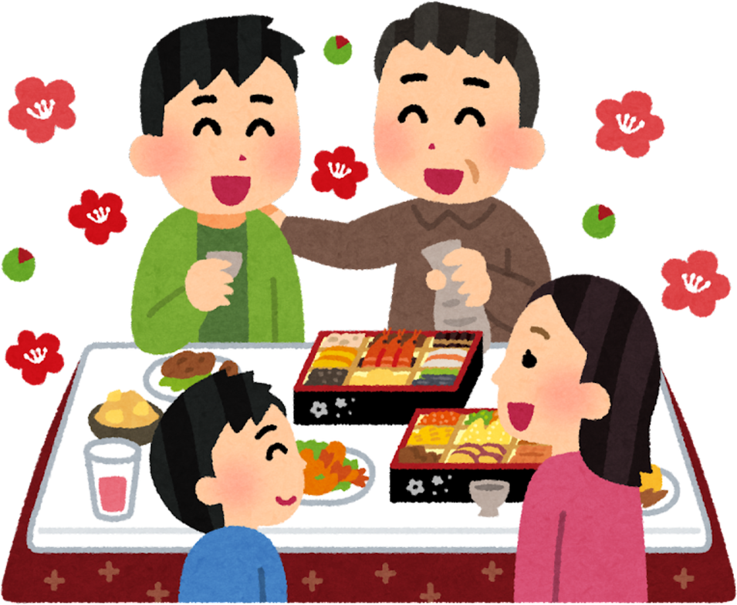
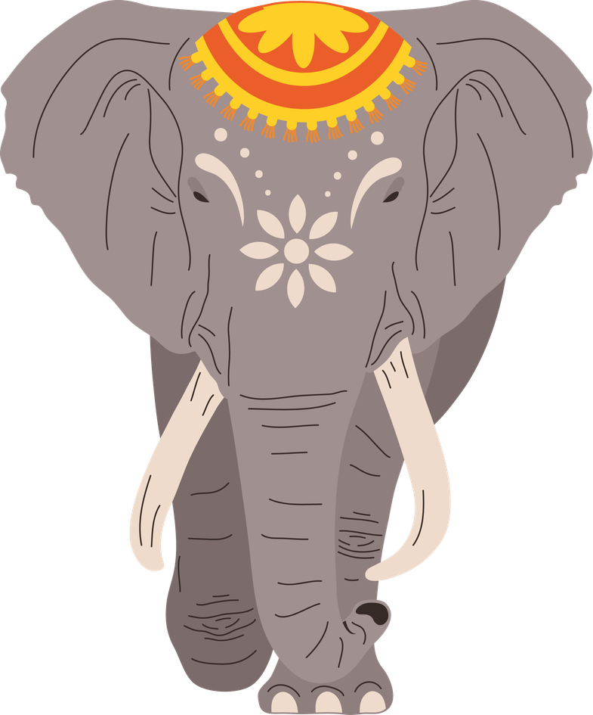

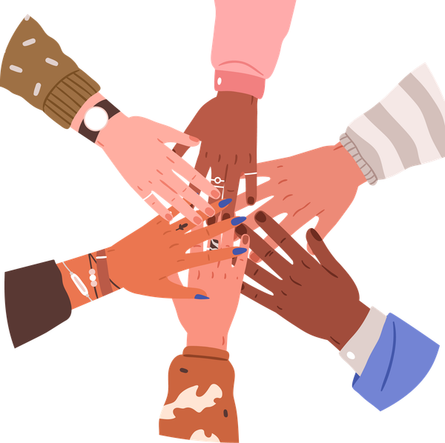
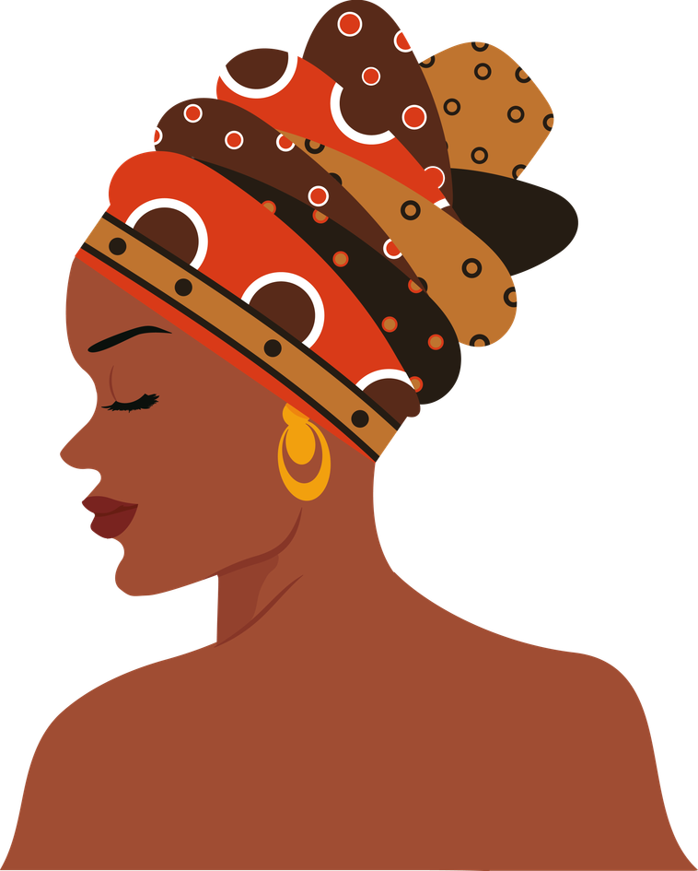
Culture is all around us

Slide 7
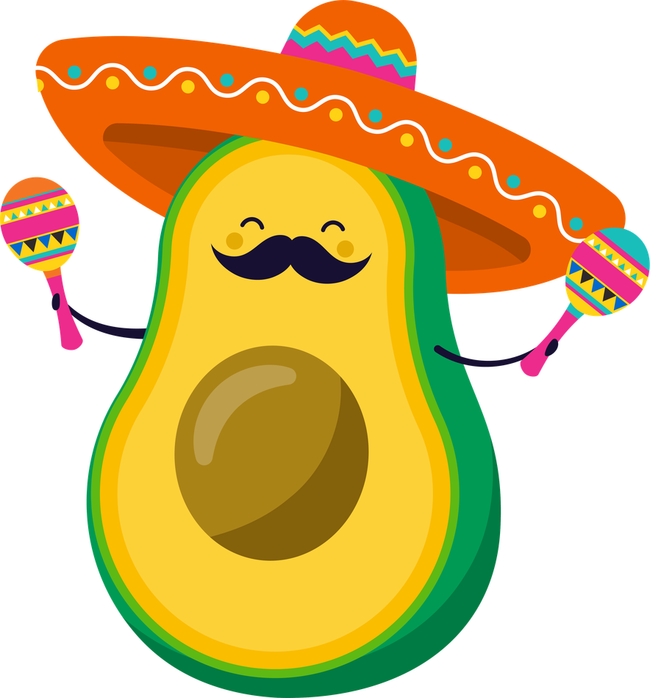



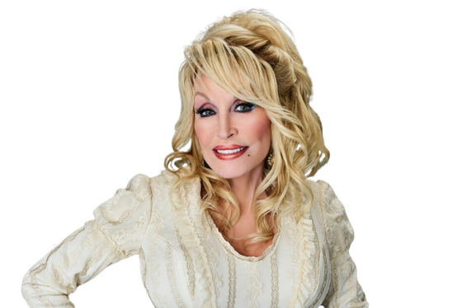
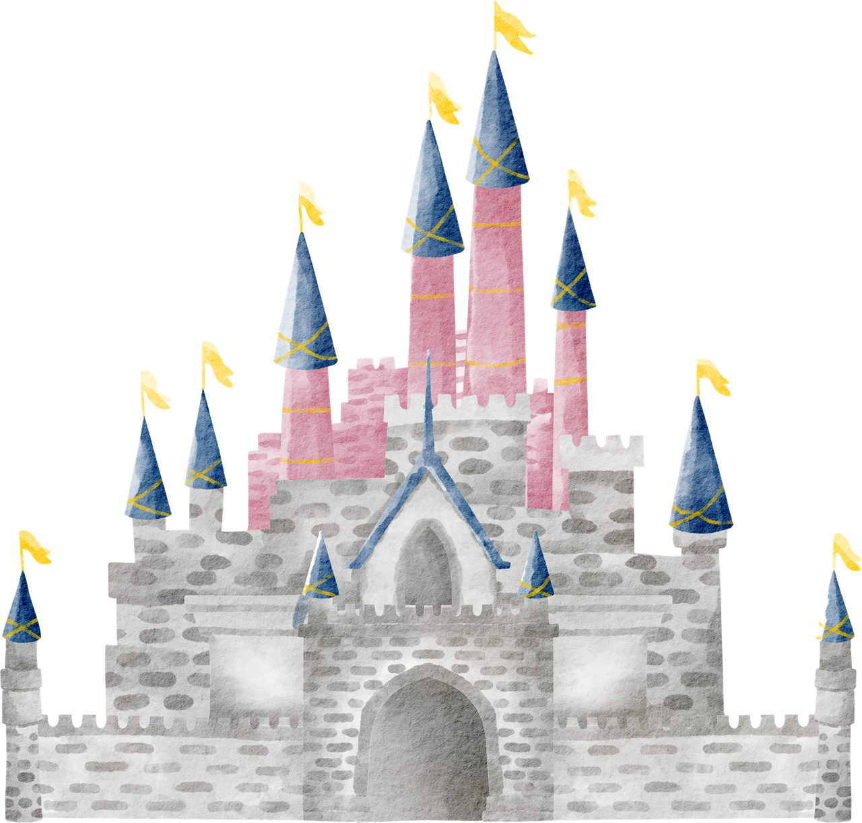
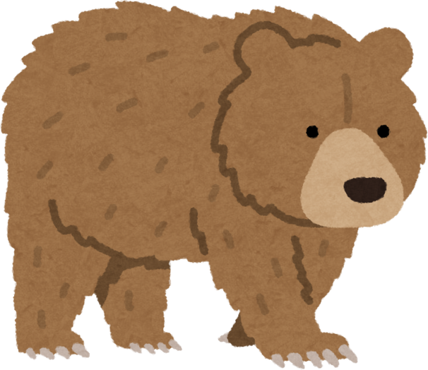
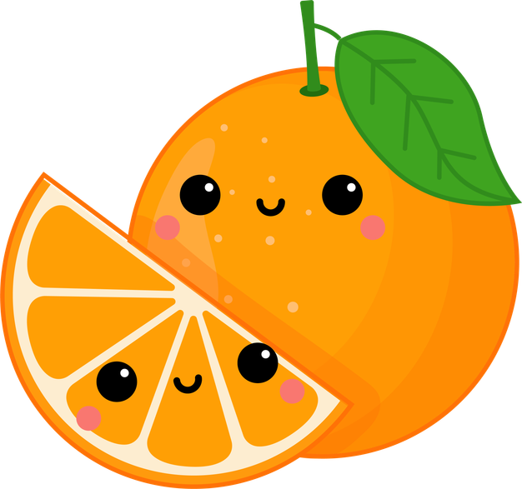
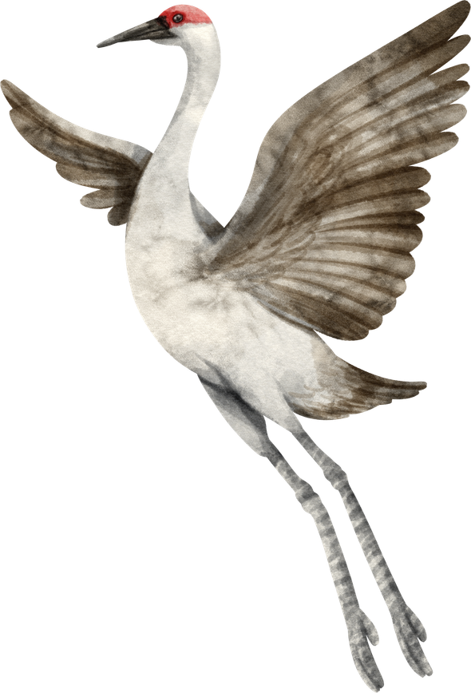
STATE & LOCAL CULTURE
Teacher Tip: This slide and the following one were personalized to the backgrounds of my students. Consider discussing cultural elements related to your state, or the home states of your students.
Sandhill Cranes
80% of the world’s population ends up here every March

Slide 8


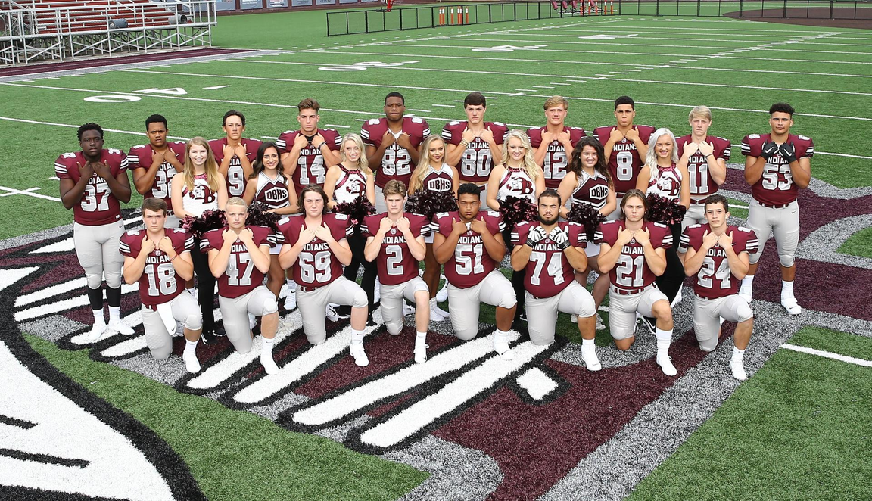
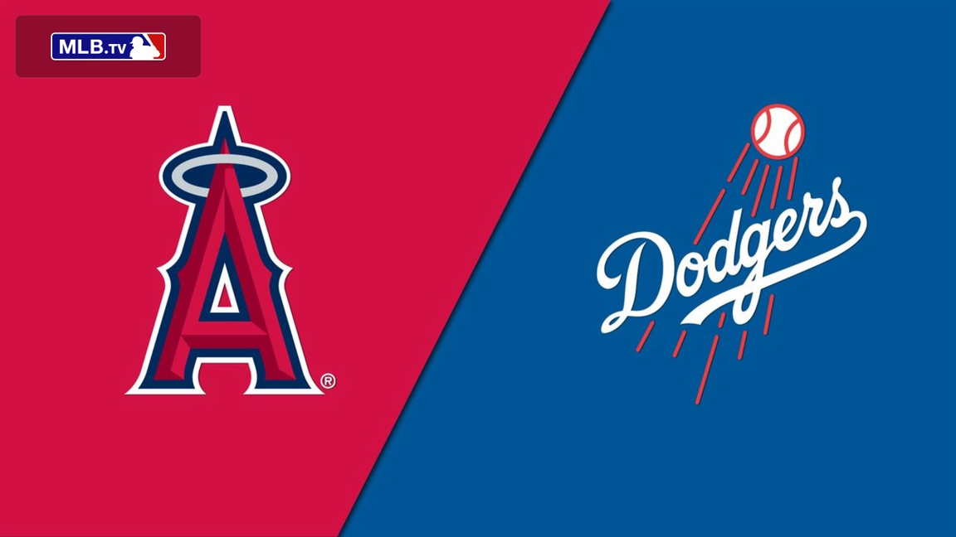
S
P
O
R
T
S

Slide 9
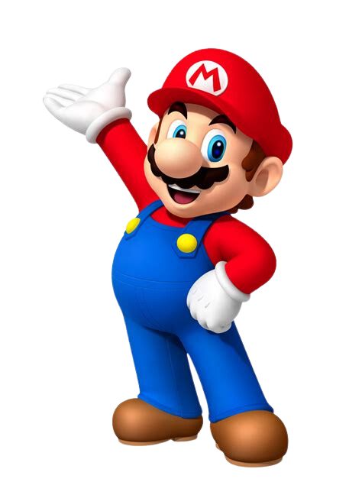
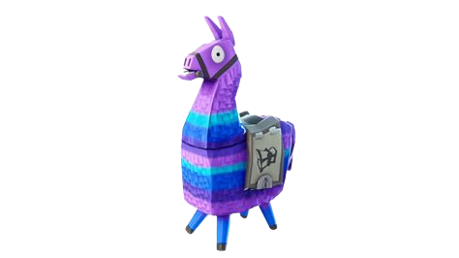
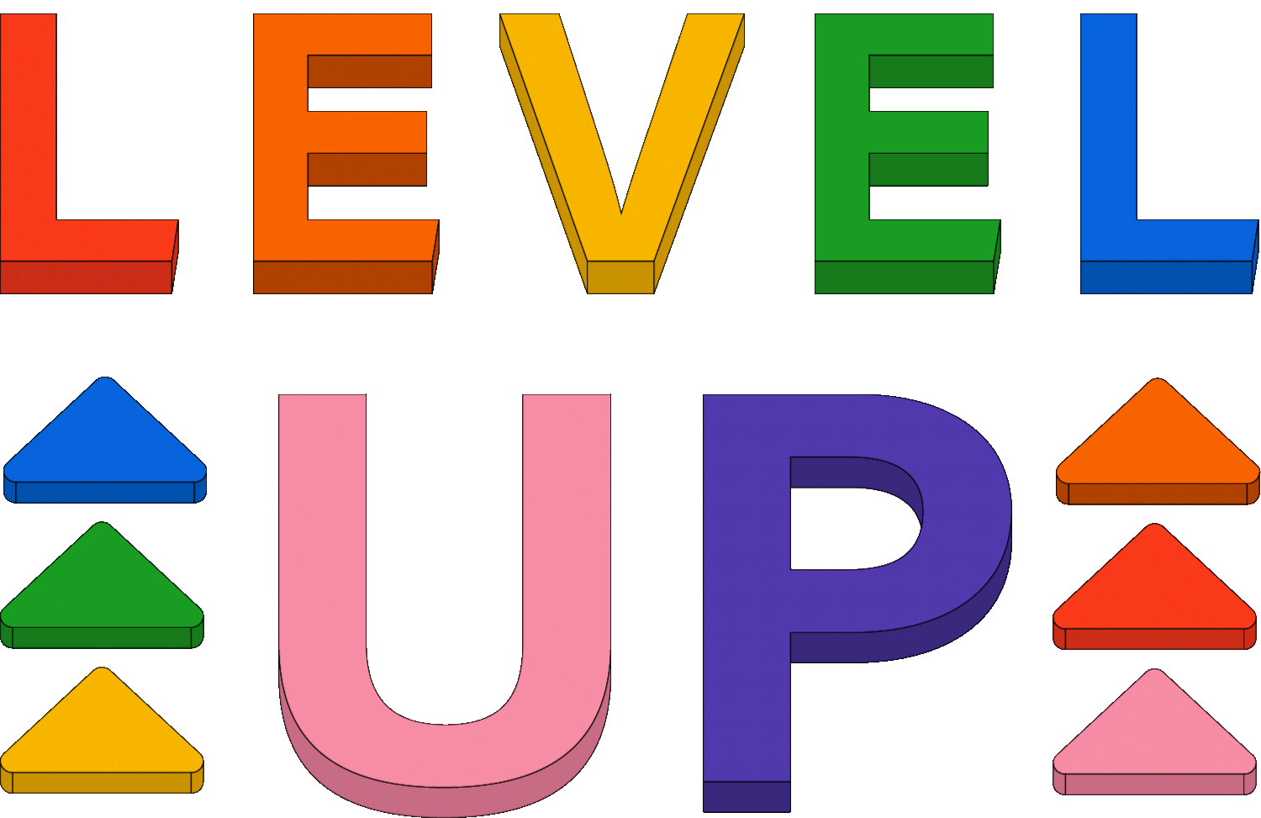


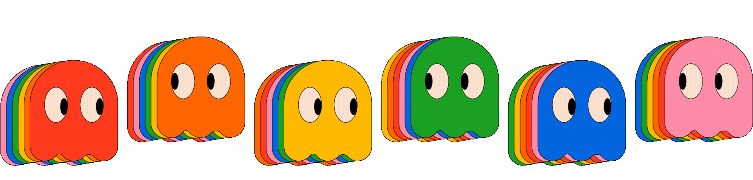
VIDEO GAME CULTURE

Slide 10

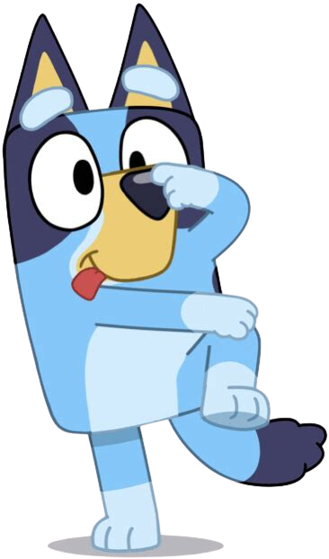
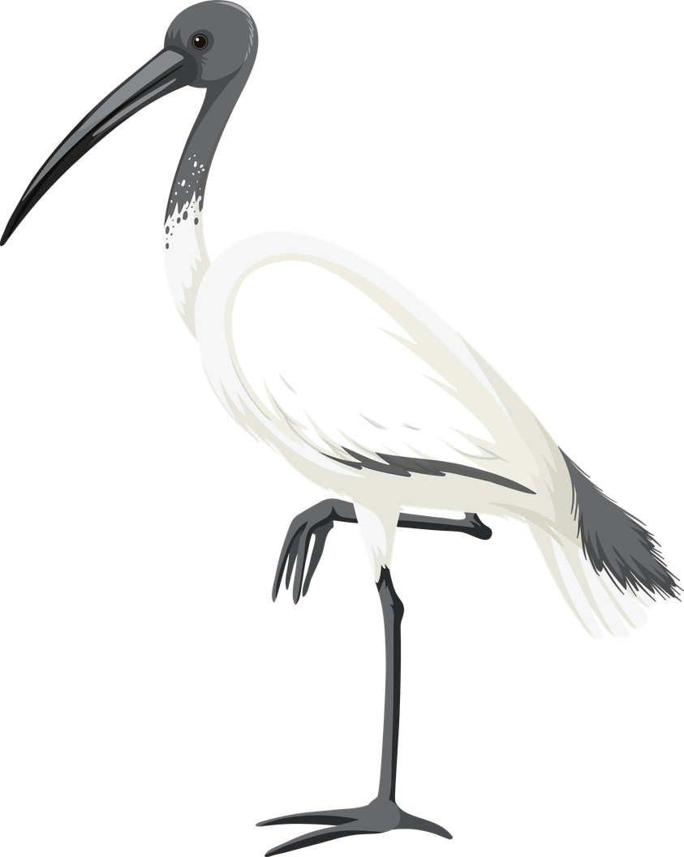

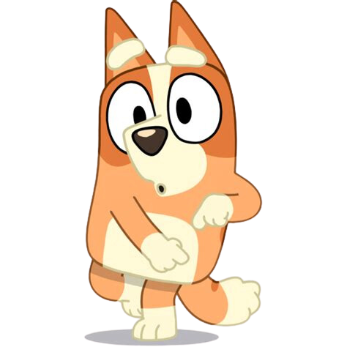
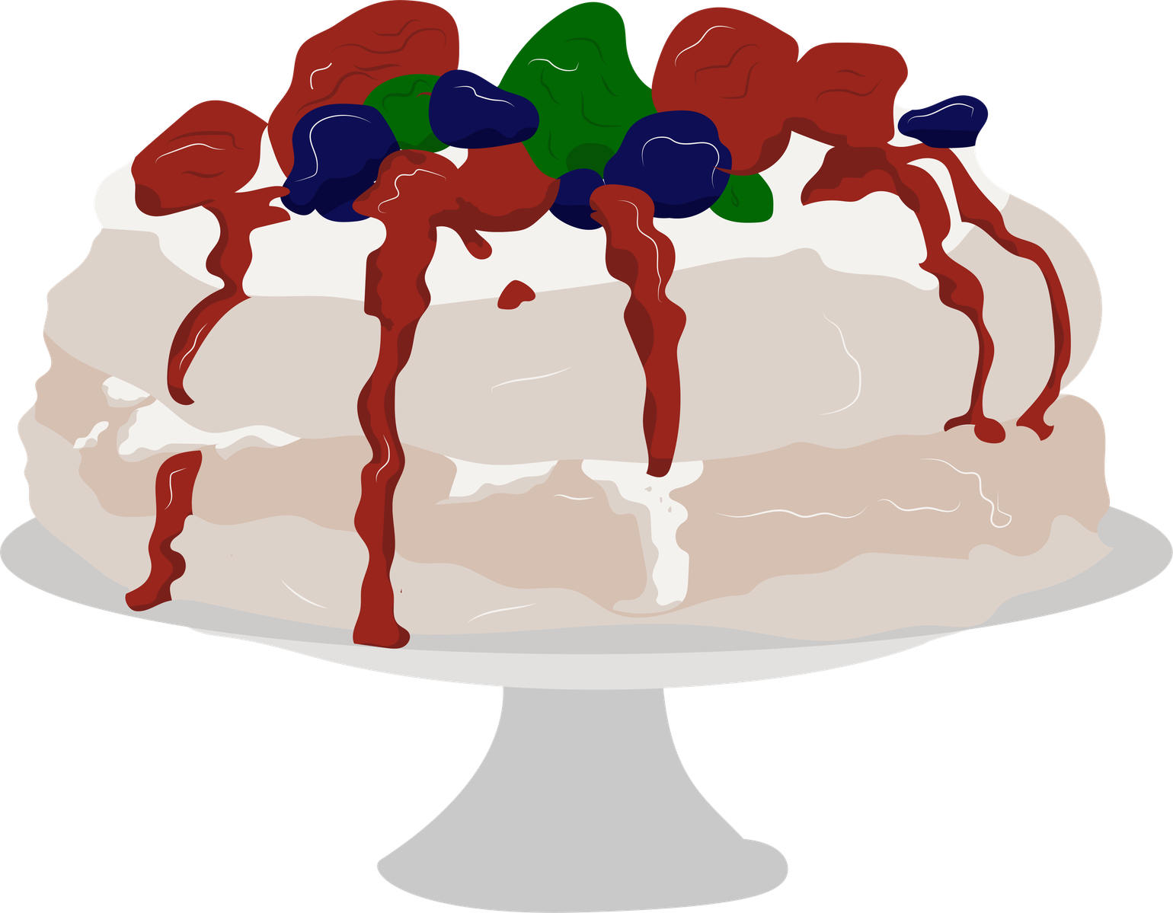
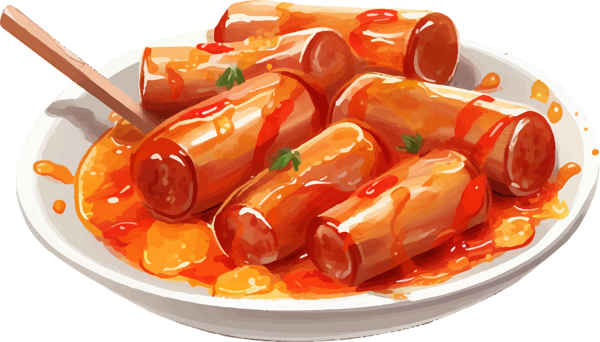
BLUEY & AUSTRALIA
White Ibis

Slide 11
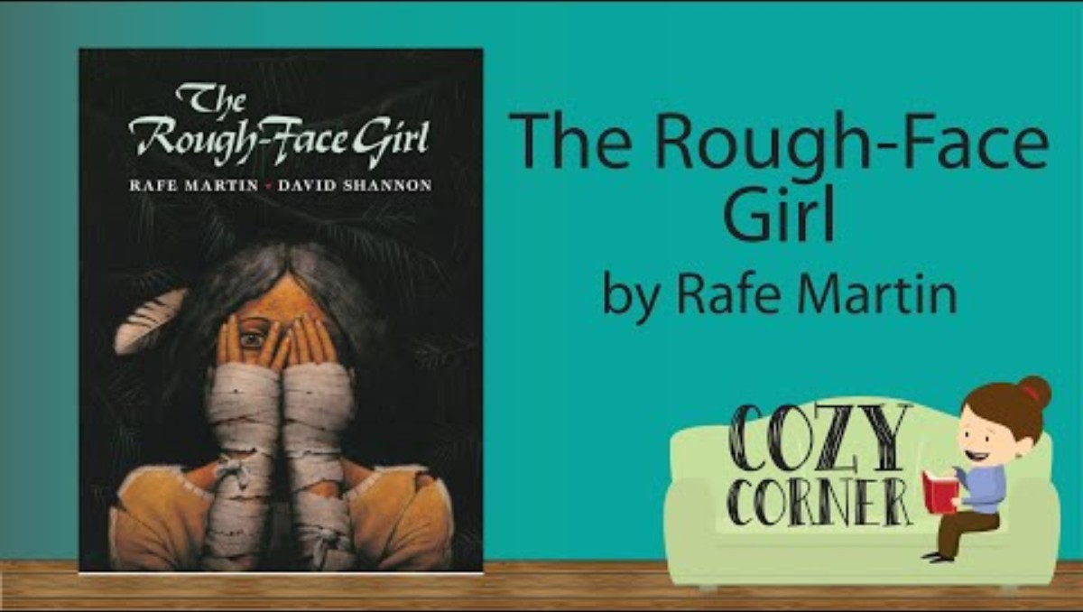
“The Rough-Face Girl”

Slide 12
Why Comparing and Contrasting Cultures & Stories is Important.
  Learn About Different Places: Comparing stories helps us learn about how people live in different parts of the world. Each story can tell us something special about a place.
  Understand Characters Better: By comparing stories, we can learn more about the characters. We see how they are alike and how they are different, which helps us understand them better.
  Appreciate Other Cultures: It's important to learn about different cultures; we can see how people from other places might think and feel differently."

Slide 13
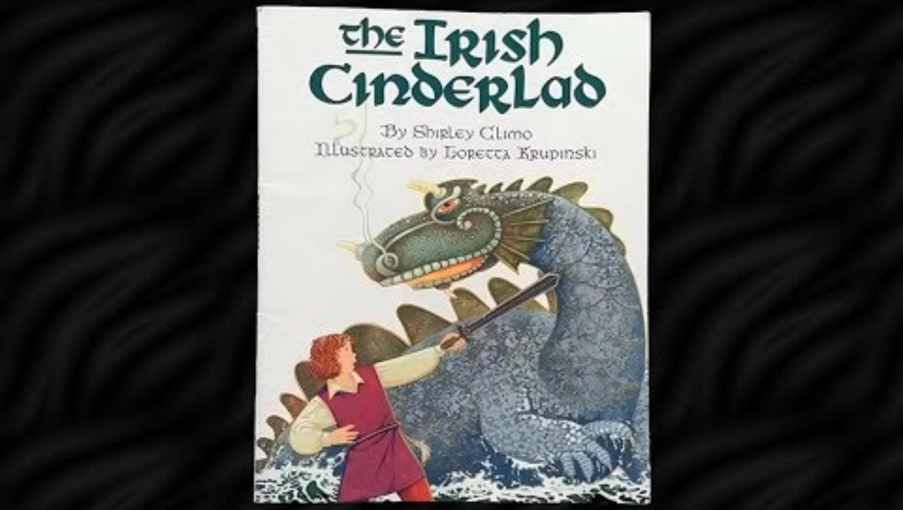
“THE IRISH CINDERLAD”
Teacher Tip: Consider playing this story a day before the lesson if your students may have difficulty sitting still for so long. When teaching this, I read this story to the students the day preceding the lesson.

Slide 14
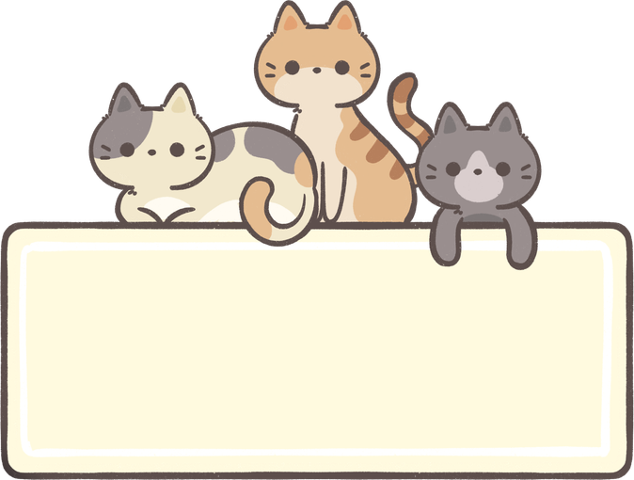

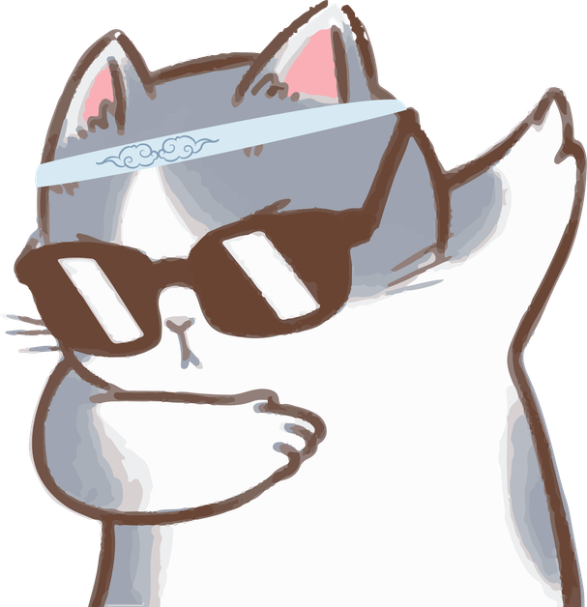

D
I
F
F
E
R
E
N
T
U
N
I
Q
U
E
CATS
DOGS
YOUR PARAGRAPH TEXT
YOUR PARAGRAPH TEXT
YOUR PARAGRAPH TEXT
SAME

Slide 15

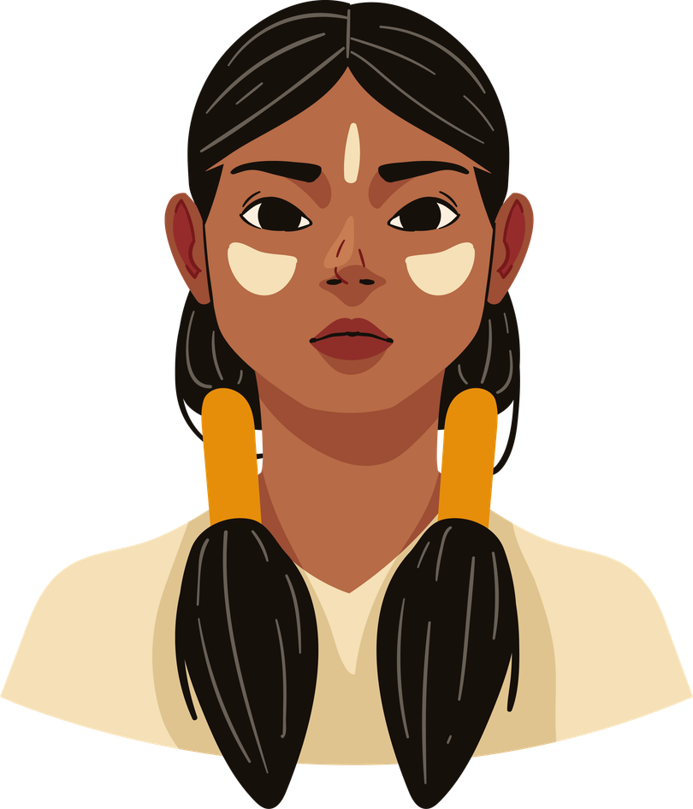



LET’S
IRISH CINDERLAD
COMPARE
IRISH CINDERLAD
ROUGH-FACE GIRL
SHOES
BOY CINDERELLA
MAKES HER OWN OUTFIT

Slide 16
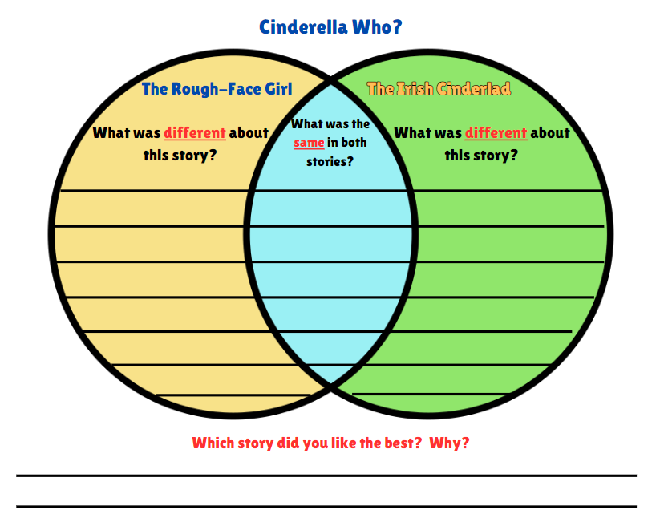
Instructions:
  Think about the differences and similarities between the stories.
  Yellow Circle: Write what was different about “The Rough-Face Girl.”
  Green Circle: Write what was different about “The Irish Cinderlad.”
  Blue Area: Write what was the same about both stories.
  Bottom: Write about which story was your favorite and why

Slide 17
I Can Statement:
I can use a Venn diagram to show how two Cinderella stories are the same and how they are different.
Why is Learning About Different Cultures Important?:
Learning about different cultures helps us understand the world around us. It teaches us that people from different places can have their own ways of thinking, doing things, and telling stories. By understanding other cultures, we can be kinder and work together with people who are different from us. It makes the world a better, more interesting place!

Slide 18
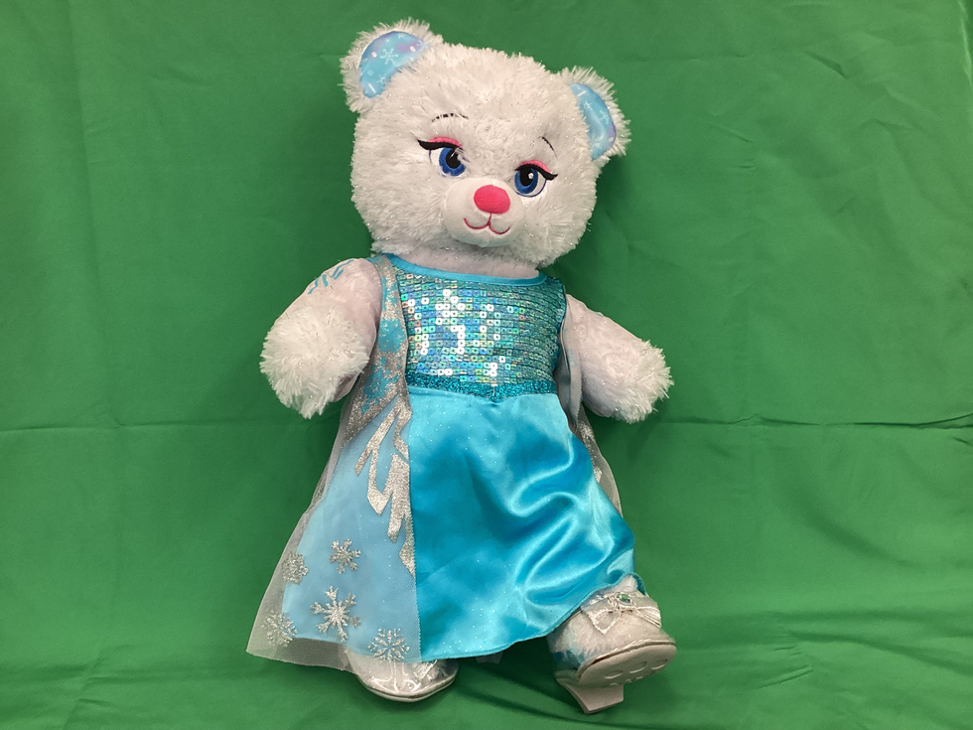
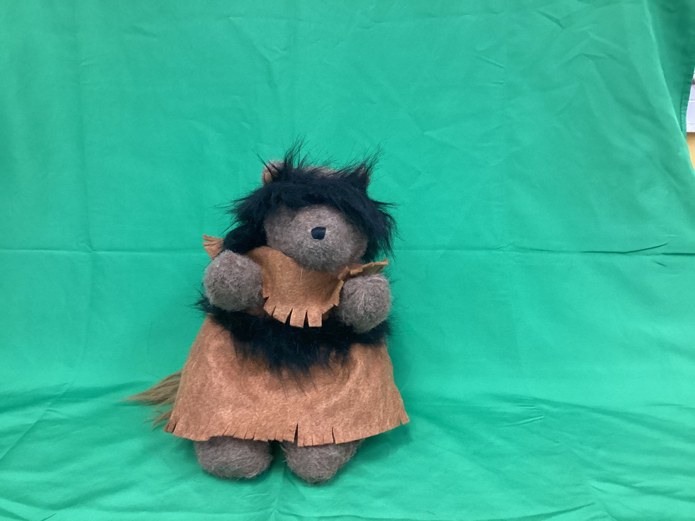
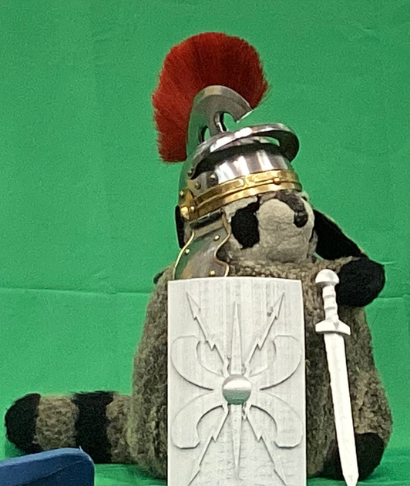
THE CAST HAS SIGNED A SPECIAL AUTOGRAPH FOR EACH OF YOU.
Cinderella
Rough-Face
Girl
Becan

Slide 19
