Slide 1

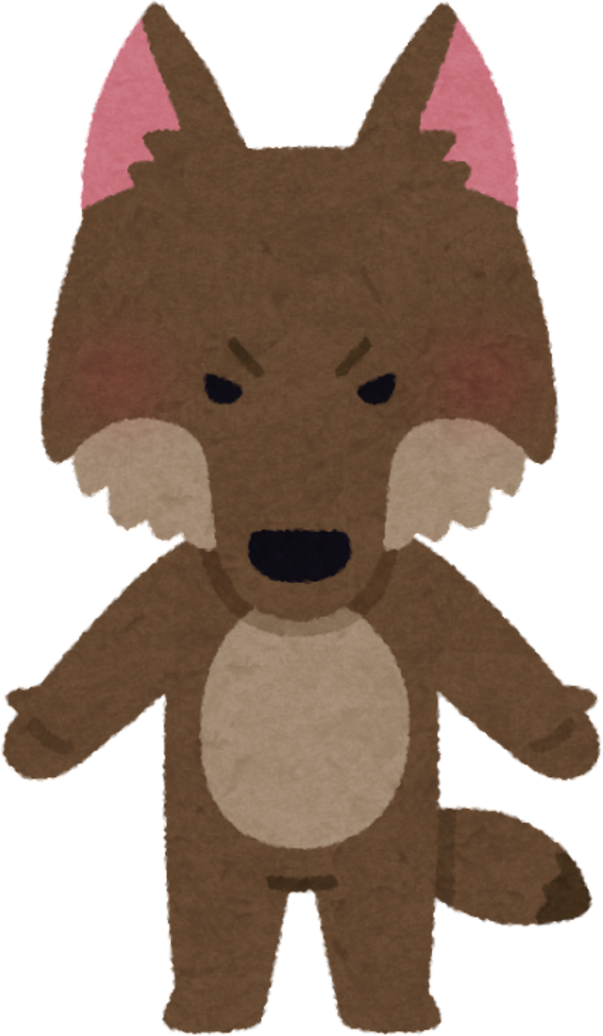

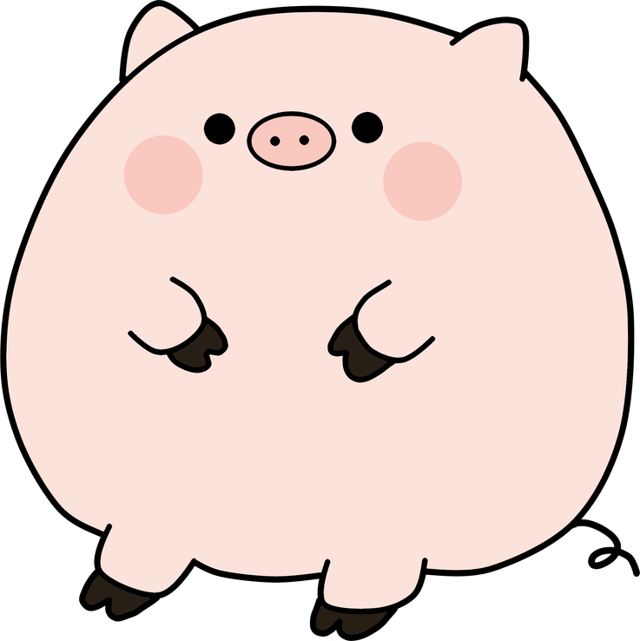
Who’s Afraid of the
Big Bad wolf?

Slide 2
Wolf & Pig Partners
For this lesson, you’ll either be wolves or pigs.
Let’s meet our Wolf & Pig partners.

Slide 3
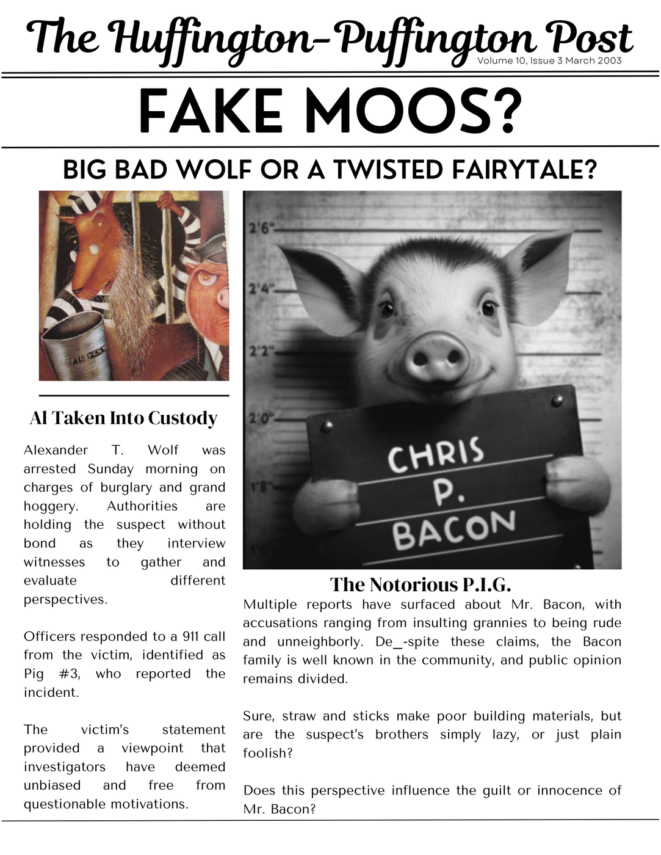


Slide 4
OBJECTIVES
Today we are going to learn about how the wolf perceives the
story differently from the way we usually hear it told in “The
Three Little Pigs.”
By the end of today, you will be able to tell me how the wolf has his own version of what happened.
Say it with me:
I can use a graphic organizer to compare how characters’ points of view are different.

Slide 5


Slide 6


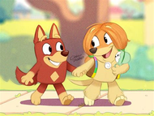


VOCABULARY
Compare: To find how two or more things are alike
Example: Let’s compare the pigs in the story; they all build houses, that’s the same.
Contrast: To find out how two things are different.
Remember our Venn
diagrams from
Cinderella.
Example: The Wolf in the new story is funny, but in the traditional story, he seems mean. That’s a contrast!
Analyze: To look at something carefully to understand it better.
Example: We’re going to think carefully about why the pigs built their houses out of straw, sticks, and bricks.
Point of View: The way someone sees or tells a story.
Example: In the traditional story, the pigs tell the story, but in the new book, we hear the Wolf's point of view.
Narrator: The person or character telling the story.
Example: In the new book, the narrator is the Wolf. He tells us what happened in his own words.
Perspective: How someone thinks or feels about something based on their experiences.
Example: In the traditional story, the pigs tell the story, but in the new book, we hear the Wolf's point of view.
Bias: A strong feeling that makes someone see things in a certain way, sometimes unfairly.
Example: The pigs might have a bias because they think the Wolf is always trying to hurt them.

Slide 7
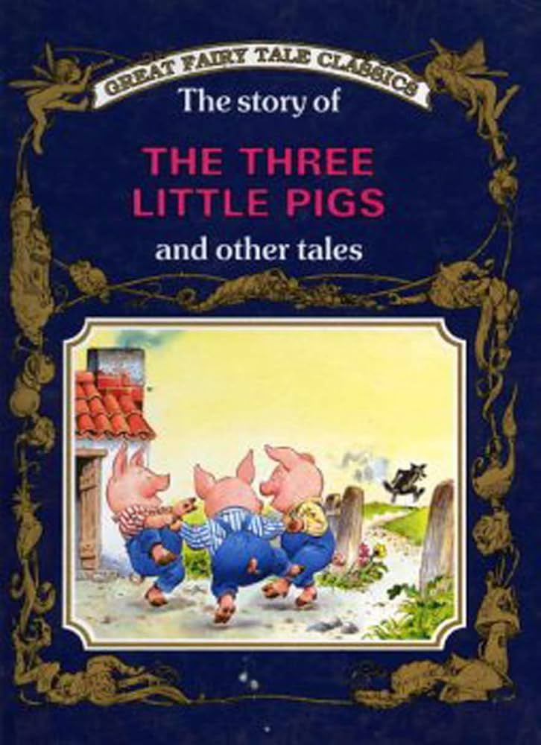
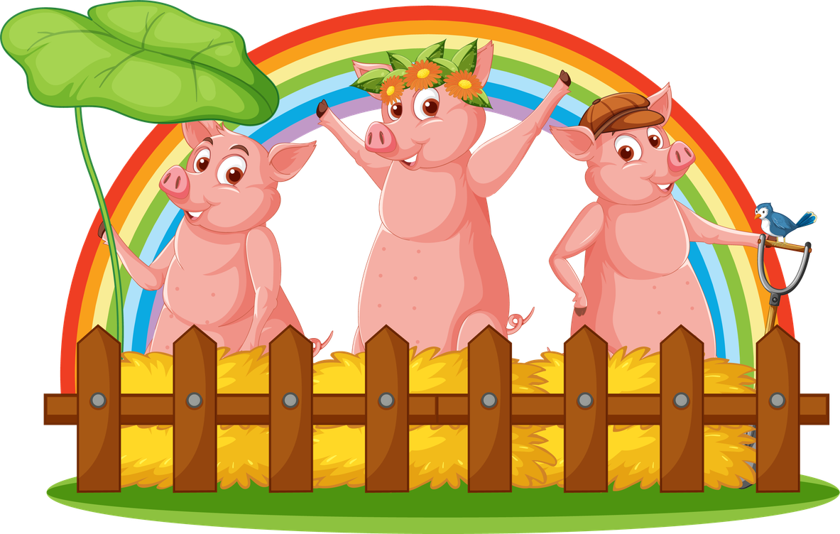
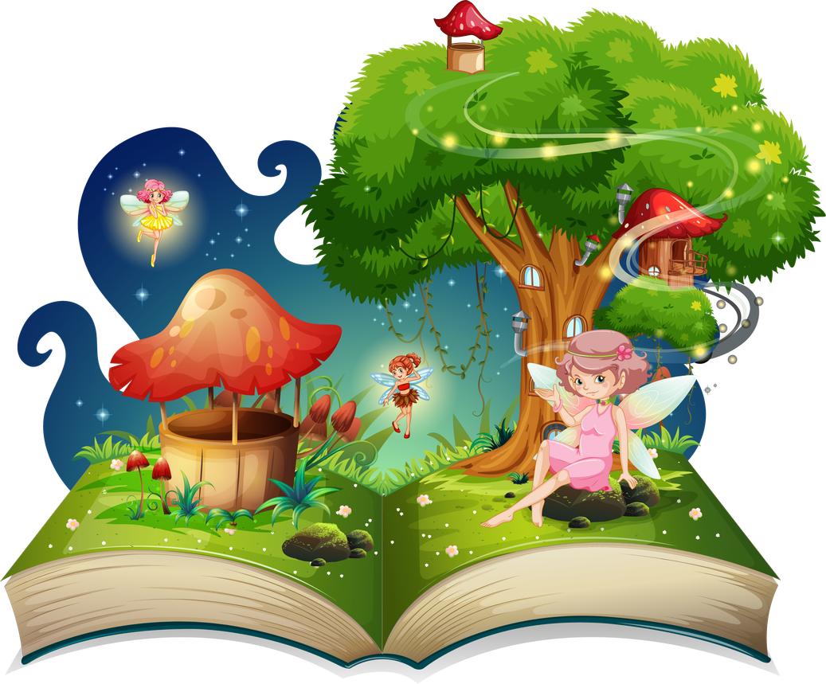
Whose perspective is this story from?
How do we know?

Slide 8
Turn
& Talk
How do you think the wolf might
tell this story differently?

Slide 9
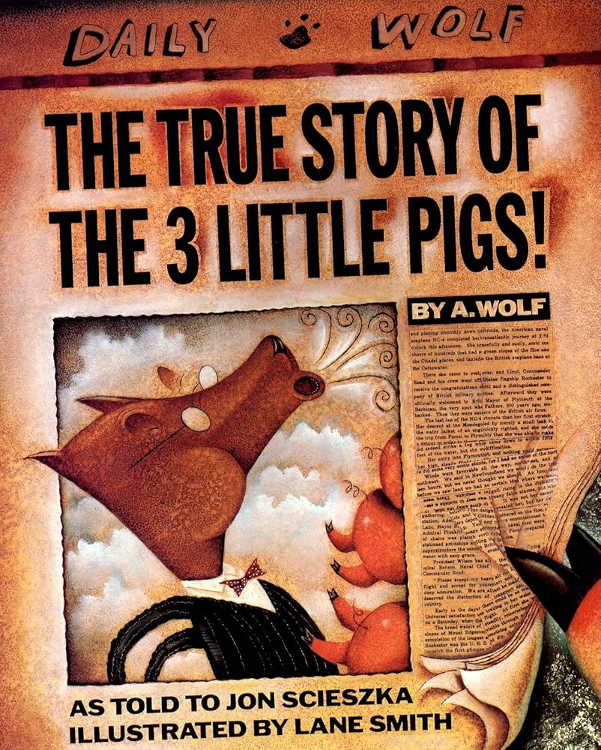

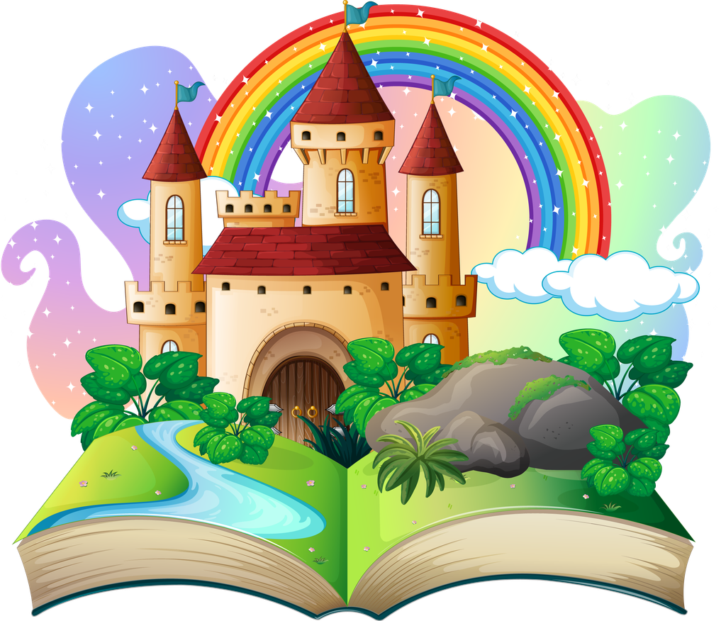

Slide 10
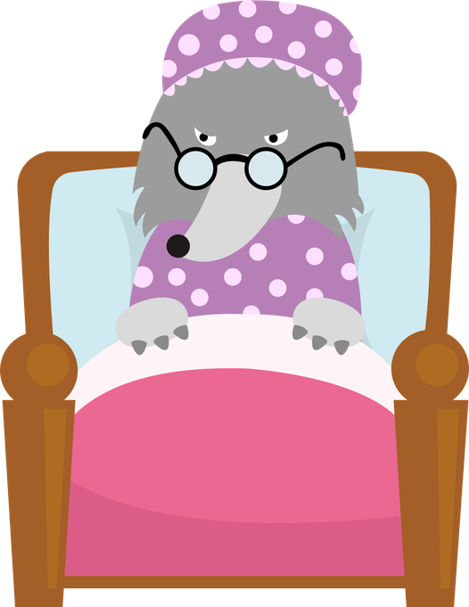
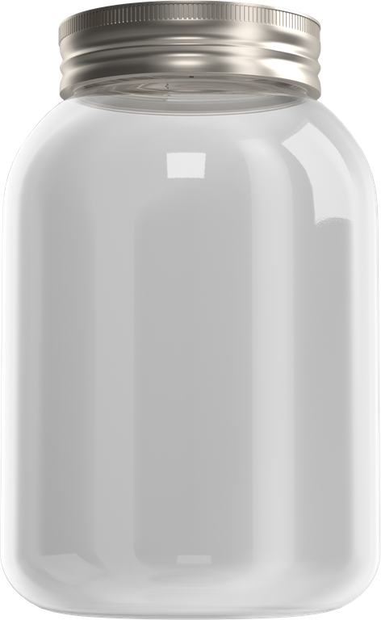
BIG BAD WOLF?
“The Three Little Pigs”
“The True Story of the Three Little Pigs”
The Wolf
Al
Wolf’s Perspective
Text Evidence
Al’s Perspective
Text Evidence
UH-OH
ACHOO!

Slide 11

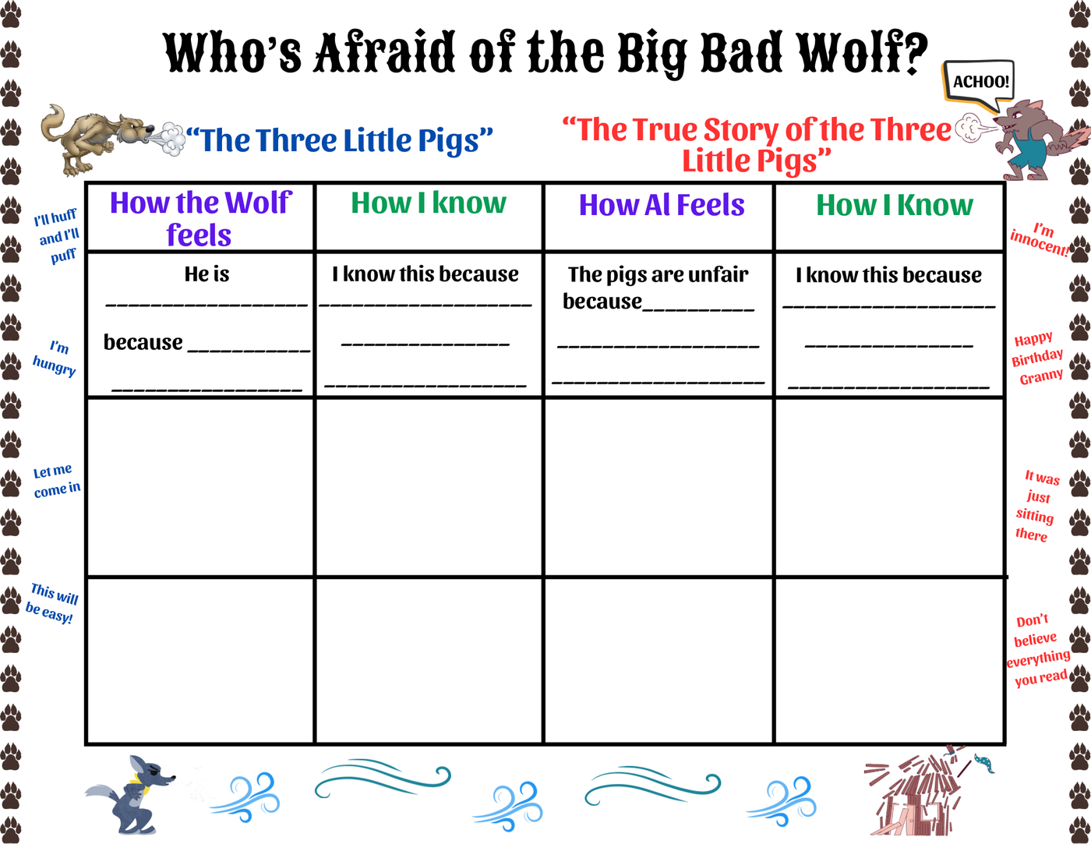
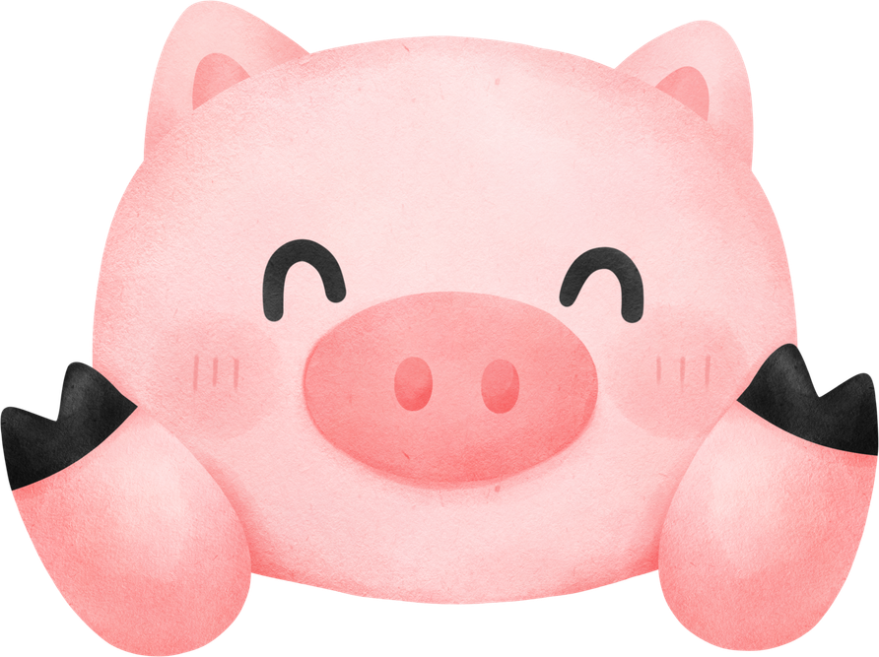
NOW IT’S YOUR TURN!

Slide 12
LET’S REVISIT!
I can use a graphic organizer to compare how characters’ points of view are different.
Have you ever disagreed with a friend because you saw something differently? How did understanding their perspective help?
Why is it important to see something from someone else’s point of View, especially when there is a disagreement?

