Slide 1
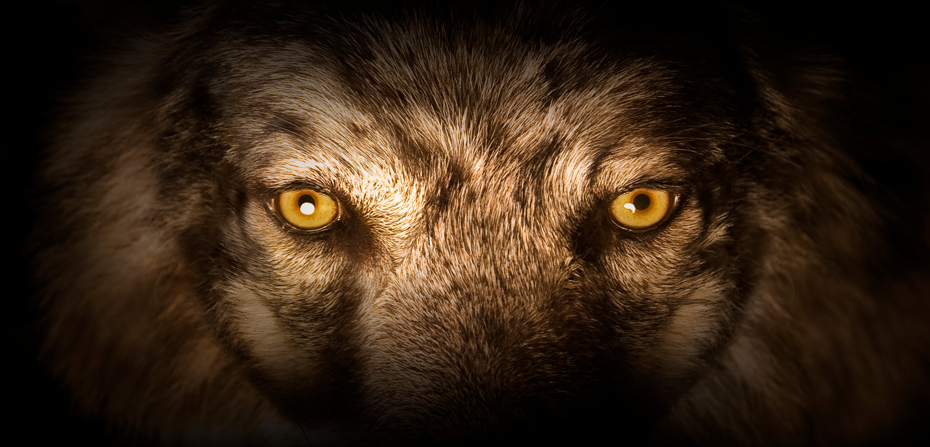


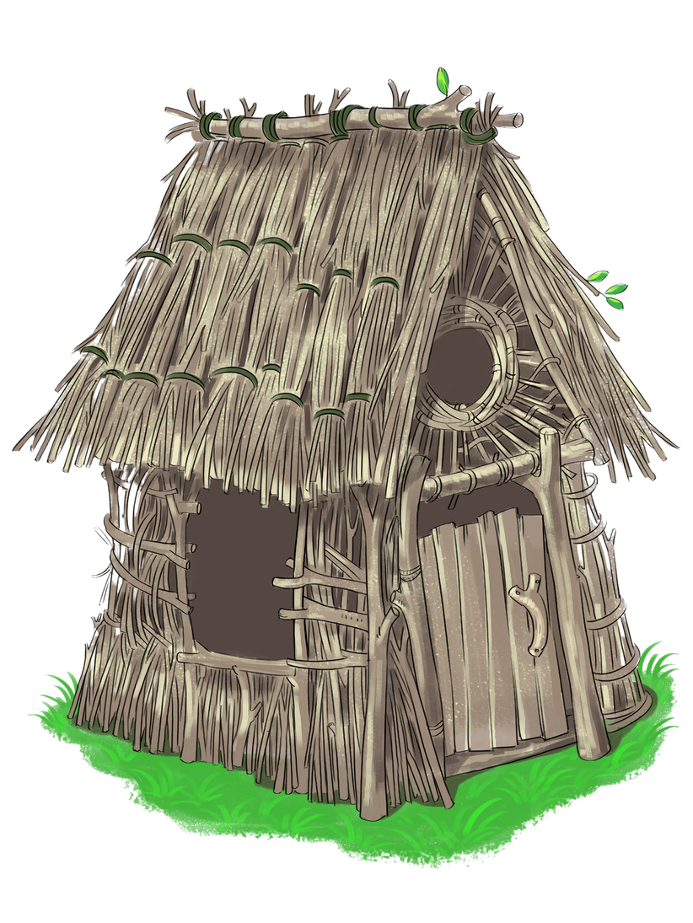
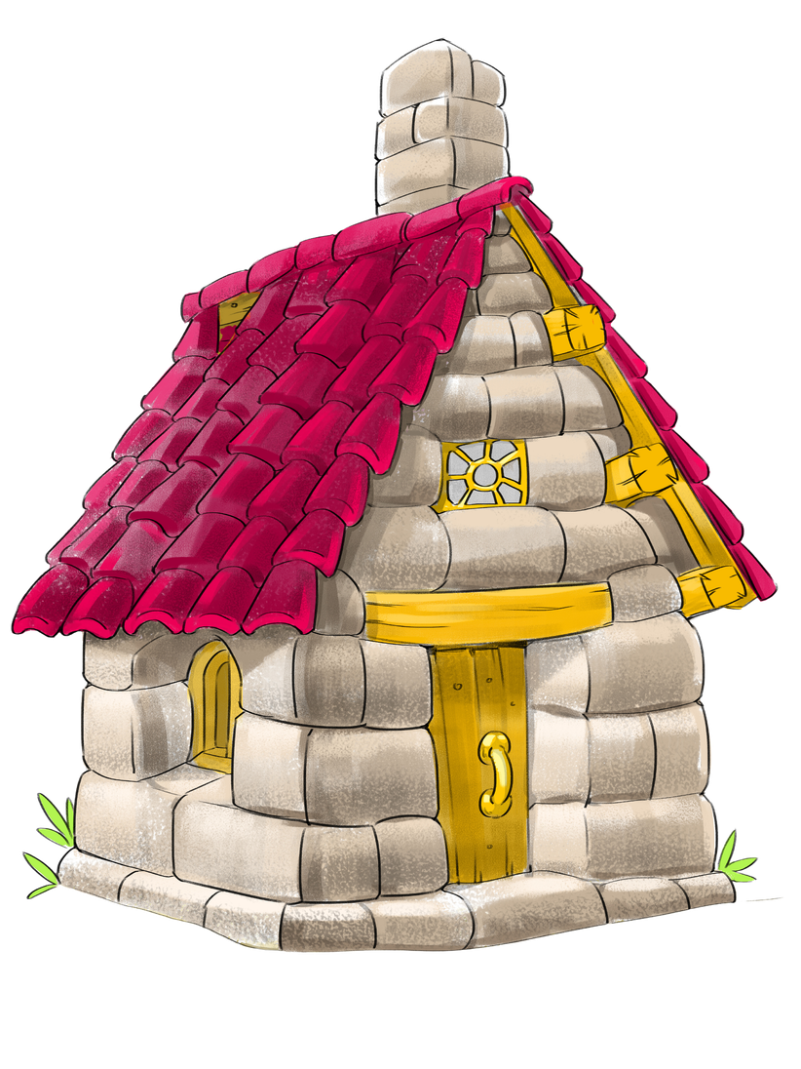
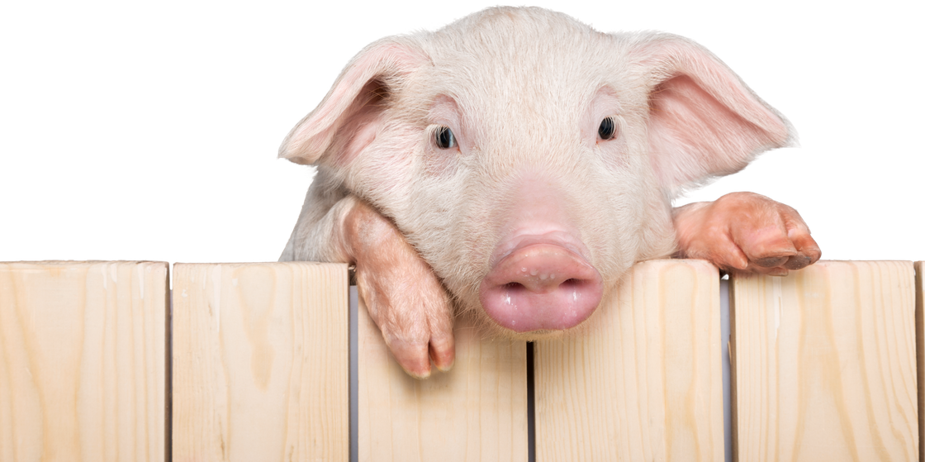
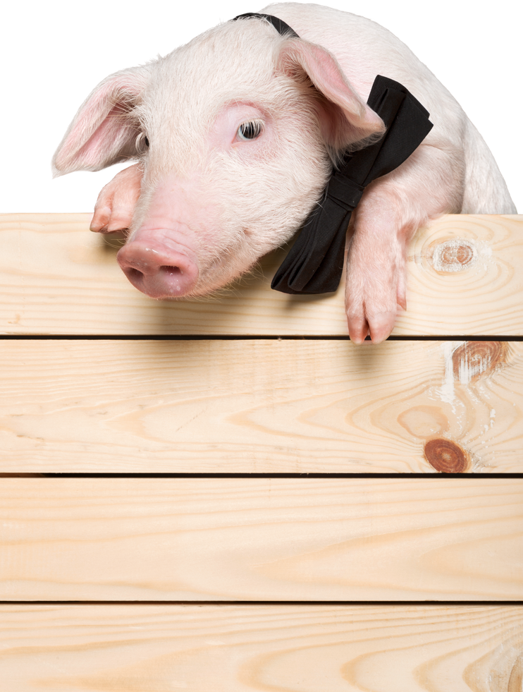
What’s the Truth
Fur Real?

Slide 2
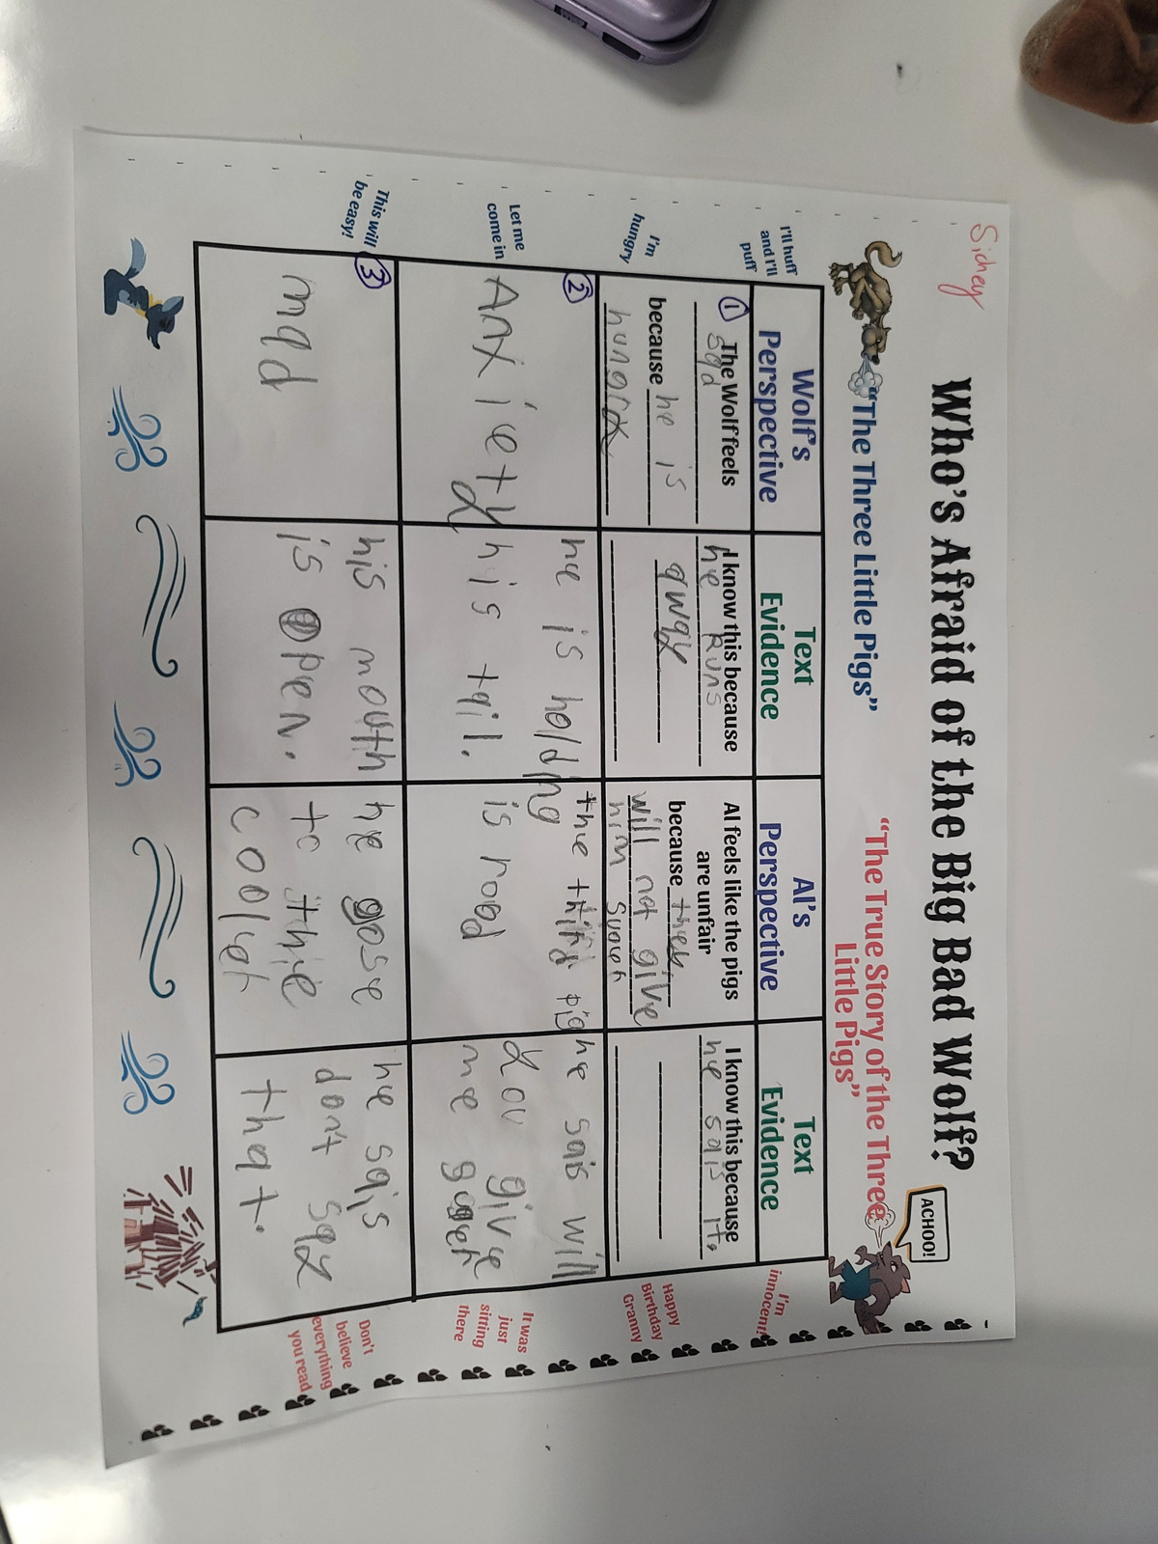
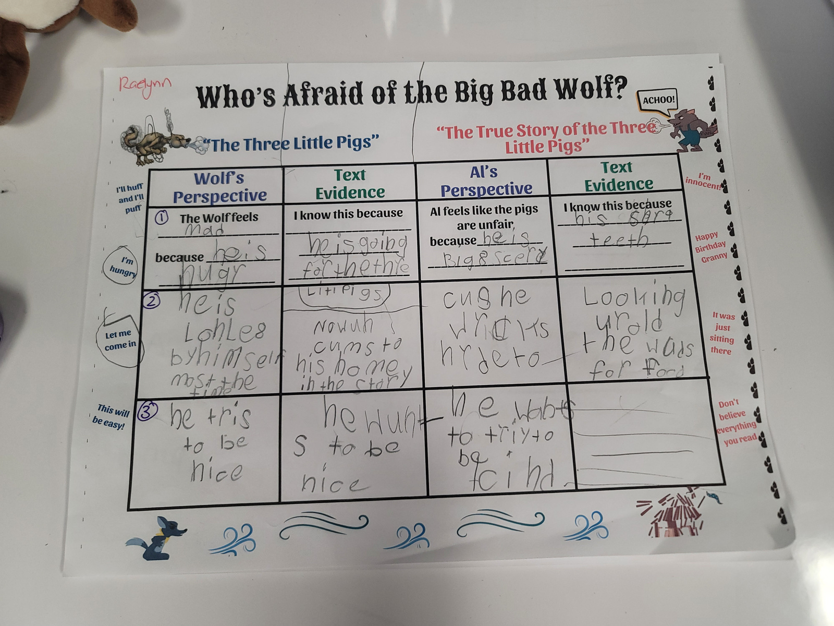
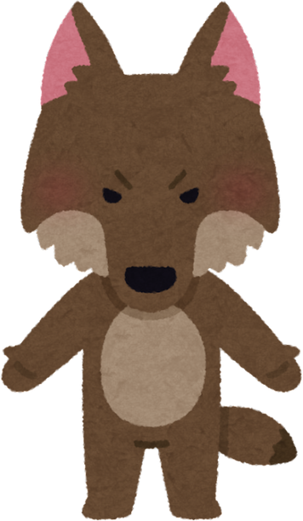
LET’S RECAP

Slide 3

OBJECTIVES
Yesterday, we compared the Wolf’s perspectives in both stories. Today, we are going to to decide whose story is fairer—the wolf’s or the pigs’.
SAY IT WITH ME
I can use evidence from the story to explain why characters see things differently.

Slide 4


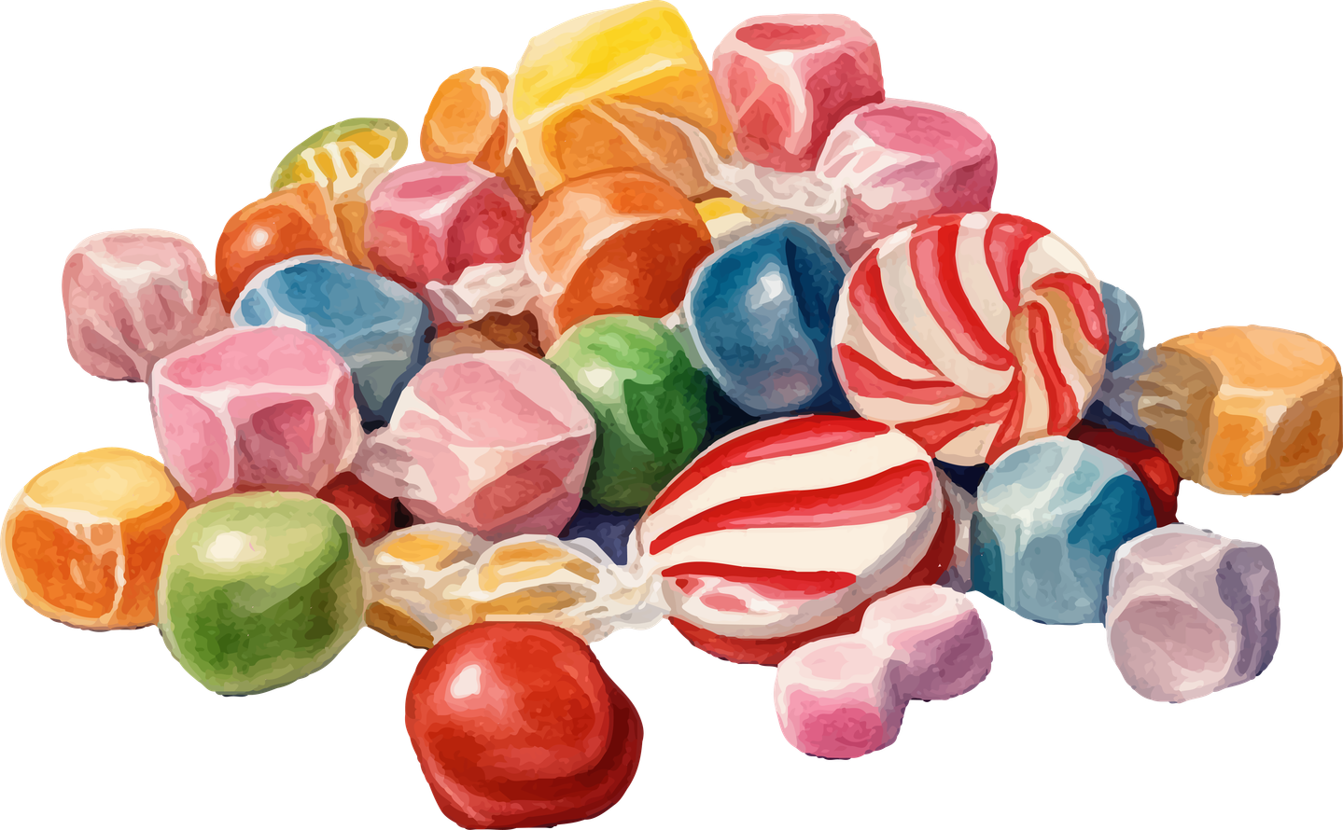

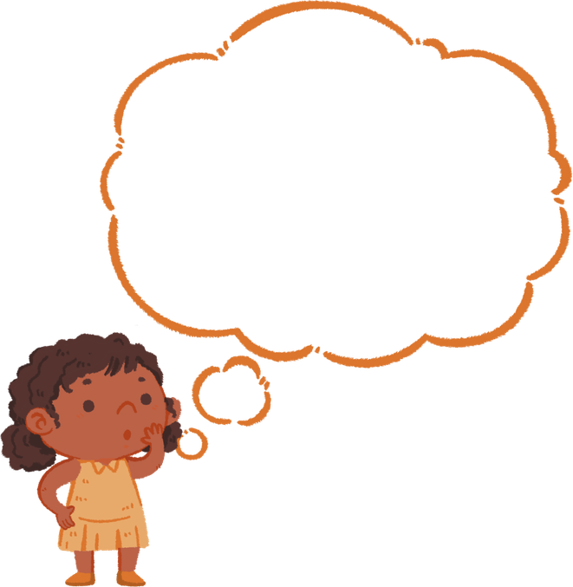
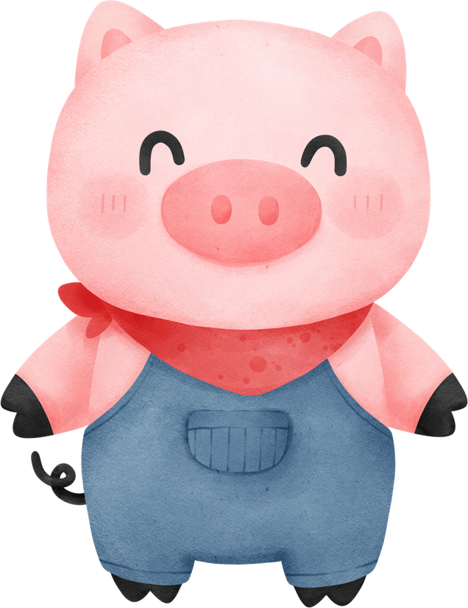
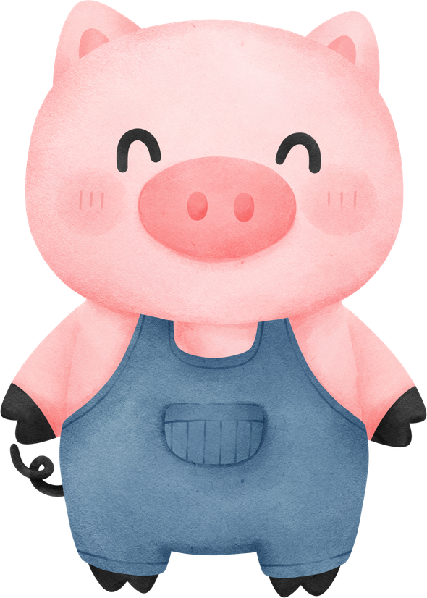

VOCABULARY
Opinion: What you think or feel about something; it’s not a fact.
Remember your
rule from our
Constitution lesson;
That was your
opinion.
Example: My opinion is that the pigs were too quick to judge the wolf.
Debate: A discussion where people share different ideas and try to explain their thinking.
Example: Later, in our debate, half of you will argue why the Wolf is innocent, and the other half why the pigs are right.
Argument: A reason or explanation to show why you think something is true.
ACHOO!
Example: My argument is that the Wolf sneezed accidentally, so he’s not a bad guy.
Fairness: Treating everyone equally and making sure things are right.
Example: It’s only fair to let the Wolf explain his side of the story before deciding what happened.
Evidence: Information or clues that show something is true.
Example: The Wolf’s evidence is that he had a cold and didn’t mean to blow down the houses.
  Perspective-taking: Trying to understand how someone else feels or sees something.
Example: If we take the Wolf’s perspective, we might see he was just trying to borrow some sugar.
Bias: A strong feeling that makes someone see things in a certain way, sometimes unfairly.
Example: The pigs might have a bias because they think the Wolf is always trying to hurt them.
Motivation: The reason why someone does something.
Example: The pigs motivation to build strong houses was to stay safe from the wolf.

Slide 5



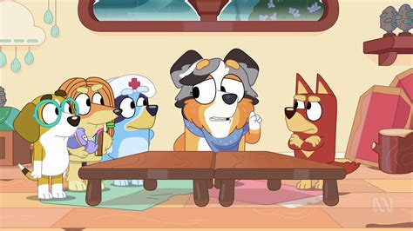
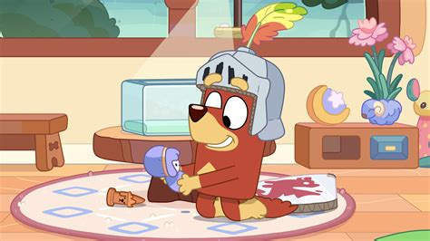
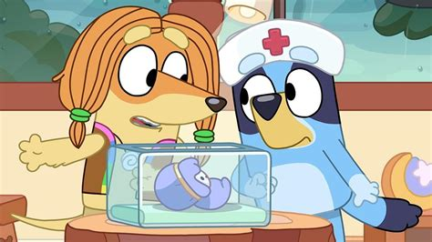
EARLY
BABY

Slide 6
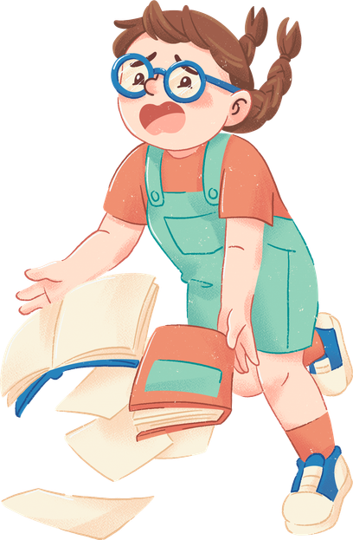
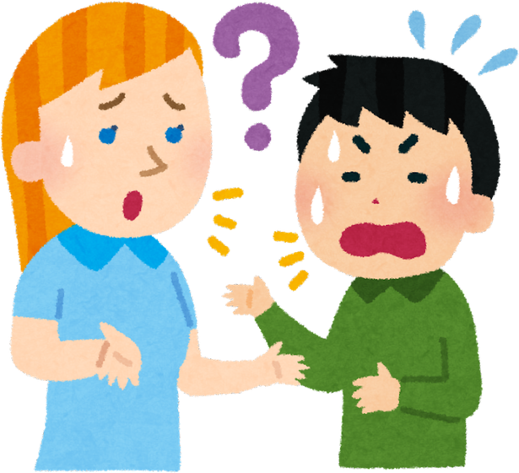
CONNECTION
Has there ever been a time when you felt misunderstood?
How do you feel when you’re trying to tell your side of the story to a teacher or parent, but someone has a different version to tell?
How does this make us feel?

Slide 7
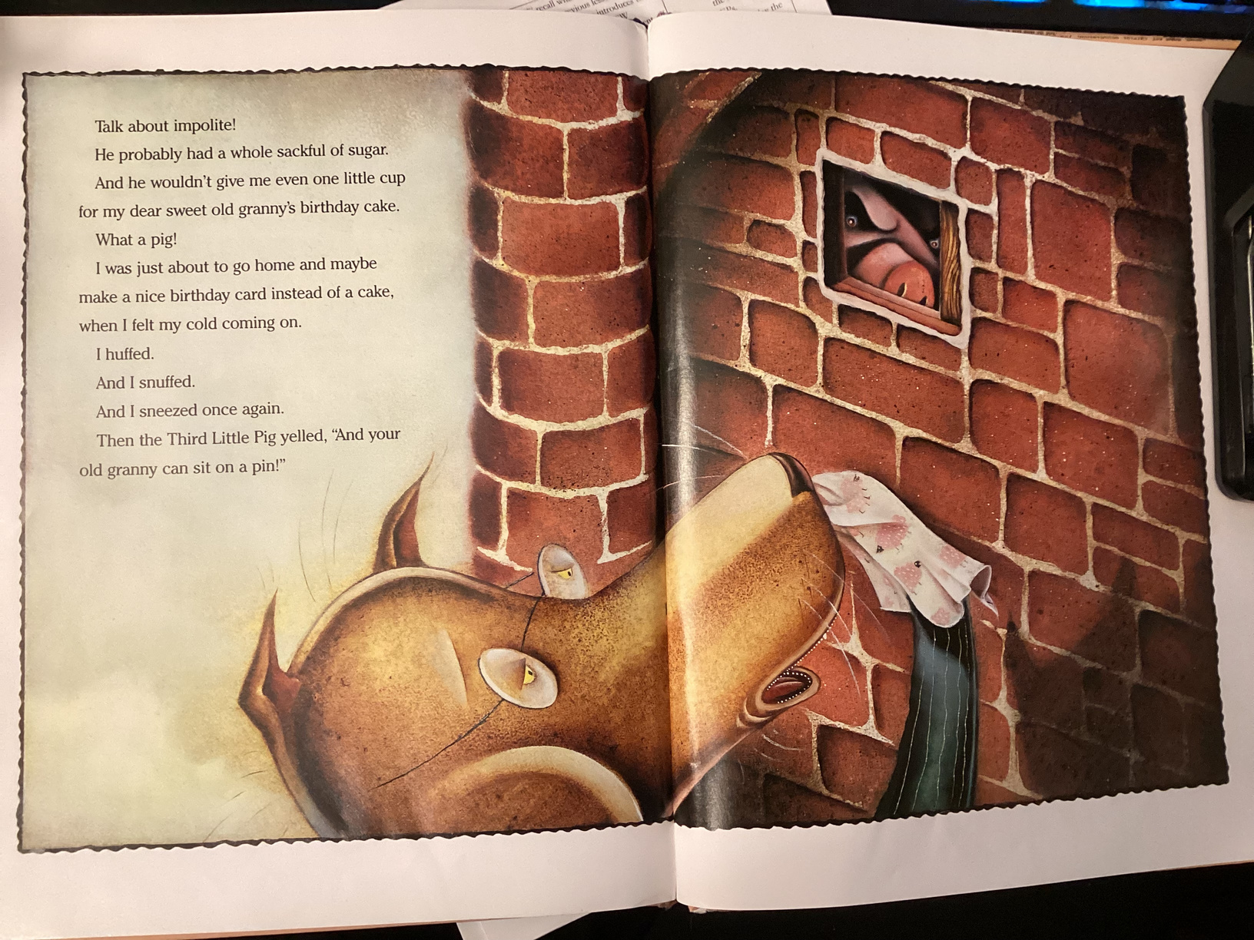
Think
Aloud
What do I see?
What do I read?
What do I think and feel?
But?

Slide 8
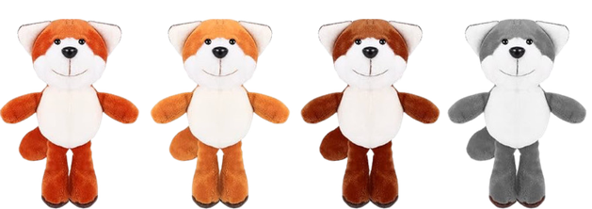

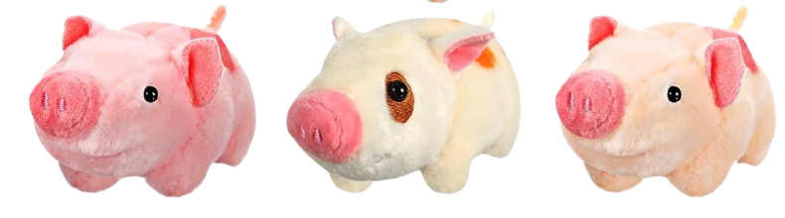
Think Pair Share
  Discuss and compare the wolf’s and pigs’ perspectives
Wolf & Pig Partners
2. Use evidence from the story

Slide 9
Class Debate
Continue your discussion from earlier.
Wolf team, you will focus on the wolf’s perspective, and Pig team, you will focus on the Pig’s perspective.
Use evidence from the story

Slide 10
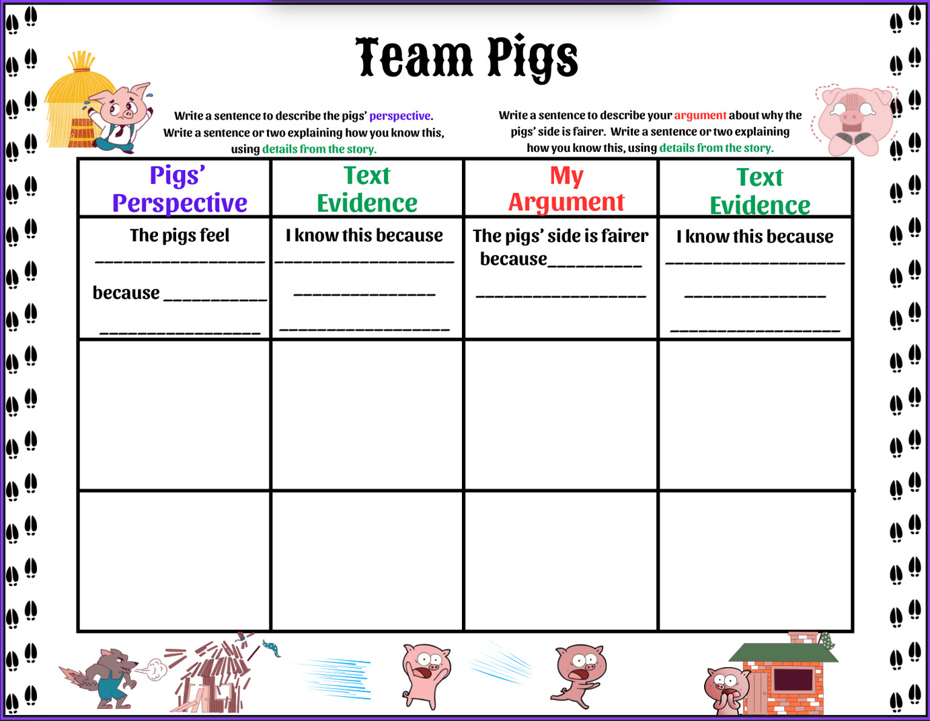
Modeling
Write a sentence to describe the your character’s perspective.
Write a sentence using details from the story to show how you know the character’s perspective
Write a sentence explaining how your character’s side of the story is fairer.
Write a sentence using details from the text to show how you know your character’s side is fairer.

Slide 11
Public Speaking Tips
1. Speak Loudly and Clearly
Make sure everyone can hear your ideas. Use your “outside voice,” but don’t shout.
2. Take Your Time
Speak slowly so your classmates can understand you.
3. Look at Your Audience
Try to look at your classmates or teacher when you are talking.
4. Stay on Topic
Talk about your character’s point of view and use reasons from the story.
5. Be Confident
Believe in what you’re saying! Your opinion is important.
6. Be Respectful
Listen when others are talking and wait for your turn to speak.

Slide 12

Debate Time
Choose a person from each team to present your
argument in front of the class.
Tell the class your findings and show us your debate sheet.

Slide 13
Let’s Reflect!
I can use evidence from the story to explain why characters
see things differently
Why is it important to understand different perspectives, even if we don’t agree with them?
Share a takeaway from the debate. What did you learn?
Let’s take a vote! Which perspective do you believe was fairer after hearing the evidence—the wolf’s or the pigs’?

