Slide 1
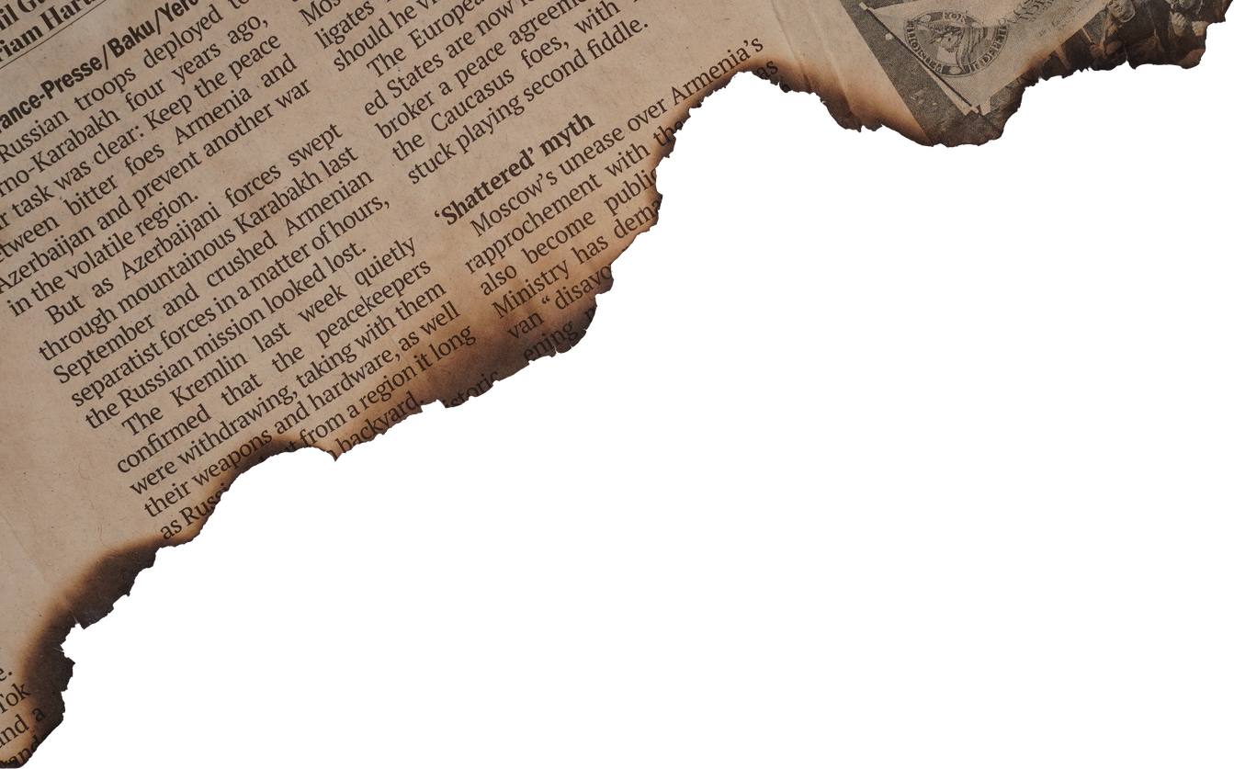
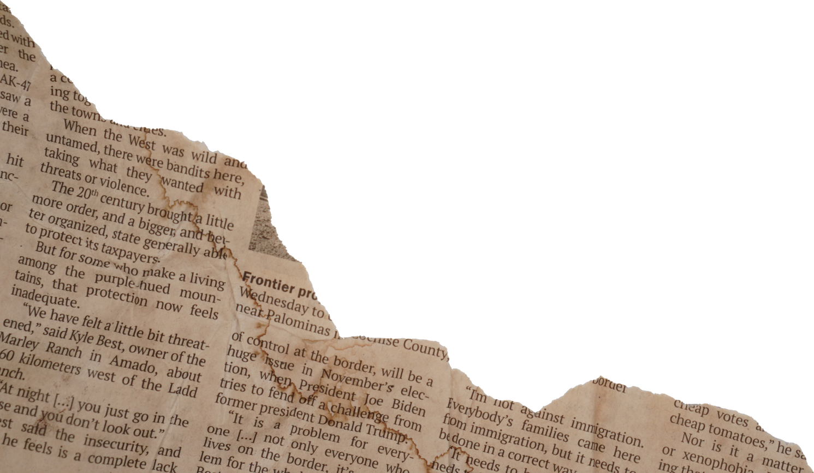
WHOSE SHOES
ARE THESE?
Exploring Perspectives

Slide 2
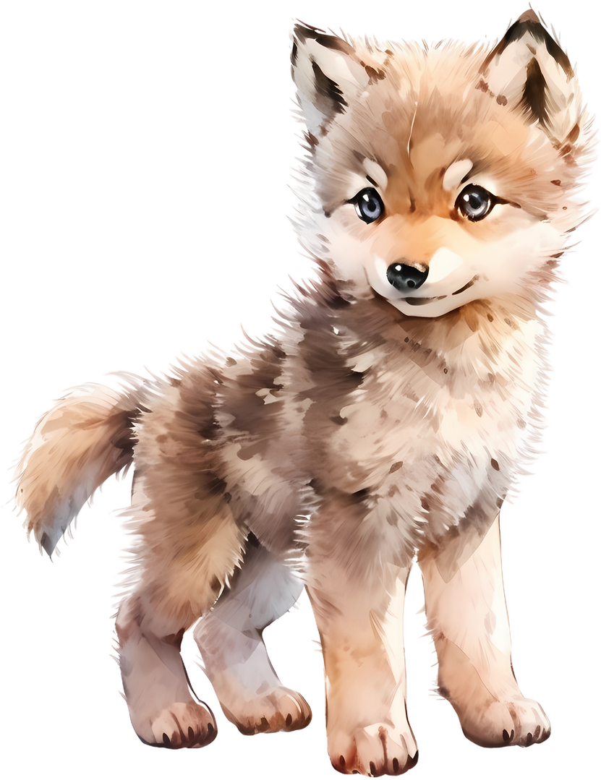
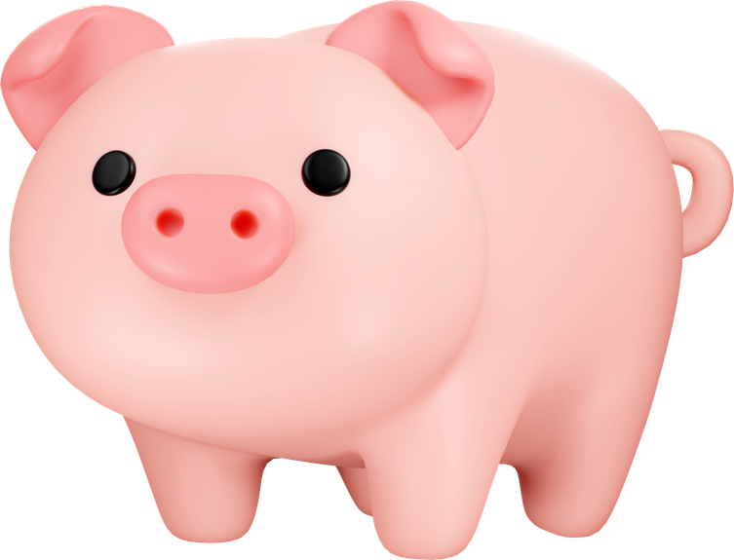

OBJECTIVES
Today we are going to explore different perspectives further. We will even create
our own scene from a new point of view.
Say it With Me
I can write a new version of a scene by imagining what another character thinks and feels.

Slide 3




VOCABULARY
Compare: To find how two or more things are alike
Example: Let’s compare the pigs in the story; they all build houses, that’s the same.
Contrast: To find out how two things are different.
Remember our Venn
diagrams from
Cinderella.
Example: The Wolf in the new story is funny, but in the traditional story, he seems mean. That’s a contrast!
Analyze: To look at something carefully to understand it better.
Example: We’re going to think carefully about why the pigs built their houses out of straw, sticks, and bricks.
Point of View: The way someone sees or tells a story.
Example: In the traditional story, the pigs tell the story, but in the new book, we hear the Wolf's point of view.
Compose: To create or write something.
Example: Today we will compose a scene for the story from a different perspective.
Perspective: How someone thinks or feels about something based on their experiences.
Example: In the traditional story, the pigs tell the story, but in the new book, we hear the Wolf's point of view.
Bias: A strong feeling that makes someone see things in a certain way, sometimes unfairly.
Example: The pigs might have a bias because they think the Wolf is always trying to hurt them.
Empathy: Understanding how someone else feels.
Example: When we show empathy, we might try to imagine how the pigs felt when their houses fell. down.
Dialogue: The words characters say to each other in a story.
“Gryffindor!”
Example: The Wolf’s dialogue was, “Little pig, little pig, let me come in!”

Slide 4


VIDEO TIME

Slide 5
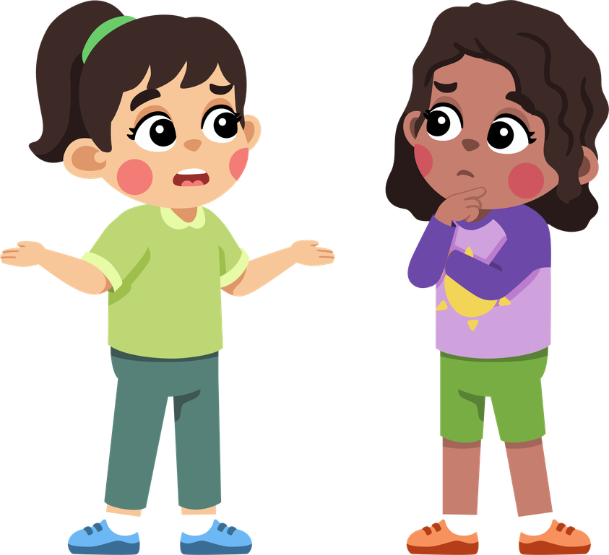
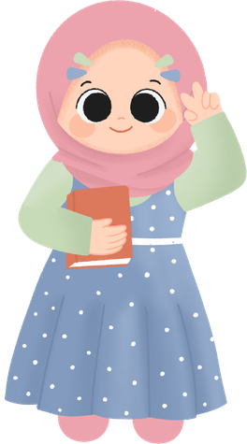
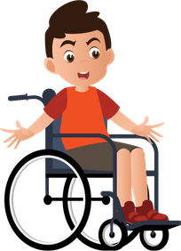
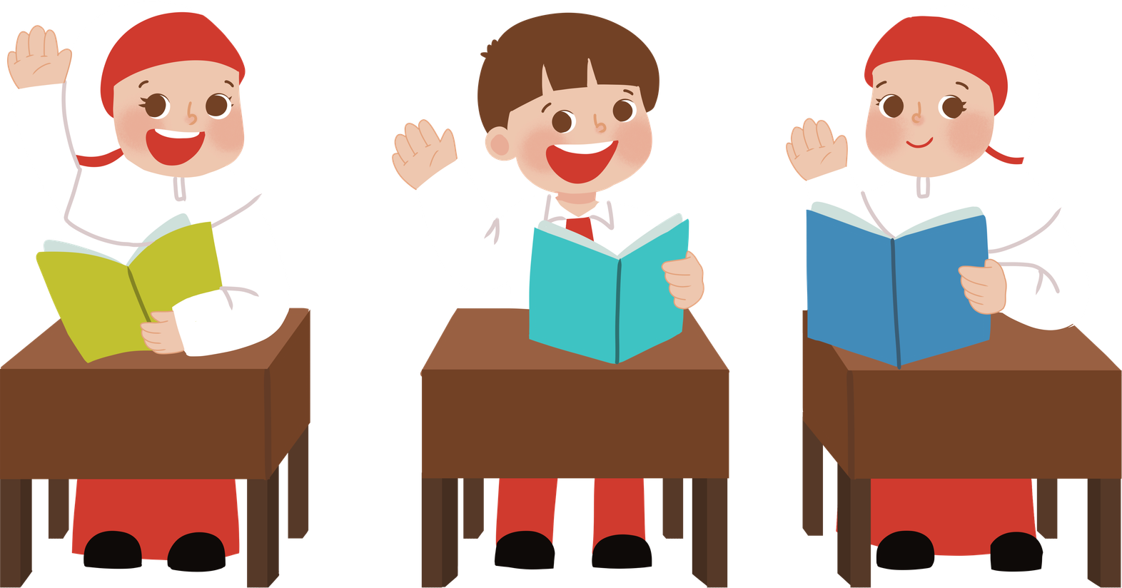
THINK PAIR SHARE
Turn to your pig or wolf partner from yesterday.
What did you learn about understanding someone else's perspective?
How can seeing things differently help us in real life and in stories?

Slide 6

DIFFERENT
PERSPECTIVES
Just like in the video, different characters in a story may have different perspectives.
We are going to explore this idea by looking at both versions of “The Three Little Pigs” and imagining how the story might change if it was told by a different character.

Slide 7
TRADITIONAL VERSION
Introduction: Three pigs leave home to build their own houses.
First Pig: Builds a house out of straw.
The Wolf comes, blows the straw house down, and the pig runs to his brother’s house
Second Pig: Builds a house out of sticks.
The Wolf comes, blows the stick house down, and both pigs run to their brother’s house
Third Pig: Builds a house out of bricks.
The Wolf tries to blow it down but fails.
He climbs down the chimney, but the pigs light a fire, and the wolf burns his tail.
Ending: The wolf returns to the village, but is afraid when he sees three chimneys.
The wolf vows never to come back again, and the pigs dance happily.

Slide 8
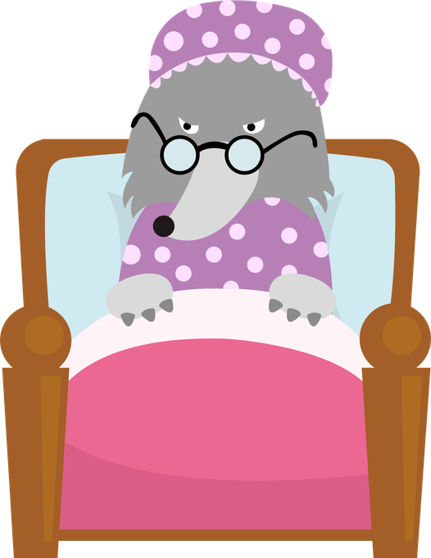



TRUE STORY OF THREE LITTLE PIGS
Introduction: The Wolf explains he was baking a cake for his granny and needed sugar.
First Pig: The Wolf visits the straw house to borrow sugar.
He sneezes accidentally (due to a cold), and the house collapses.
The pig is already dead under the rubble, so the Wolf eats him to avoid waste.
Second Pig: The Wolf visits the stick house to borrow sugar.
He sneezes again, and the house collapses.
The second pig is also dead, so the Wolf eats him too.
Third Pig: The Wolf visits the brick house to borrow sugar.
The third pig refuses to help and insults the Wolf’s granny.
The Wolf loses his temper and causes a scene.
Ending: The police arrive and arrest the Wolf.
The Wolf claims the story of him being a "Big Bad Wolf" is unfair and exaggerated.
UH-OH
ACHOO!

Slide 9

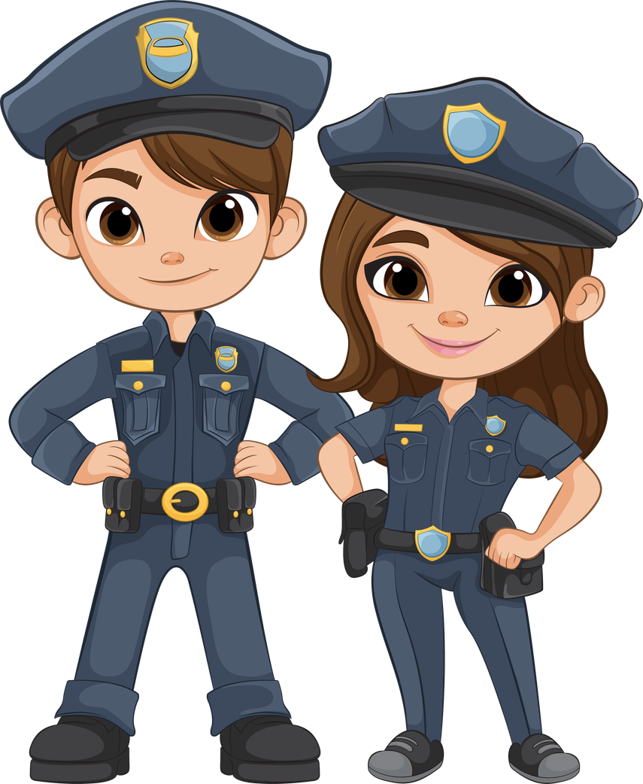
NEW PERSPECTIVES
New Characters
Think
Pair
Share
New Viewpoint
UPS driver delivering a package
He/she could say what was really said. Maybe the driver witnessed a fight breaking out.
A ghost that lives in the attic
UPS

Slide 10
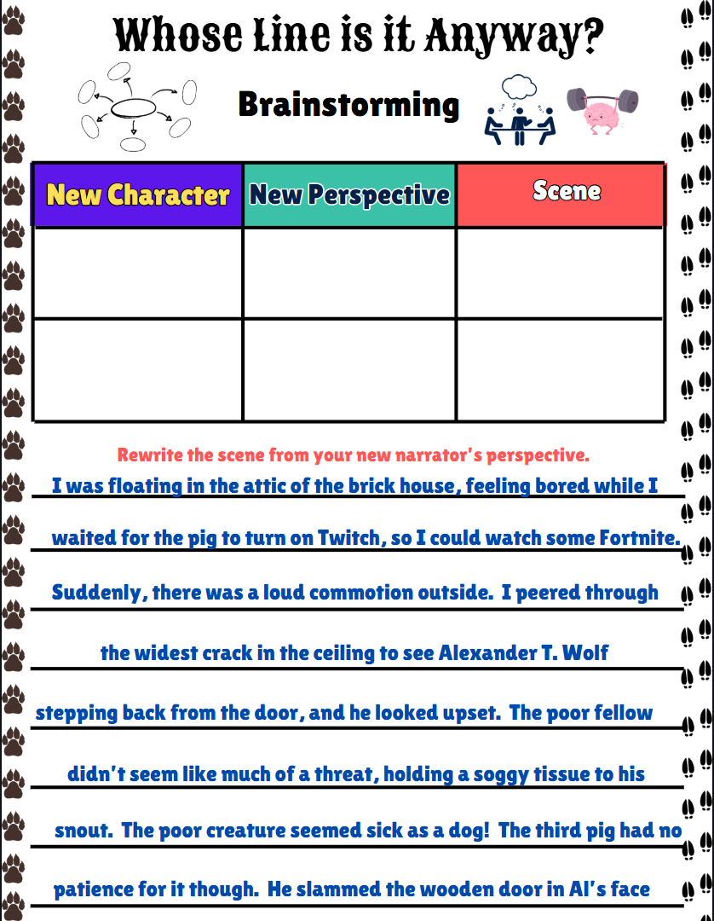
NEW PERSPECTIVES

Slide 11
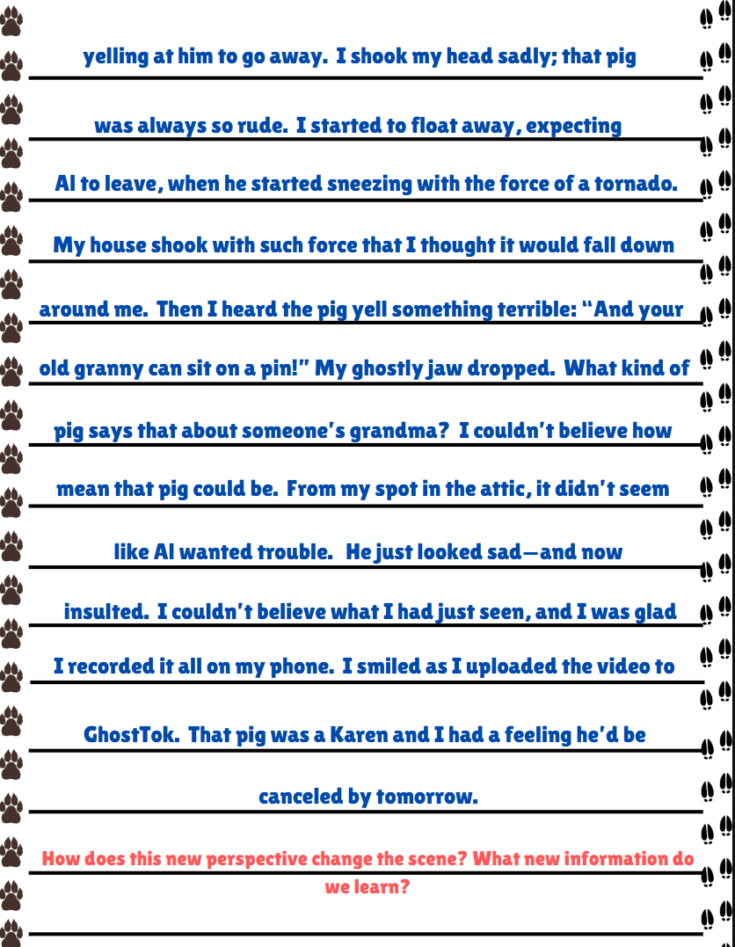
NEW PERSPECTIVES

Slide 12
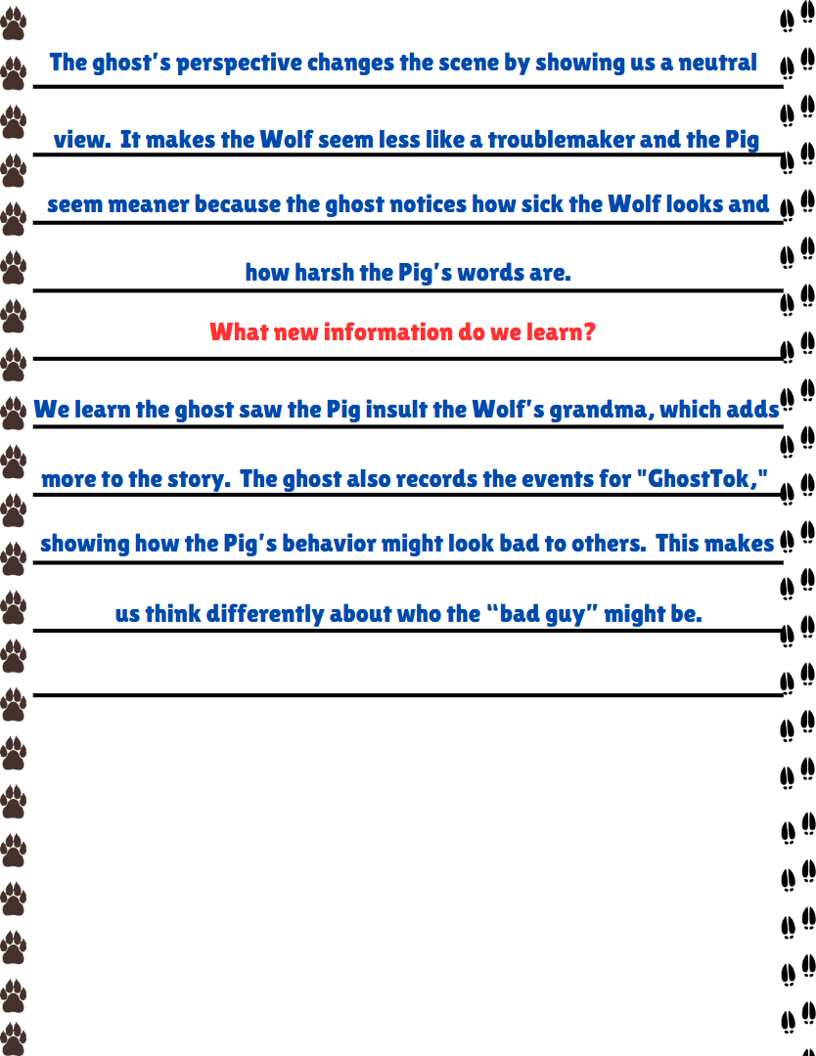
NEW PERSPECTIVES

Slide 13
GHOST MOVIE

Slide 14
LET’S REFLECT
I can write a new version of a scene by imagining what another character thinks and feels.
How do you think the pigs and the wolf would describe each other after the story?
Just like the pigs and the wolf might see each other differently after the story, we often see people differently after we've had experiences with them. Think about how understanding someone else’s side of the story could change how you describe them or how you feel. For example, if you and a friend have a disagreement, seeing things from their perspective might help you better understand each other.

