Slide 1



From We the People,
to We the Class

Slide 2

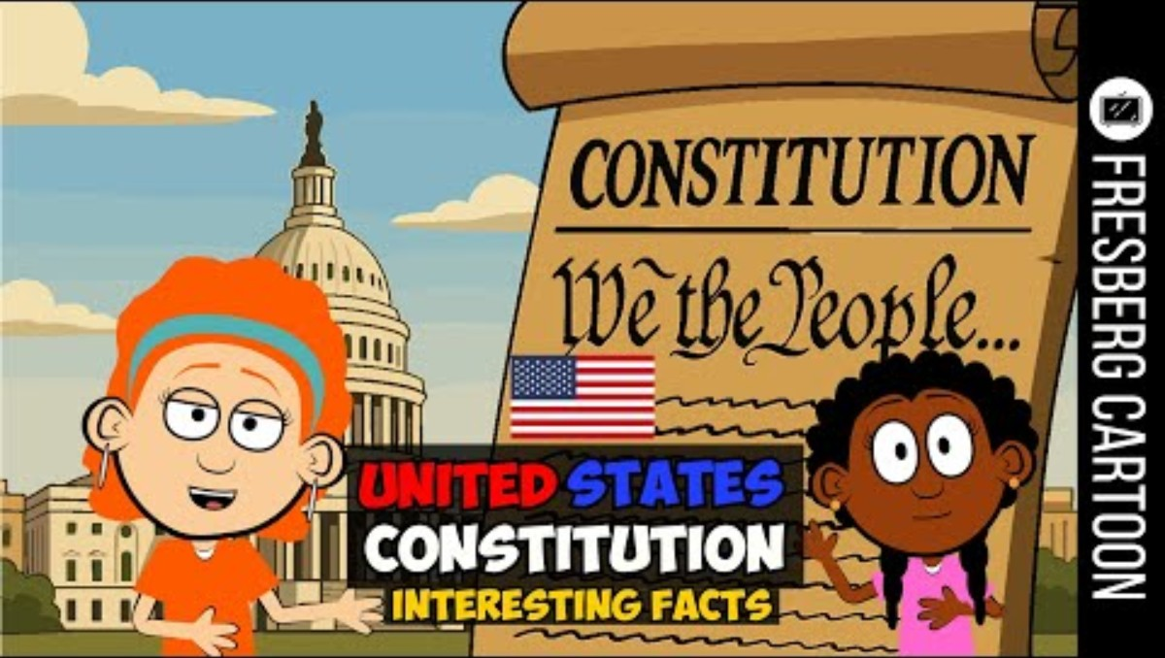
Video Time
Teacher Note: Play approximately the first minute of the video to introduce the purpose of rules and communities. Pause before the video begins explaining the Constitution in detail.

Slide 3

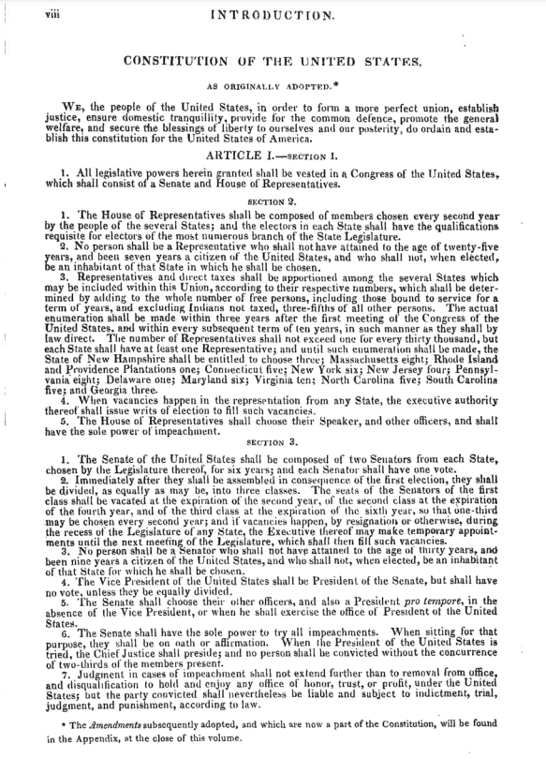
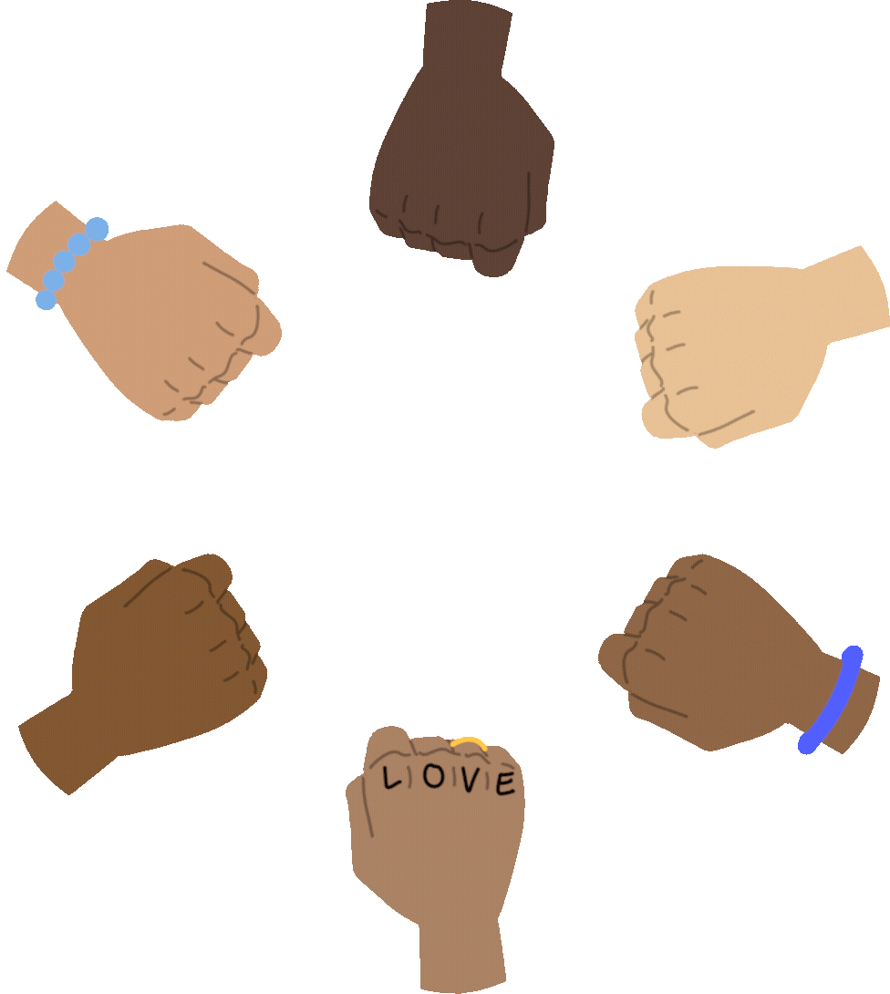
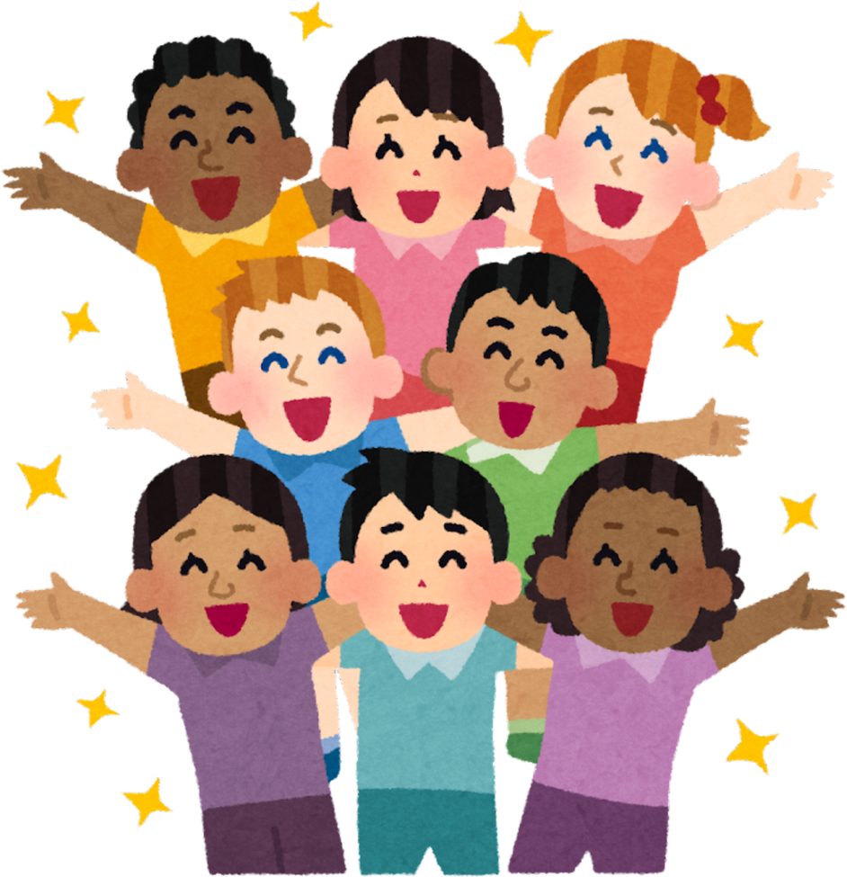
What is the constitution?
A constitution is a special set of rules that everyone agrees to follow. Just like the rules we have at school, the U.S. Constitution helps everyone in our country get along and be safe. Today, we are going to learn how important these rules are and how we can make our own classroom constitution to help us learn and have fun together!

Slide 4


Essential Questions
Why do we need rules to make our classroom a happy and safe place?
Why do you think we have a constitution?
How does this help us as a country?

Slide 5
I need a volunteer
What was wrong with that situation?
What should have happened?
Let’s try that again.
Teacher Note: Model a classroom conflict (example: refusing to share markers, cutting in line, or interrupting a classmate). Ask students to identify what went wrong and how rules help solve the problem.

Slide 6
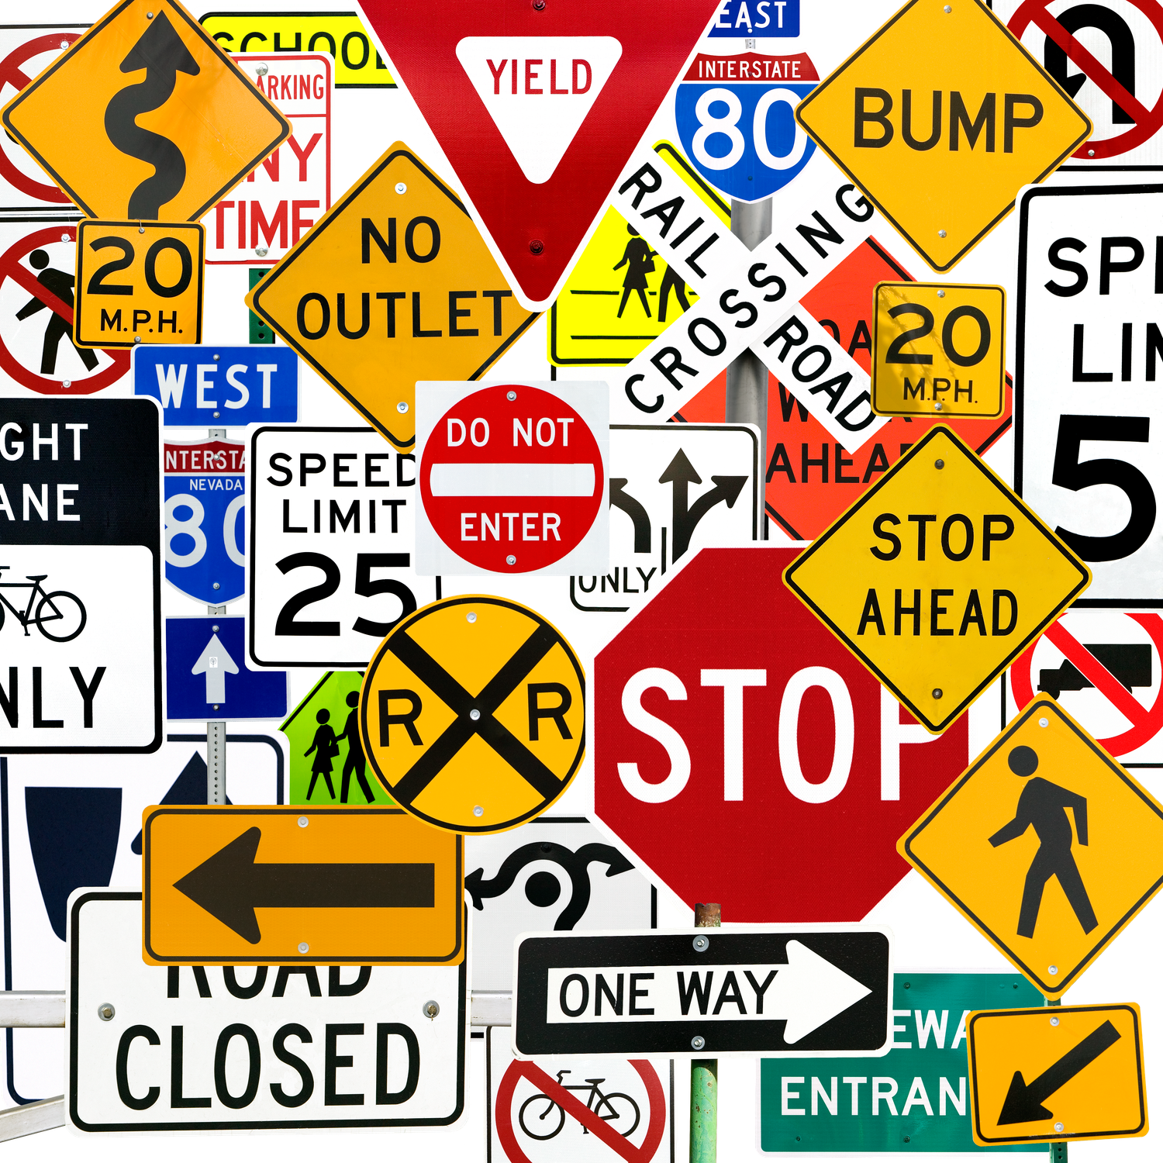
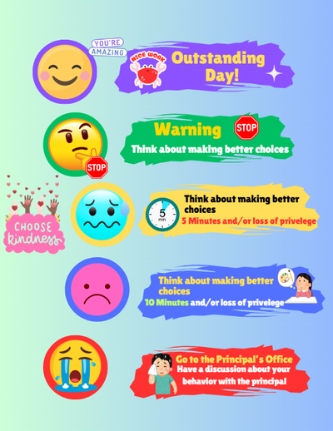

What are the Rules?
School
Home
Teacher Note: This lesson works best when students compare the Constitution to rules they already follow. Consider replacing these examples with your classroom expectations or school behavior matrix.

Slide 7
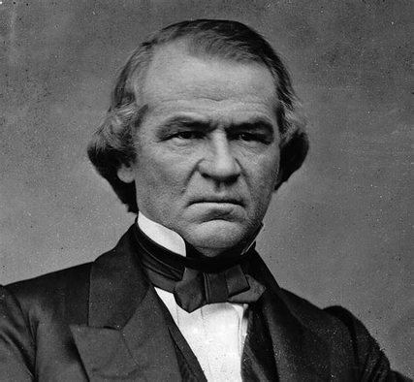

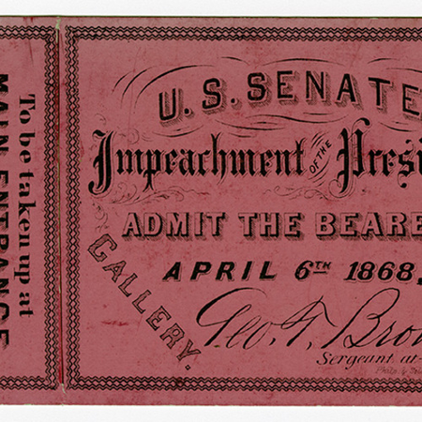

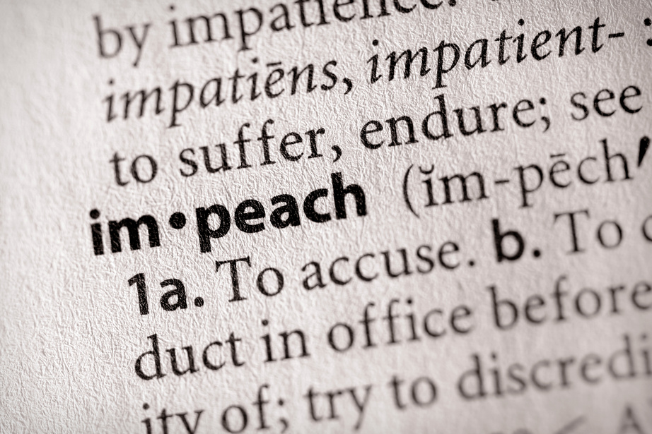
Does Everyone have to follow the Constitution?
Does the principal have to follow the school rules?
Does the president have to follow the constitution?
What would happen if people only followed the rules when they wanted to?
Archives of Appalachia

Slide 8
Now Let’s Make Our Own Constitution!

Slide 9

Our Rules
Treat everyone with kindness and respect.

Slide 10
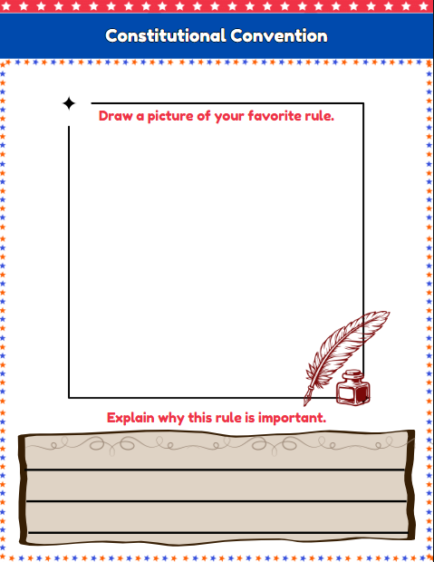


Slide 11
Peer Talk
  Tell your partner about your rule.
2. Tell them why you chose it.

Slide 12

Voting Time!

Slide 13
It’s Time to Sign our Constitution!
We the class of (your school name here)

Slide 14
Let’s Reflect
Why do we need rules to make our classroom a safe and happy place?
Do you think the rules we chose are fair to everyone? Why or why not?
If you were a teacher, would you choose the same rules? Why or why not?

Slide 15
Remember, just like in our country, everyone’s voice matters. And these rules are here to make things fair and safe for everyone

