Slide 1
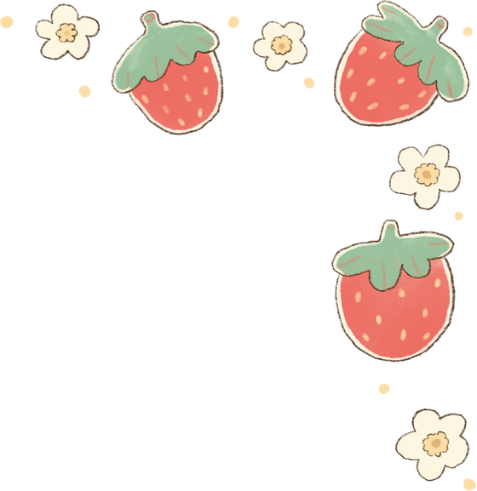
MISS T’S
BUDGET
SCHOOL

Slide 2

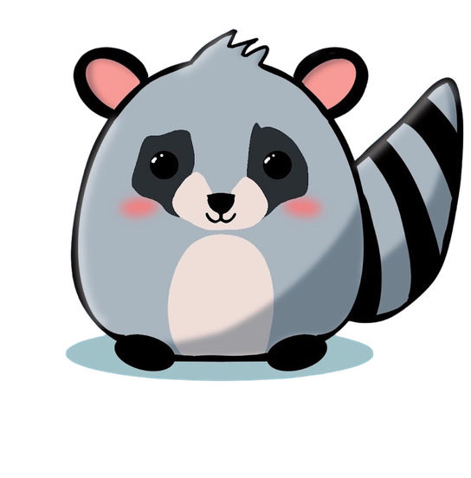


INTRODUCTION

Slide 3
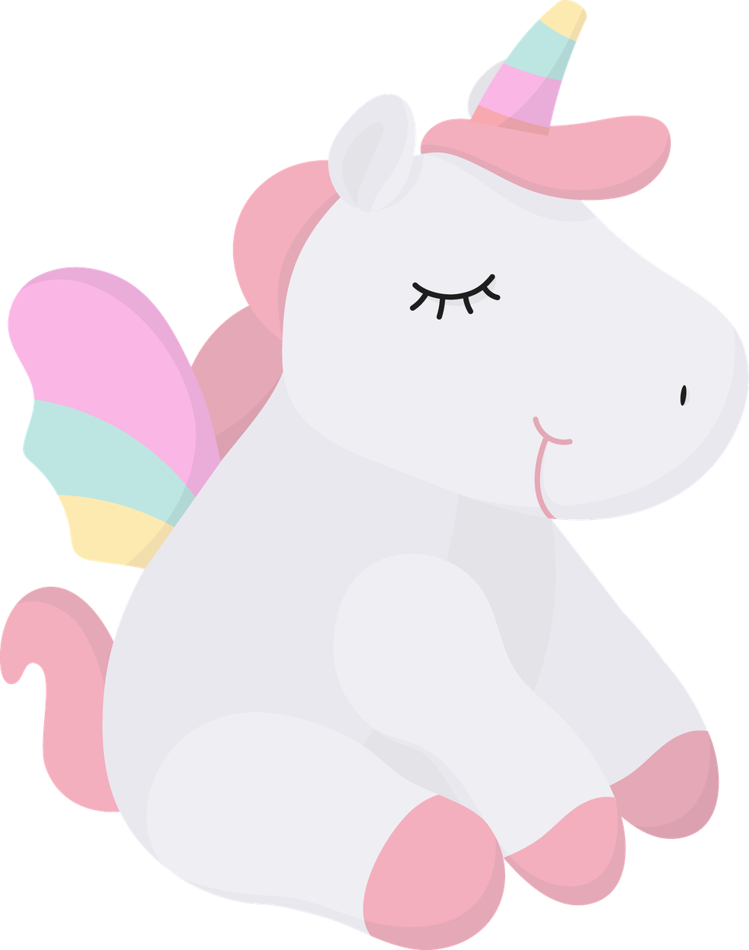

QUESTION
Have you ever wanted something you didn’t have enough money to buy?
What happened?
Could we figure out a way to buy the item?

Slide 4
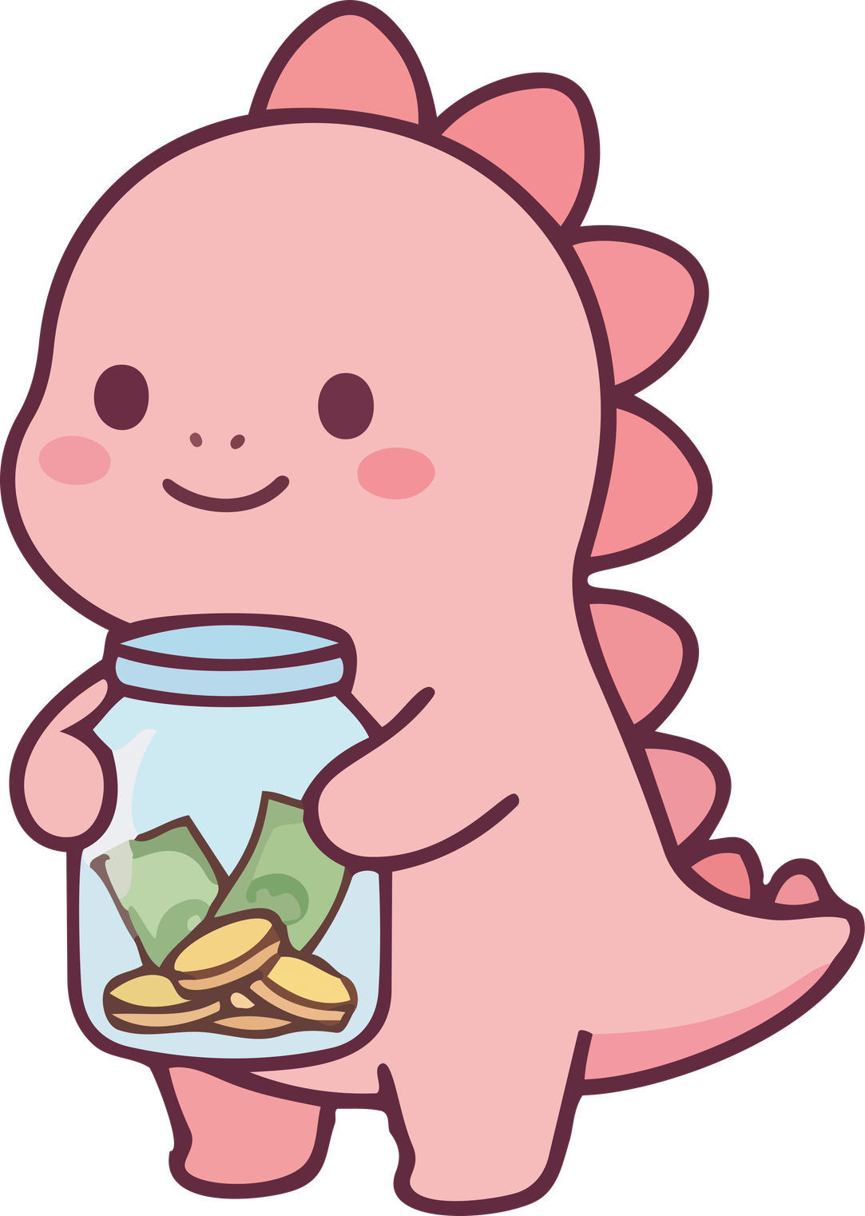
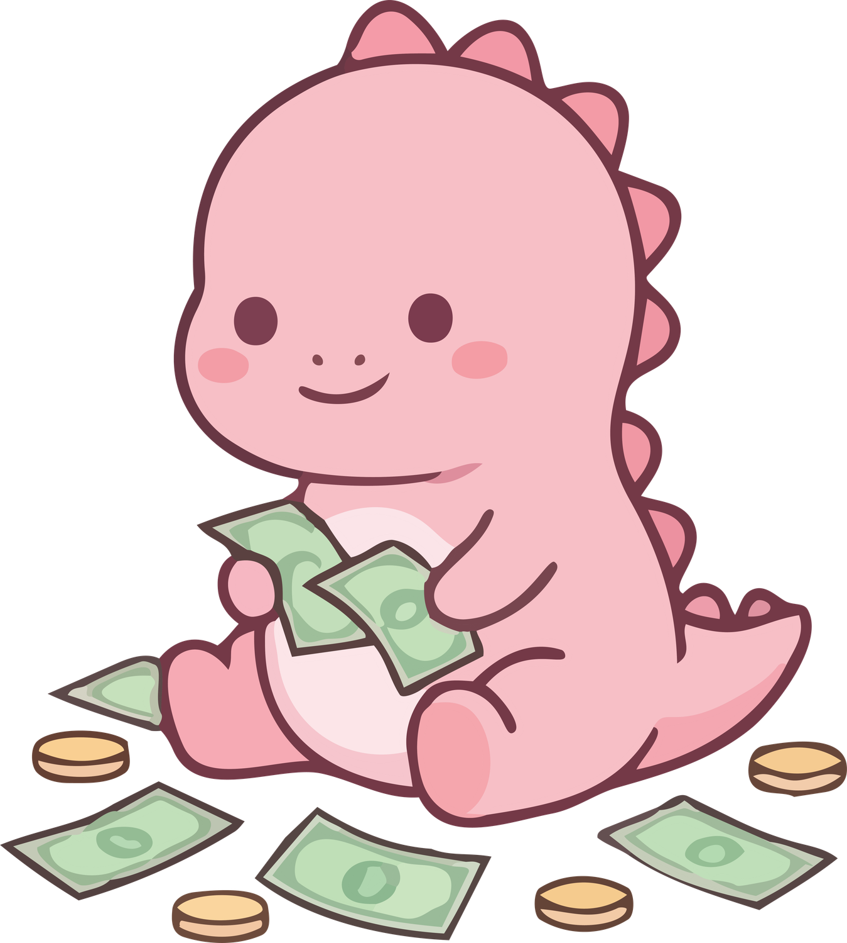
OBJECTIVES
Know the purpose of a budget & explain it in your own words.
“I can spend within a budget”
“I can prioritize my spending”

Slide 5

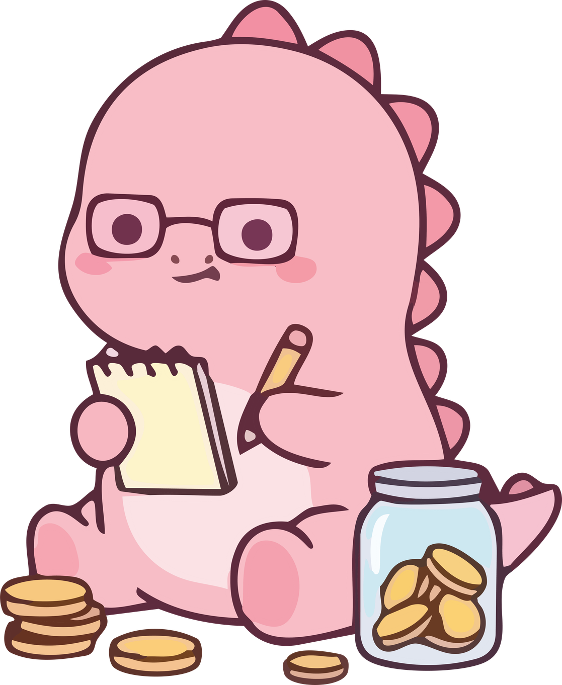
A budget is a plan that helps people save and make the best use of their money. It helps you understand how much money you have and what you spend your money on .
WHAT IS A BUDGET?

Slide 6


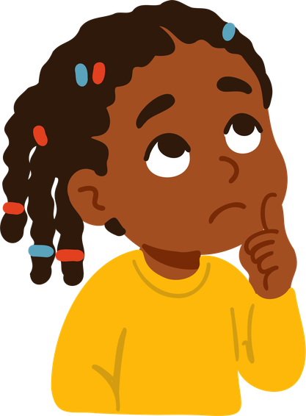
VOCABULARY
Need: A requirement; something that is essential. We need water and food to live.
Want: Something desired; not necessary for survival. We might want a new video game but do not need it to live.
Prioritize: To choose which things are more important than others.

Slide 7
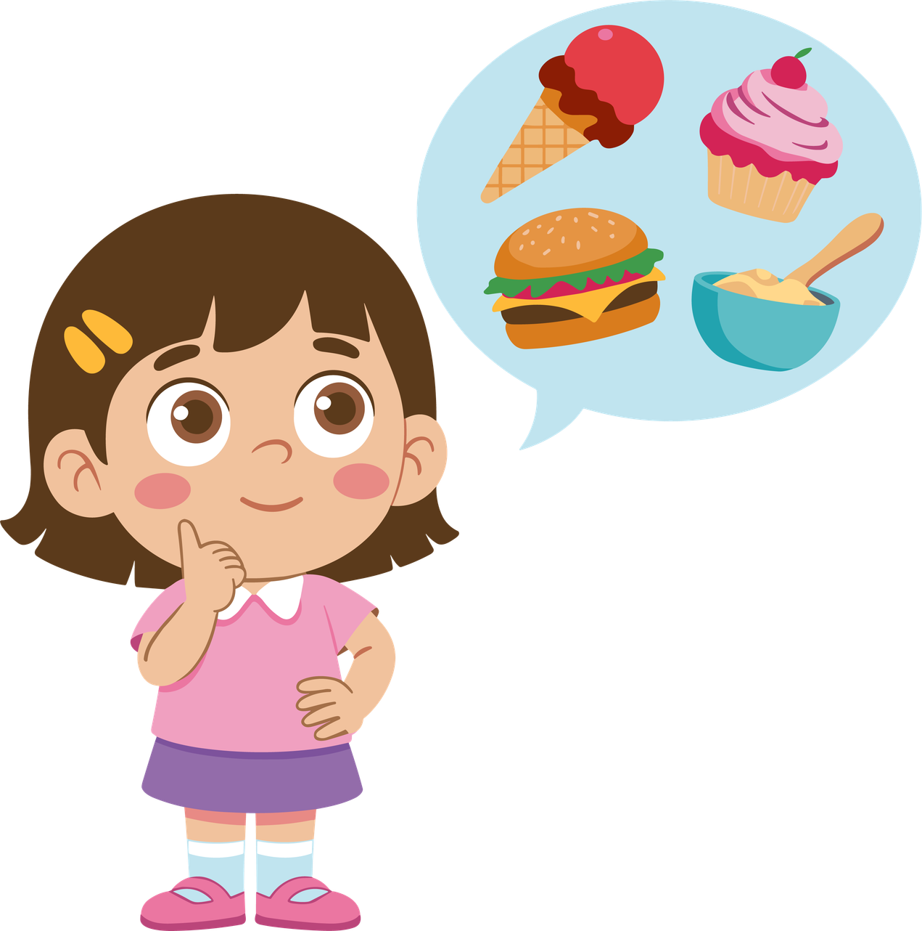
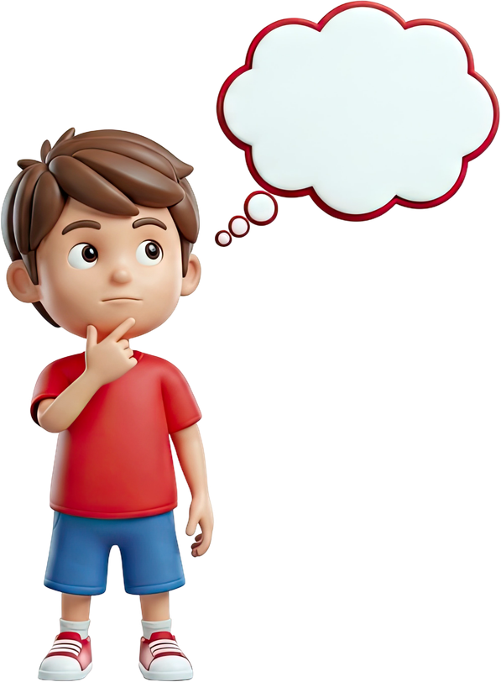

PRIORITIZATION
When we choose priorities for our budget, needs always come first! We can make a plan to get the things we want, but we need food, shelter, and other things first.
Even when our needs are met, we may still need to make difficult choices.

Slide 8
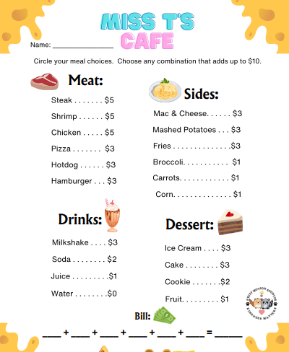
MISS T’s CAFE
You have a budget of $10 to choose any combination of food you want.
Consider your needs like feeling full & healthy and eating vegetables.
Add your total at the bottom of your worksheet and count out your dollars to pay the check.

Slide 9
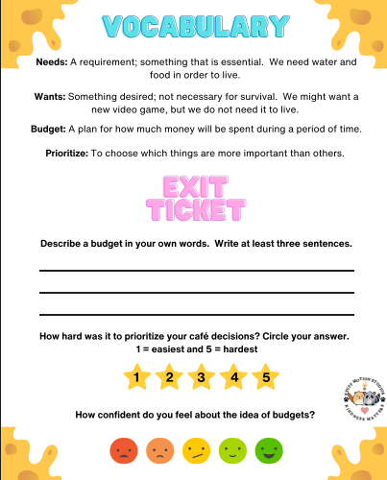
EXIT TICKET
Describe a budget in your own words.
How hard was it to prioritize your cafe choices?
How confident do you feel about budgets?

