Slide 1
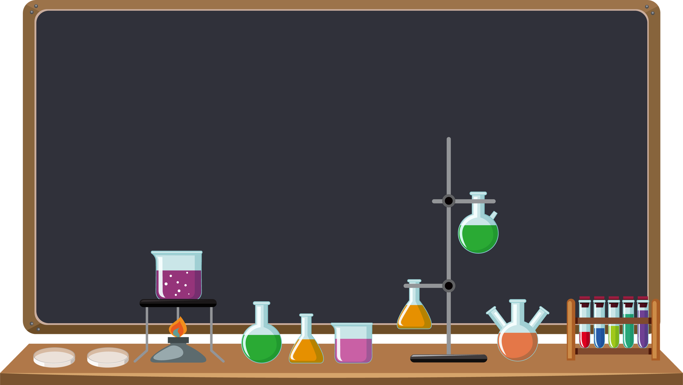
Welcome
Scientists!
Friction

Slide 2
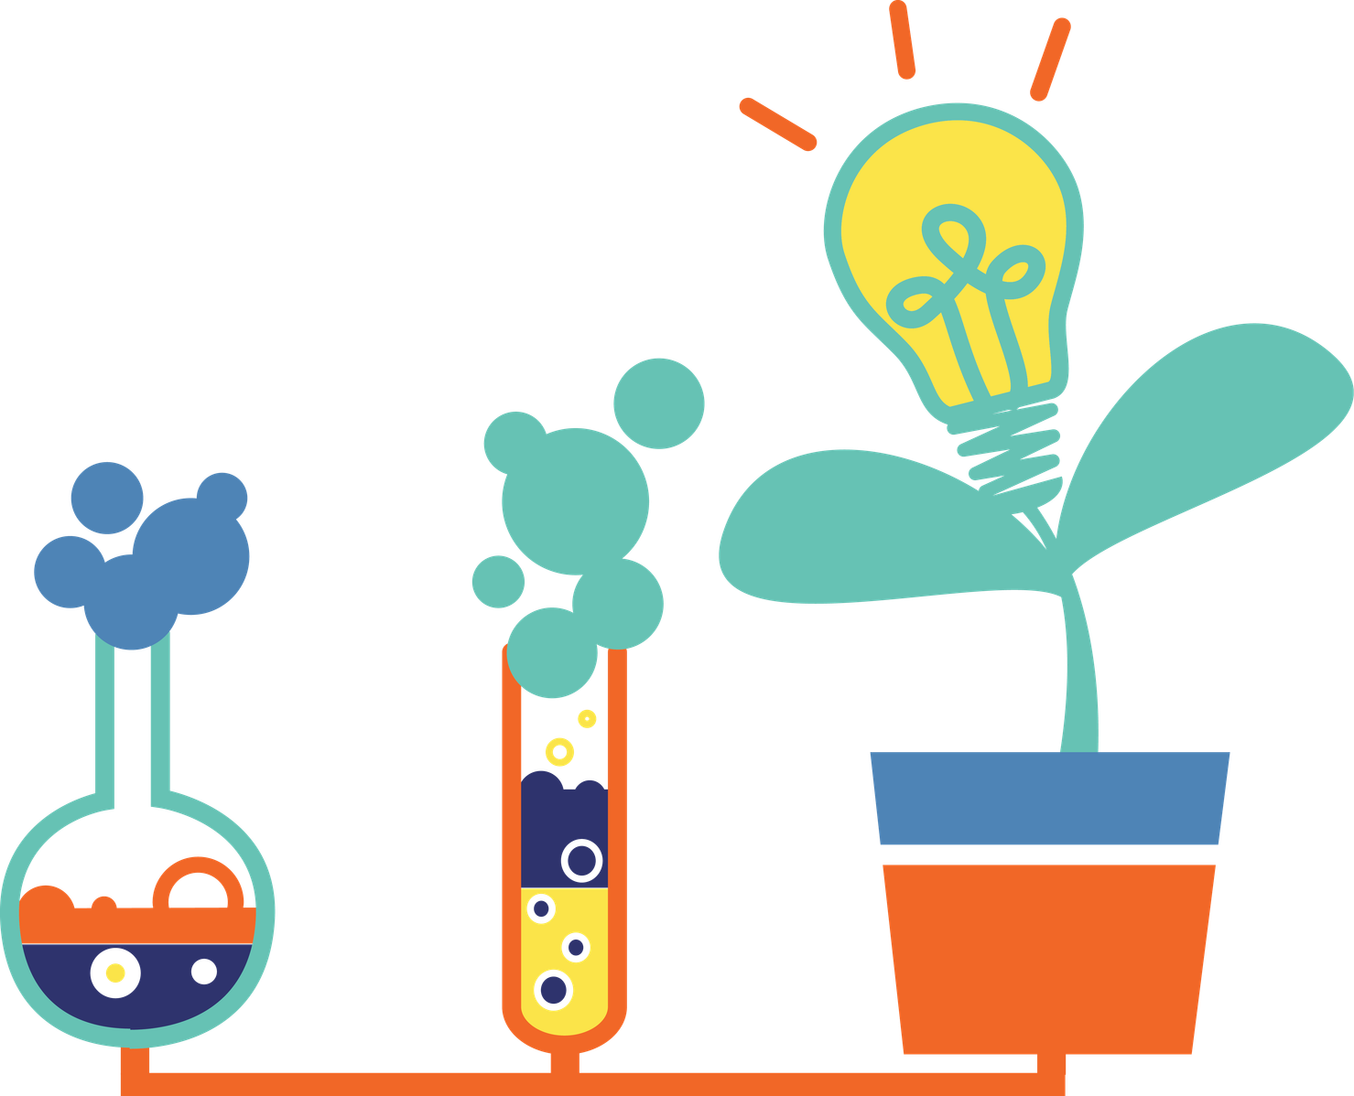


Slide 3


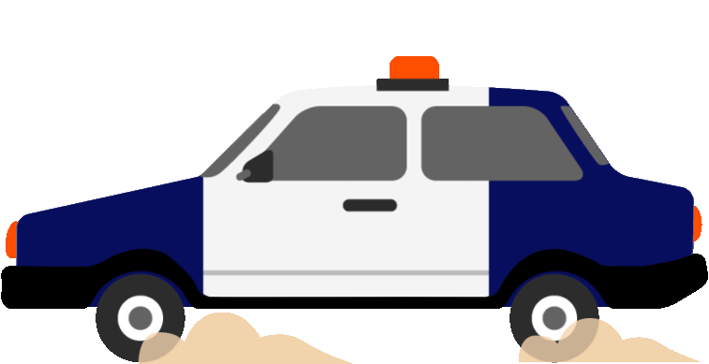

Motion

Slide 4

Friction
Friction makes things slow down or stop.
It happens when surfaces
rub together

Slide 5
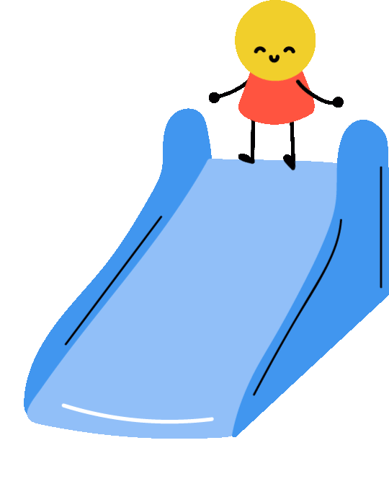



Smooth vs. Rough
Smooth surfaces, let objects move easily because there is less friction.
Rough surfaces, make it harder for things to move because there is more friction.
Without even knowing it, you were thinking about friction!

Slide 6
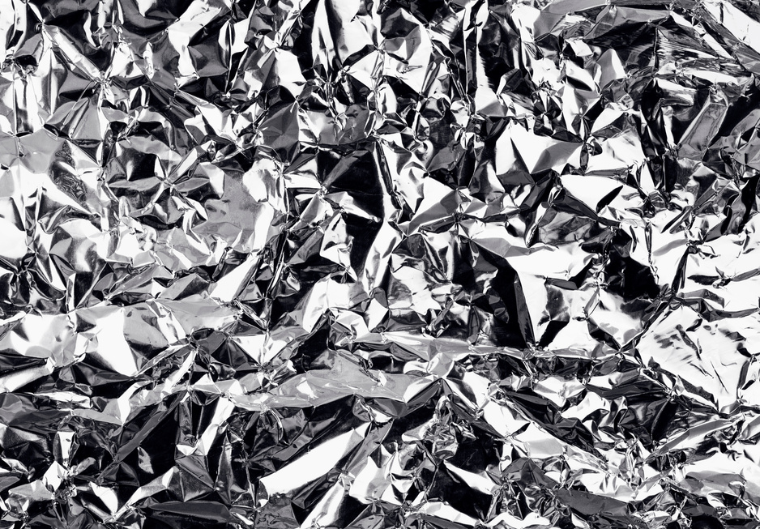

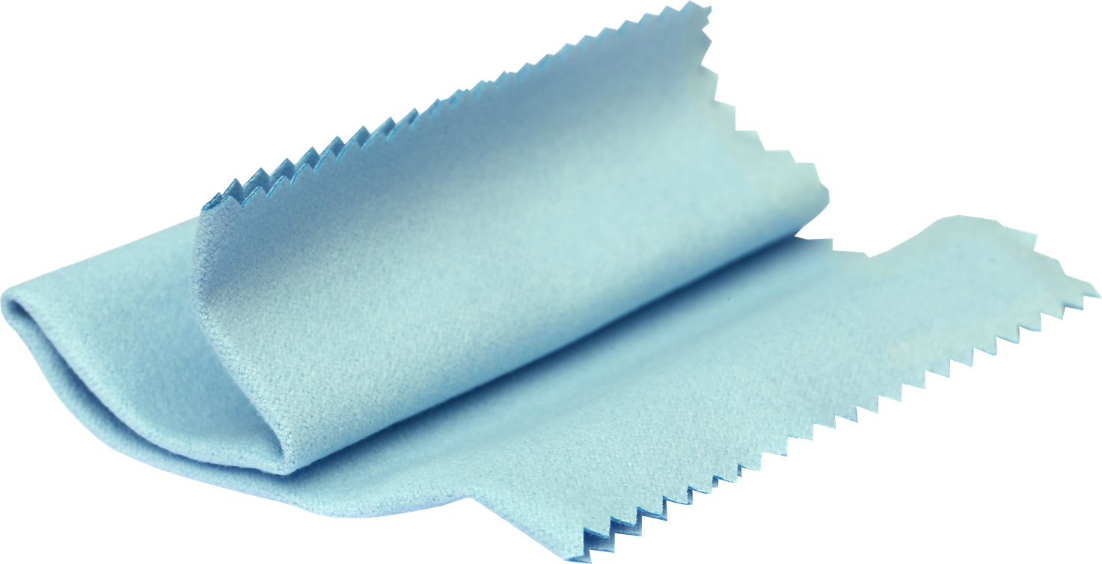
Hypothe-what?

Slide 7
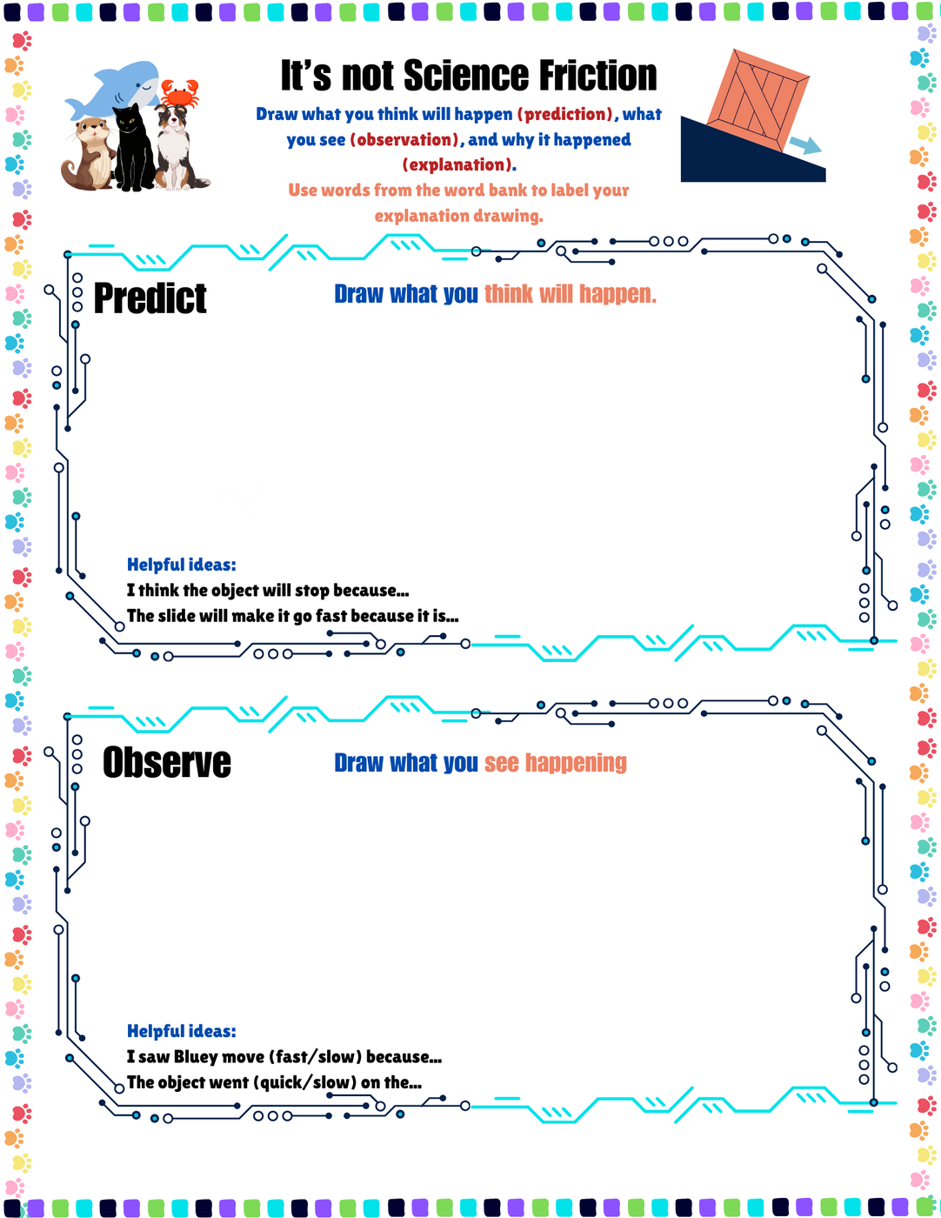
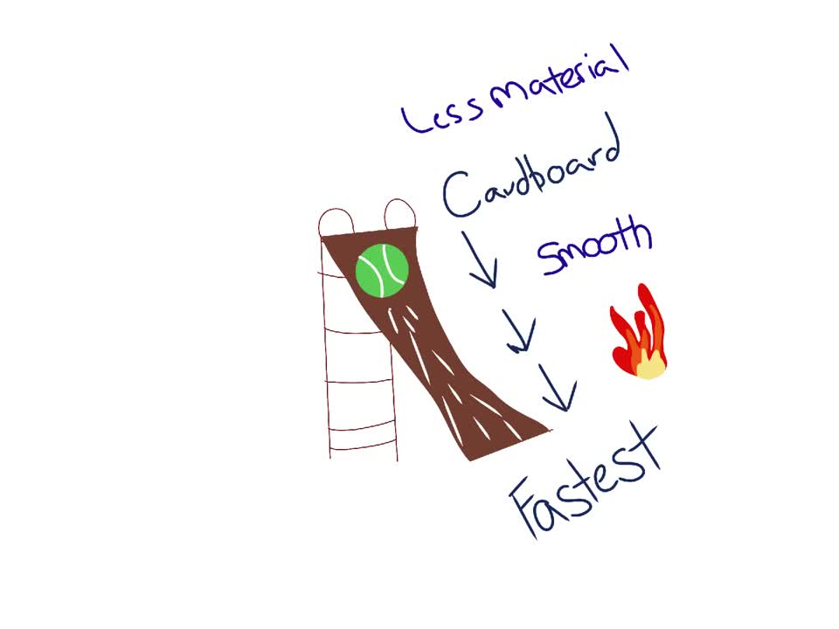
What do you think?

Slide 8
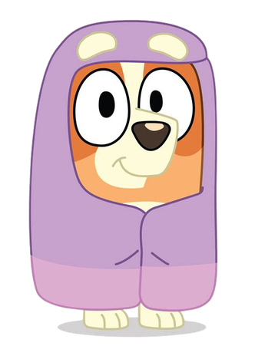

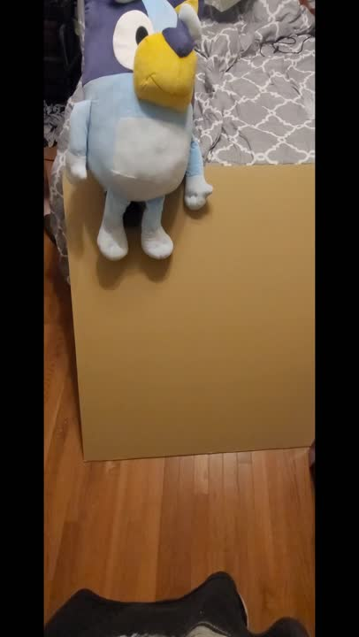
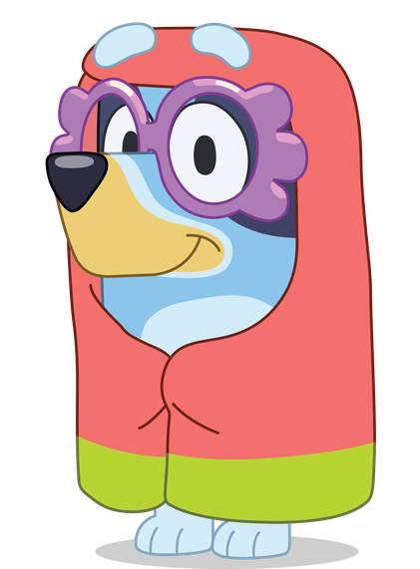

Ex 1: Cardboard

Slide 9
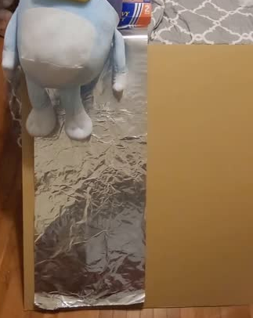
Ex 2: Foil

Slide 10
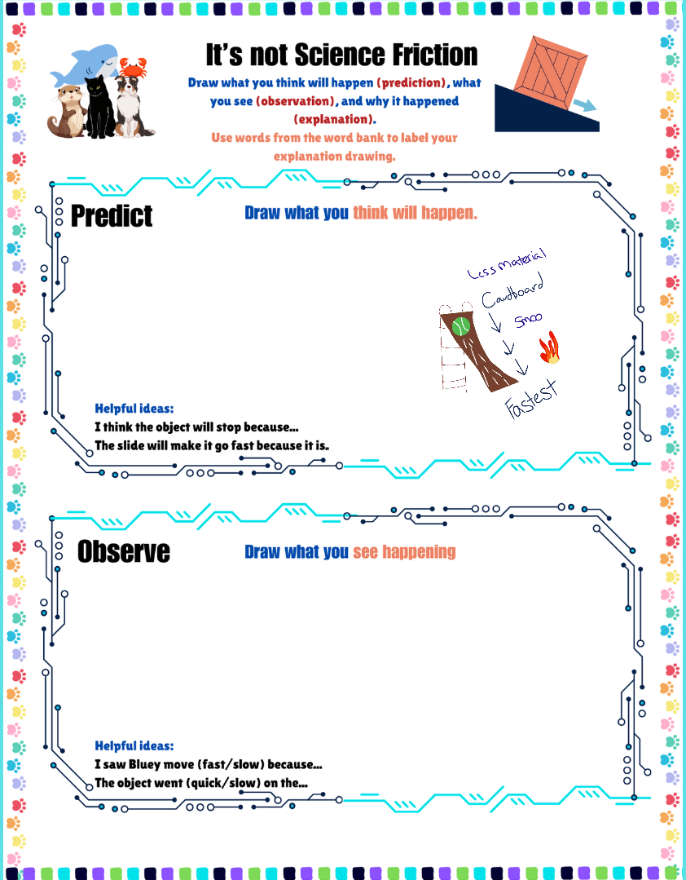
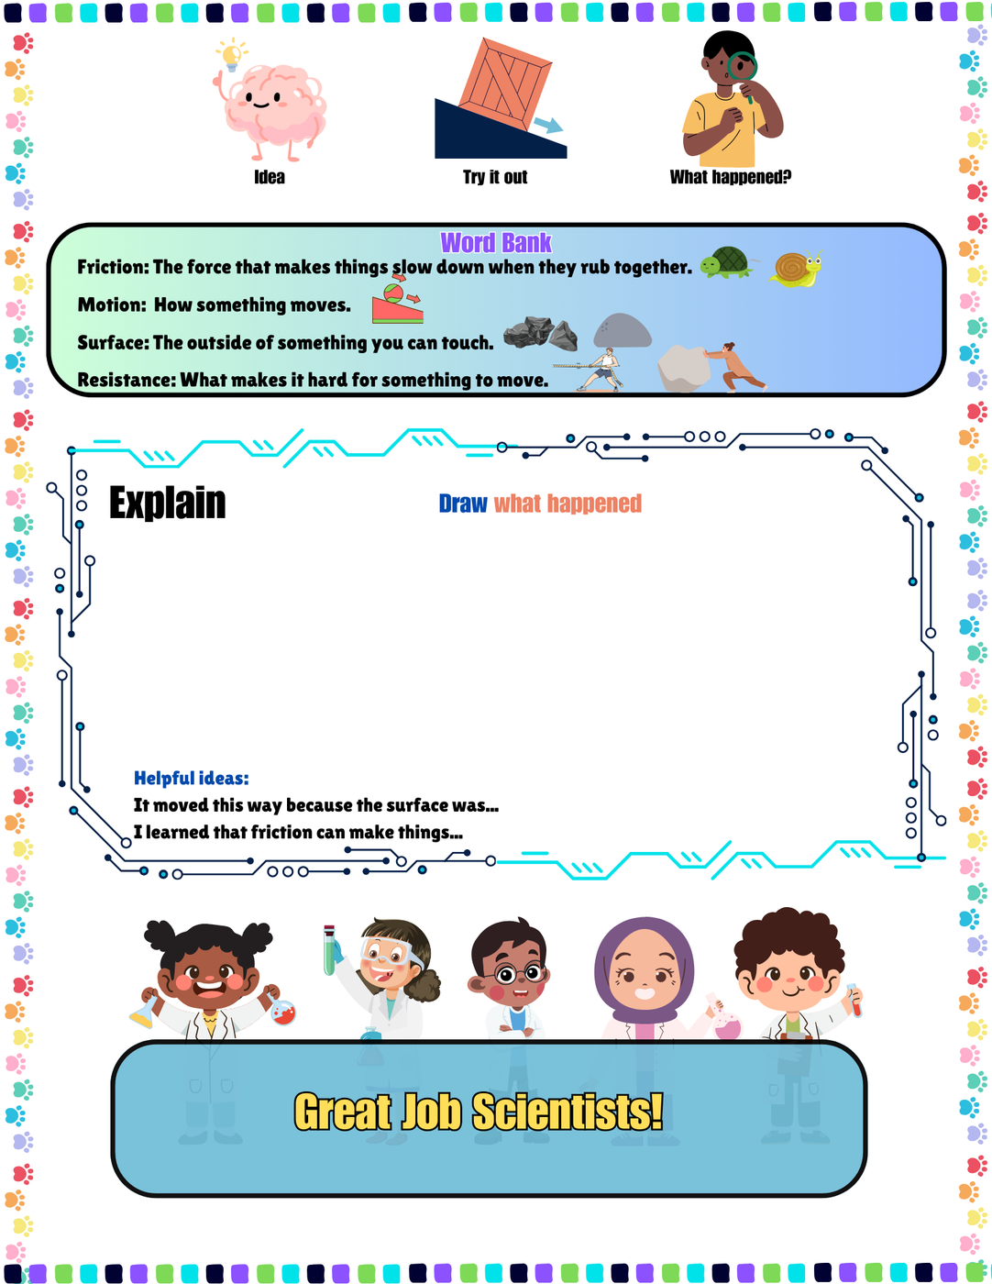
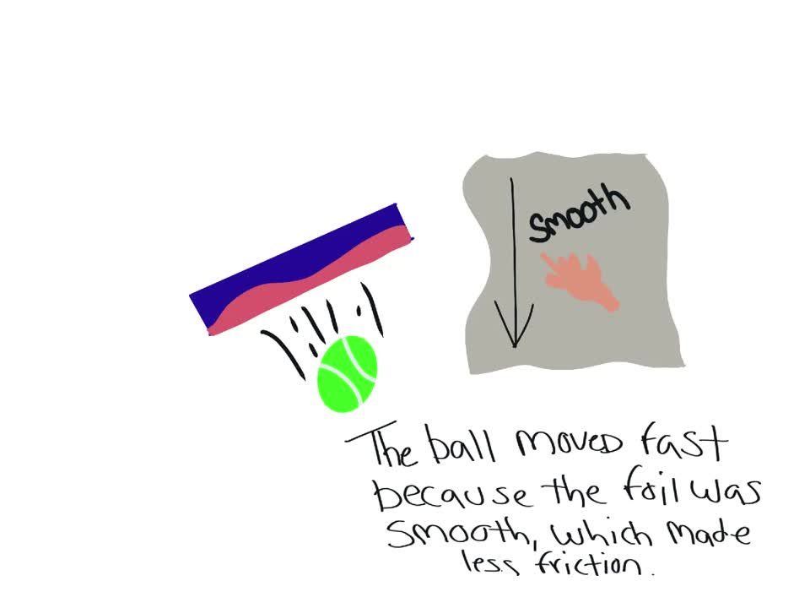
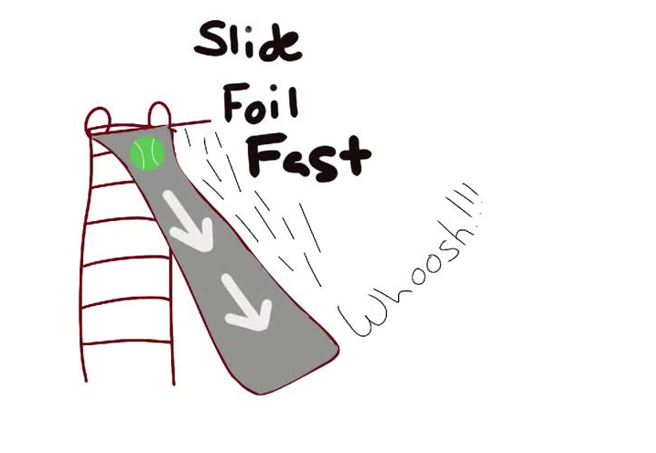
Teacher Tip: Click on the images in the observe and explain boxes to play videos of modeled examples, or draw them yourself on a whiteboard.

Slide 11
Objectives & I Can
We will learn how friction can make things move faster or slower by doing an experiment with objects on different surfaces.
  I can make a prediction about how friction will affect an object.
  I can conduct an experiment to see how different surfaces affect movement.
  I can draw my observations and explain what I learned about friction.

Slide 12
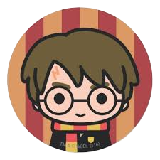



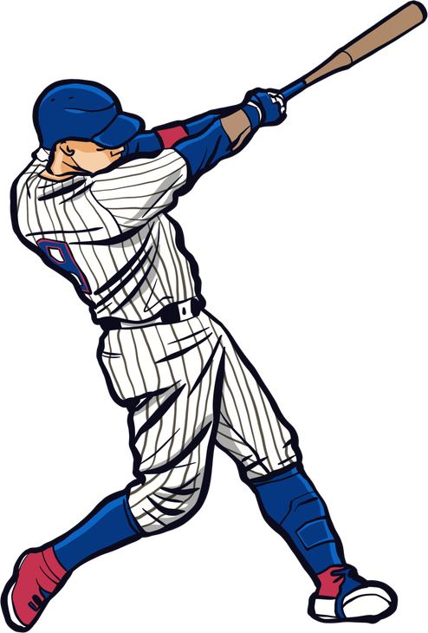
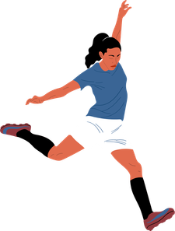

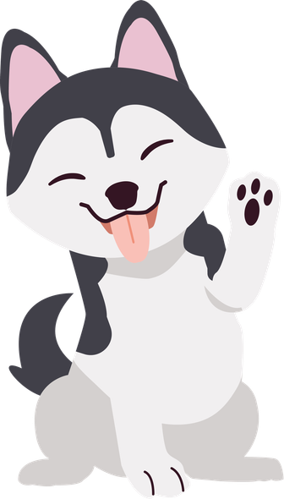

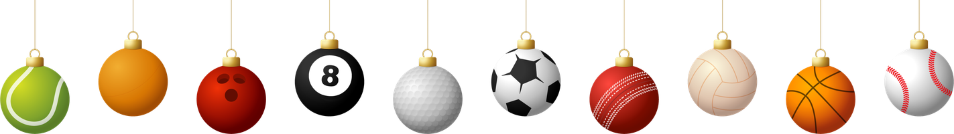
Groups
Slow
Speed Up
Slow
Speed Up
What’s Your Favorite?

Slide 13

Experiment Time

Slide 14
Revisit
  I can make a prediction about how friction will affect an object.
  I can conduct an experiment to see how different surfaces affect movement.
  I can draw my observations and explain what I learned about friction.
From reading the assessments I gave you on Friday, I could tell that most of you knew what friction was, but you just didn’t know what to call it.
You’ve done your own experiments without realizing it.
That’s because friction is very important to our everyday lives.

Slide 15

Peer Talk
  Turn and talk to someone who wasn’t in your group.
  Show them your lab sheet and share your results.

Slide 16
Exploration
How is friction both helpful and unhelpful in everyday life? Can you give some examples?
If you were designing a playground slide, how would you use what we learned today to make it more fun or safer?
How do different shoes (like sneakers vs. dress shoes or slippers) use friction to help us in different situations?

