Slide 1

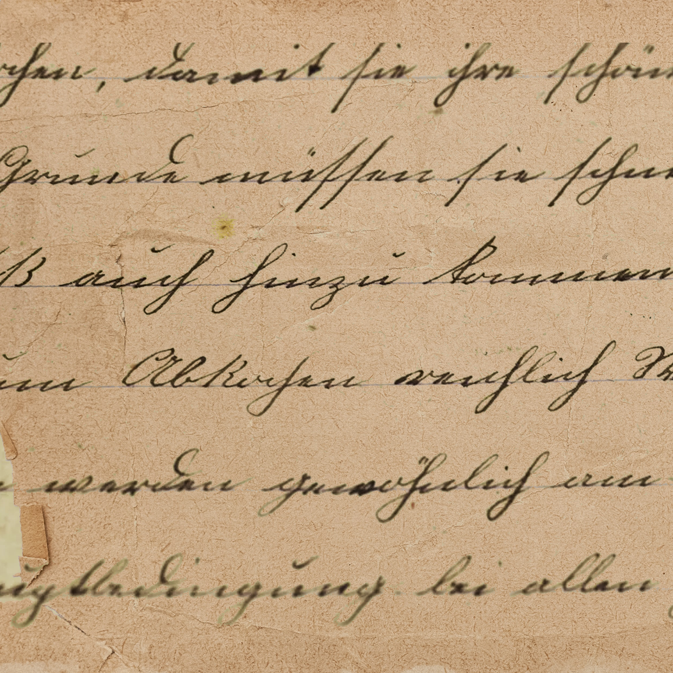


Digital Journey Box

Slide 2

Japanese Internment Camps
The United States government enacted Executive Order 9066 after the bombing of Pearl Harbor during World War II. The order authorized the forced relocation of over 120,000 Japanese Americans living on the West Coast, regardless of their citizenship status. These people were forced to leave their homes, businesses, and possessions behind as they were moved to heedlessly constructed internment camps.
These camps were abysmal places to live with scarce necessities, cramped quarters, and overcrowding. Although the Japanese Americans had done nothing wrong, they suffered great discrimination, racism, and loss of civil liberties during this period of hatred and fear.

Slide 3

Relevence to Social Studies
Teaching about Japanese internment camps is relevant to social studies education in a multitude of ways. The first of which is for students to understand significant historical events and the impact of World War II on individuals and communities. More importantly, studying these events raises questions for students about citizenship, civil rights, and the government’s responsibility to protect the rights of all its people, regardless of race or ethnicity. It provides students the opportunity to explore discourse and reflect on the inalienable concepts of equality, fairness, and justice. It is important to create awareness and appreciation of the diversity in our country. This is a great lesson to discuss the dangers of stereotypes and biases and to teach students that people always need to examine themselves for these pitfalls. One of the most important reasons to teach this lesson to students is to engender empathy and compassion. This topic is sensitive, but when administered appropriately, students can imagine how it must have felt for Japanese Americans during this time. By putting themselves in their shoes, students can grasp why empathy, compassion and tolerance are some the most important traits people can embody.

Slide 4
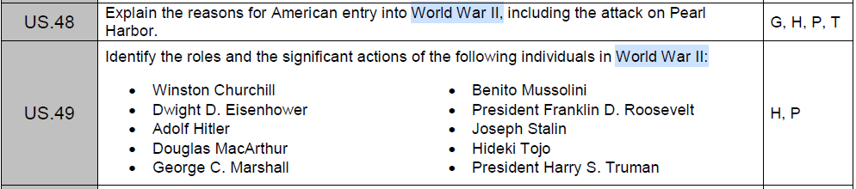
How to Teach
Standards:
This digital journey through history explores the internment of Japanese Americans through mainly primary sources. The exhibits tell the story of this period beginning with the bombing of Pearl Harbor. The sources detail the events of the bombing, the outcome of the casualties, and the reaction of the American people through images, film, and a presidential speech.
The next sources take the viewer on a harrowing journey of forced relocation, obligatory abandonment of property, and blatant fear-driven racism. Viewers intake this information from governmental orders and photographs that illustrate this tumultuous time in our history.
The next leg of the journey is an exploration of internment camps through the eyes of survivors who bravely tell the stories of their experiences in the camps and during forced relocation.
The journey continues with an exploration of a petition and government report that decry the threat of Japanese Americans and ask for their release.
The digital journey concludes with the images of two gravestones. One representing the deaths of the Japanese Americans interned in a camp and the other for Fred Korematsu, who refused to give in to injustice and instead fought for freedom and civil liberties for all.

Slide 5

Secondary Visual
01
The Attack on Pearl Harbor by the Smithsonian National Air and Space Museum
Source
Discussion Based Questions:
1. What do you know about the bombing of Pearl Harbor? Did anything in this video surprise you?
2. Why do you think the Japanese bombed Pearl Harbor?
3. What do you think it was like for the people watching and hearing about this event in 1941? What were they thinking and feeling?

Slide 6
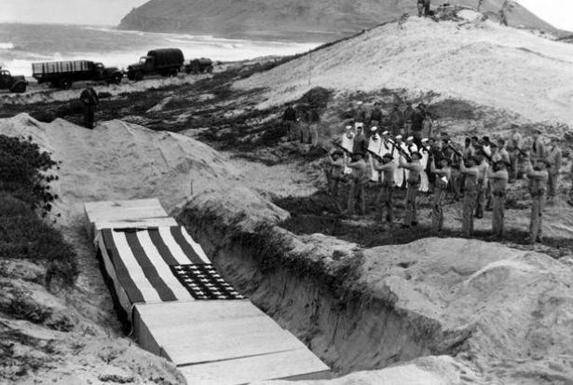
Primary Visual
02
Photograph from the funeral of 15 men killed at Naval Air Station Kaneohe Bay during the Pearl Harbor raid. - December 8, 1941
Source
Discussion Based Questions:
1. What was the significance of the attack on Pearl Harbor?
2. How do you think people who witnessed the attack first-hand were affected emotionally? What sounds and images do you think stayed with them?
3. If you could send a letter of support to someone affected by the bombing, what would you say?

Slide 7
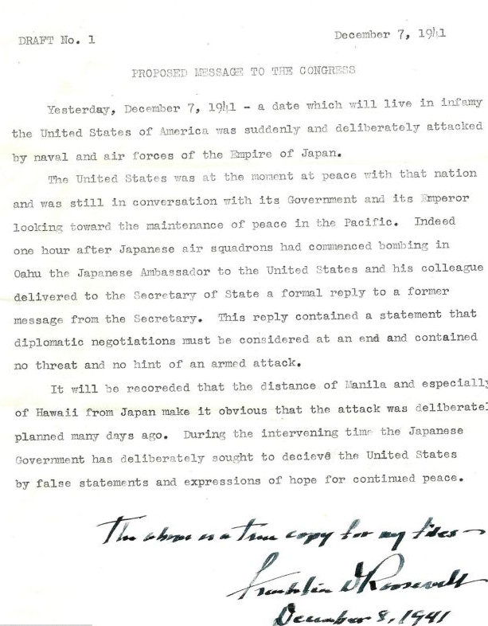
Primary Text
03
Draft of Franklin Roosevelt’s “Day of Infamy Speech” - December 7, 1941
Source
Discussion Based Questions:
1. What do you know about the U.S.‘s response to Pearl Harbor? What actions were taken and why were they significant?
2. How might the world be different if Pearl Harbor was never attacked? Explain your reasoning.
3. Imagine you were the president at the time of the attack. What message would you deliver to the American people? What emotion would drive your speech?

Slide 8
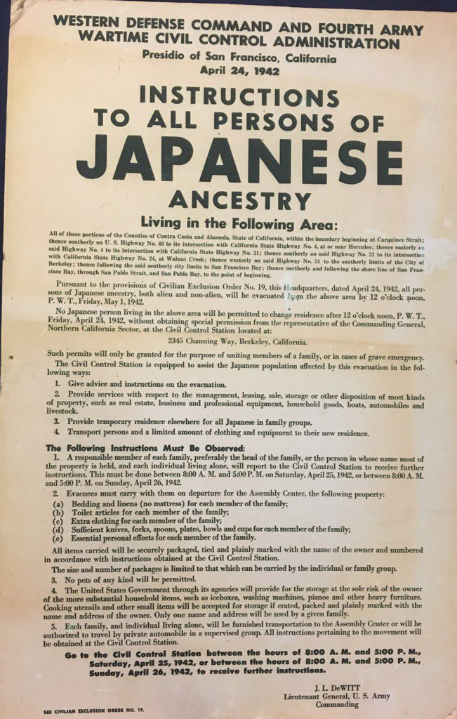
“Instruction To All Person Of Japanese Ancestry 1942"
Source:
Discussion Based Questions:
Primary Text
04
Decree for All Japanese Persons to Report to Internment Camps - April 24, 1942
Source
Discussion Based Questions:
1. What do you know about the Japanese internment camps created in the U.S.?
2. How would you feel if you suddenly had to pack some of your things and move to an unknown place?
3. Was it fair for Japanese people to be forced to leave their homes? Explain your reasoning.

Slide 9
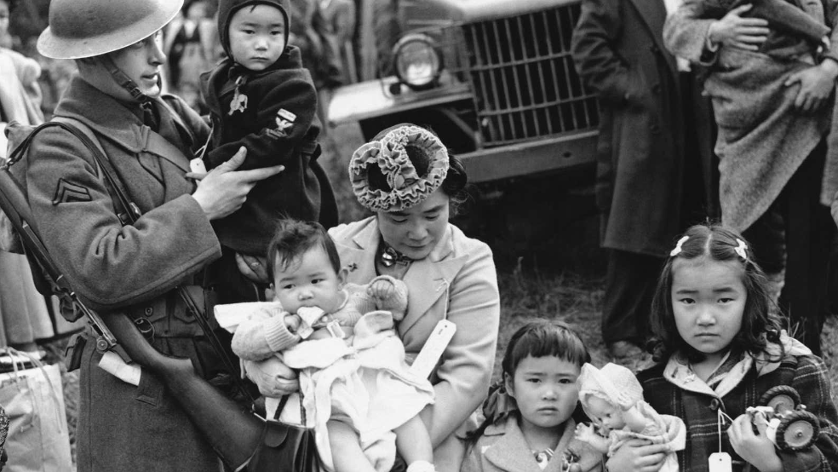
Primary Visual
05
A military guard holds Shigeho Kitamoto’s baby as her family is evacuated from their home in Bainbridge Island, WA - March 1942.
Source
Discussion Based Questions:
1. How do you think the children in this photo felt? What cues in the picture make you feel this way?
2. What can we learn from the history of the evacuation of Japanese citizens, and how can we ensure that similar injustices are not repeated in the future?
3. How do you think children your age who were evacuated felt about leaving their schools and friends behind?

Slide 10
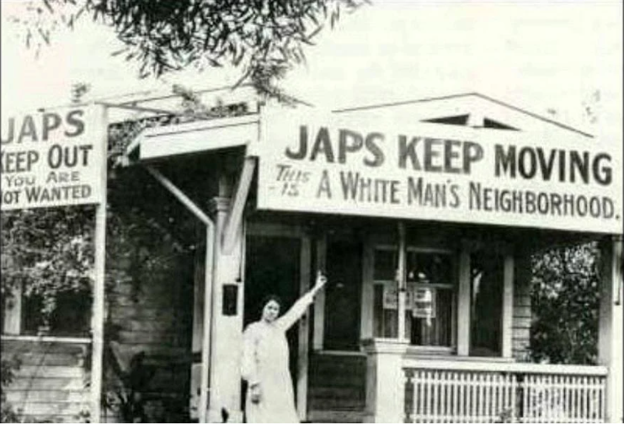
Primary Visual
06
Picture from a white neighborhood - 1942
Source
Discussion Based Questions:
1. What does racism mean to you? How do you think this affected Japanese people during World War II?
2. How widespread do you think racism against Japanese people was during this time? Do you think people felt this way before the attack on Pearl Harbor?
3. Can you imagine what it would feel like to be discriminated against for something out of your control?

Slide 11
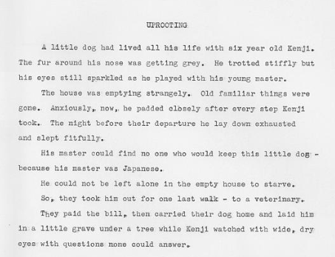
Primary Text
Excerpt from “Lone Mountain” - Written by Estelle Ishigo, an American-born Japanese woman, while interned in a camp.
Source
Discussion Based Questions:
1. What does the story about Kenji’s dog teach us about what Japanese citizens experienced during World War II?
2. No one would take the dog because his owner was Japanese. Why do you think this was? Does this make sense? Why or why not?
3. What emotions was Kenji feeling throughout this? What were the questions going through his mind?
07

Slide 12
Secondary Visual
08
Kids interview a survivor of a Japanese internment camp
Source
Discussion Based Questions:
  What are the differences between an internment camp and a concentration camp? What would you call the camp the Japanese were put in?
2. What did you know about concentration
camps before watching this video? Did
anything in the video surprise you or
change your perception?
3. Why do you think only Japanese
Americans were put into camps? Why
weren’t the Germans or Italians interned
as well?

Slide 13
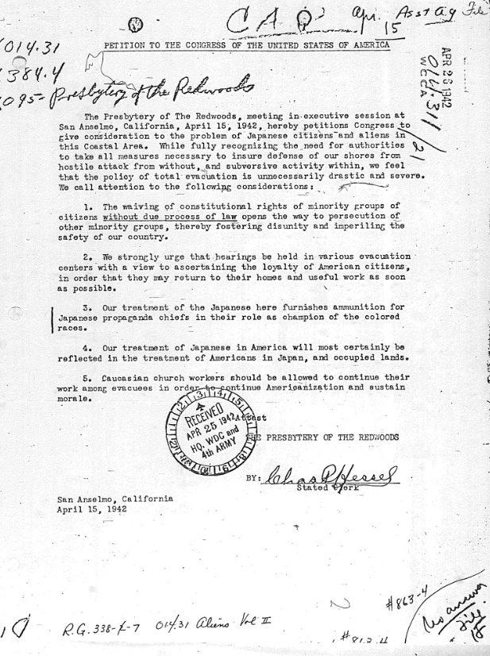
Primary Text
09
Petition to Congress from the Presbytery of the Redwoods to free the interned Japanese
Source
Discussion Based Questions:
1. What is a petition, and why do people submit them to Congress?
2. Do you think this petition had any impact on the treatment of Japanese Americans? Why or why not?
3. How might the petition to Congress by the Presbytery of the Redwoods inspire us to stand up against injustice in our own communities?

Slide 14
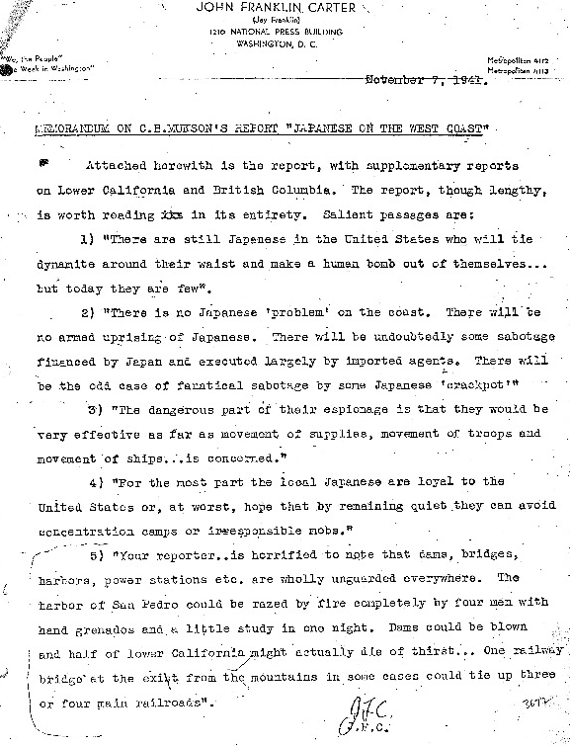
Excerpt:
“MEMORANDUM ON C.B. MUNSON'S REPORT JAPANESE ON THE WEST COAST ...
2) "There is no Japanese 'problem' on the coast. There will be no armed uprising of Japanese. There will be undoubtedly some sabotage financed by Japan and executed largely by imported agents. There will be the odd case of fanatical sabotage by some Japanese 'crackpot'."
3) "The dangerous part of their espionage is that they would be very effective as far as movement of supplies, movement of troops and movement of ships... is concerned."
4) "For the most part the local Japanese are loyal to the United States or, at worst, hope that by remaining quiet they can avoid concentration camps or irresponsible mobs."
5) "Your reporter... is horrified to note that dams, bridges, harbors, power stations etc. are wholly unguarded everywhere. The harbor of San Pedro could be razed by fire completely by four men with hand grenades and a little study in one night. Dams could be blown and half of lower California might actually die of thirst... One railway bridge at the exit from the mountains in some cases could tie up three or four main railroads.”
Discussion Based Questions:
1. The report states that Japanese citizens do not pose a threat, but expresses fear at the lack of guards in San Pedro. Do you think the author is concerned about Japanese citizens, or another one of America’s enemies at the time?
2. What do think the outcome of this report was? Were the Japanese freed? Explain your reasoning.
3. How do you imagine Japanese Americans might have felt knowing there were people in the government who disagreed with their treatment?
Primary Text
10
Memorandum on The Munson Report
Source

Slide 15
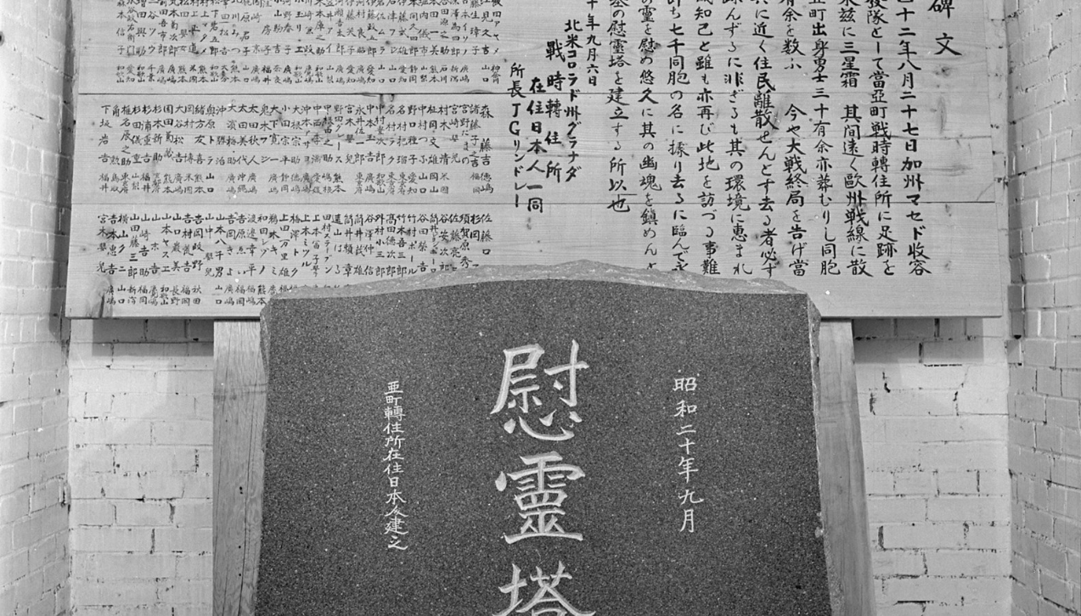
Primary Visual
11
Gravestone erected to memorialize the Japanese people who died while interned at the Amache camp.
Source
Discussion Based Questions:
1. How might the deaths of Japanese Americans in internment camps influence our understanding of history and the importance of protecting the rights and freedoms of all people?
2. How do you think the families felt receiving the news of their loved one’s passing?
3. How do you think the deaths of Japanese Americans in internment camps impacted future generations of Japanese Americans and their understanding of their own history?

Slide 16
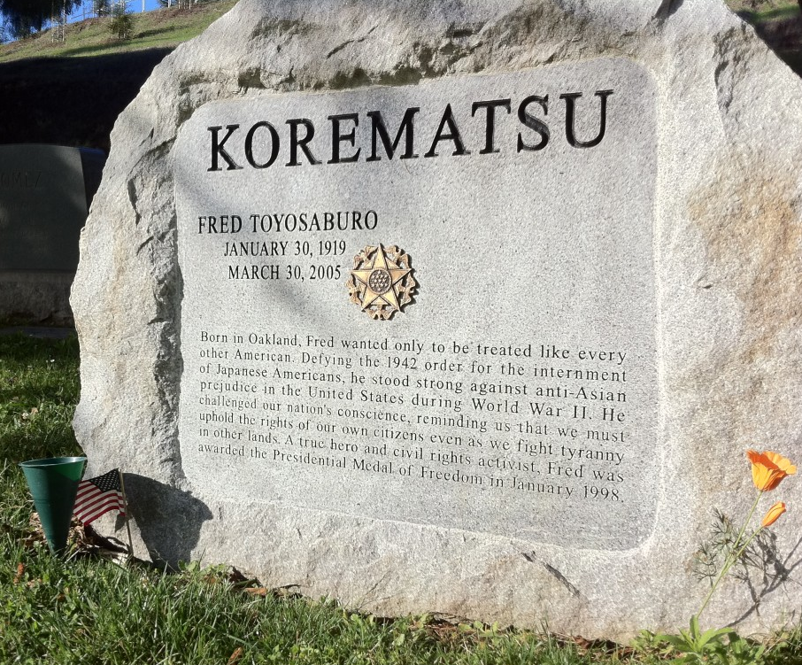
Secondary
Visual
12
Civil Rights activist Fred Korematsu’s Gravestone - Created in 2005.
Source
Discussion Based Questions:
1. Have you heard of Fred Korematsu? What do you know about him?
2. Do you think it was brave of Fred Korematsu to stand up for what he believed was right, even when it was difficult? Why or why not?
3. Can you imagine what it would be like to be separated from your family and placed in an internment camp?

