Slide 1

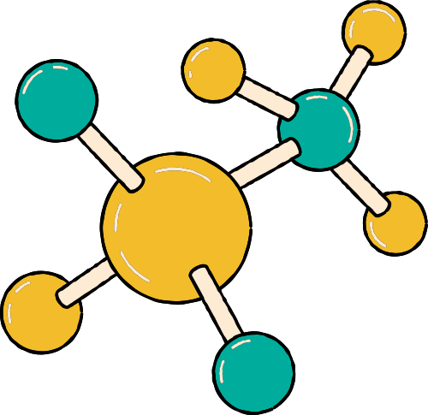
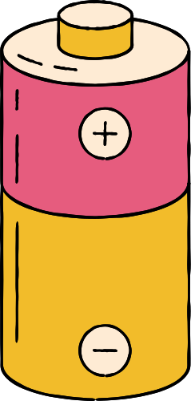



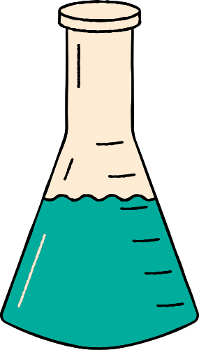





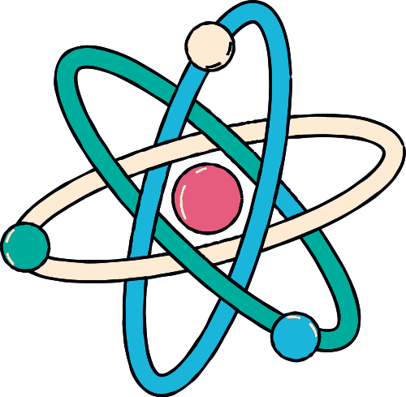
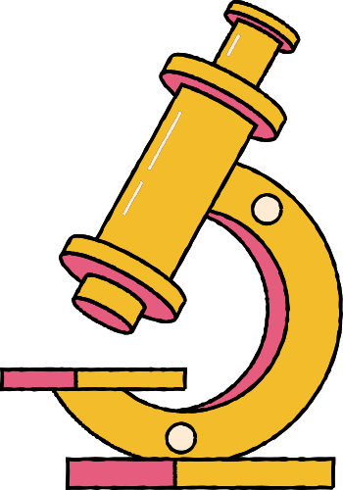
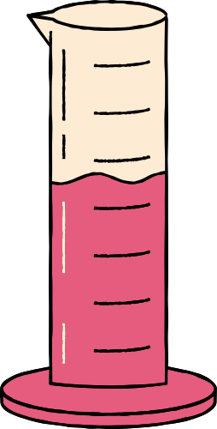

MISTAKES ARE A PART OF SCIENCE!

Slide 2

WHAT IS SCIENCE?
Science is about exploring the world around us. It involves discovering and trying new ideas. Sometimes things don’t go the way we expect, and that’s okay! Every mistake is just another step on our journey to understanding and learning new things.

Slide 3
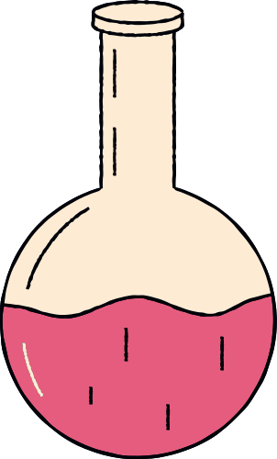

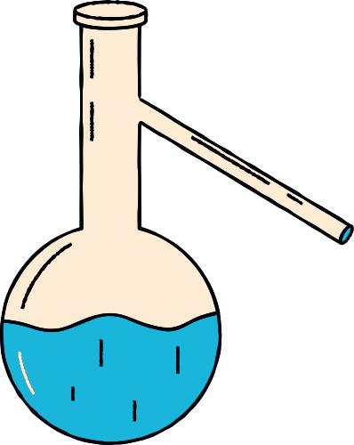
ARE SCIENTISTS PERFECT?
Absolutely Not!!!
Scientists don’t always get things right on the first try, and that’s alright!
Trying new ideas helps us learn.

Slide 4
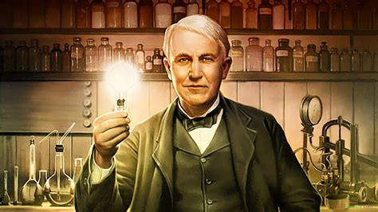
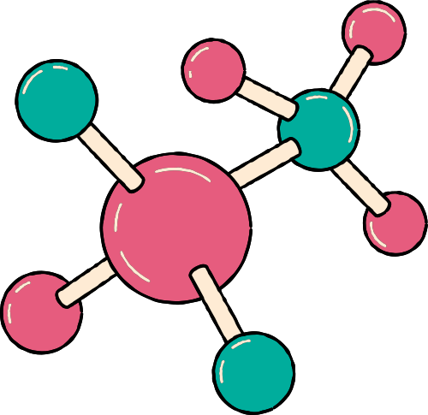
THOMAS EDISON

Slide 5

BATTERIES
In 1910, Edison wanted to invent an improved car battery that allowed cars to travel faster and further.
He worked 7 days a week for five months and tried over 9,000 experiments, but he still couldn’t make the battery work.
A friend asked him if he was upset that he failed to make a battery.
Edison replied that he didn’t fail because he now knows “several thousand things that won’t work.”
Eventually he got the battery to work and it
was the most successful invention of his career.

Slide 6

REFLECTION
AN IMPORTANT PART OF AN EXPERIMENT IS TO ANALYZE YOUR RESULTS.
[Tailor to a recent scientific experience or experiment.]
What kind of problems did you run into?
What’s one way you tried to fix this problem?
How did that work out?

Slide 7
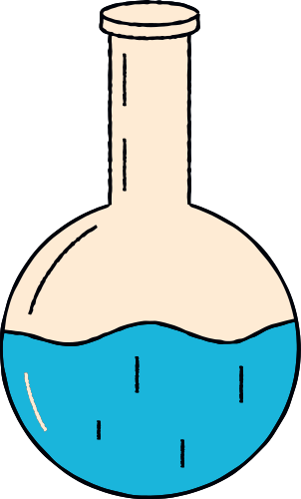
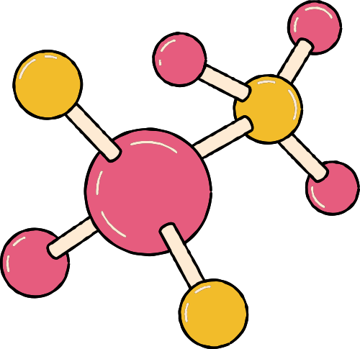

MISTAKES ARE
OPPORTUNITIES
TO HELP US
LEARN & GROW

Slide 8



WHEN YOU TRY NEW
THINGS, YOU ARE BRAVE
SCIENCE IS A JOURNEY
CELEBRATE YOUR
ACHIEVEMENTS
YOU ARE SCIENTISTS!!!

Slide 9
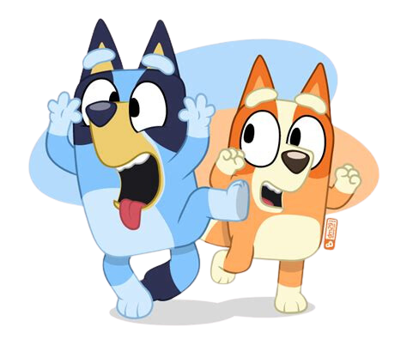

LET’S HEAR IT FROM SOME EXPERTS

